Slide 1
RSTAN

Slide 2
Meta analysis of treatment effect 8 schools
Effect of coaching program for SAT-V (Scholastic Aptitute Test - Verbal)
Data analysed at each school separately to derive:
  Estimated treatment effect
  Standard error of the treatment effect
Analysis of data at each school adjust for PSAT (initial level of students)
By pooling data across experiments we can improve all estimates
Is the pooling justified or is there an effect of “better” teaching at schools that does the best job
  If so we should look to the best school to investigate what they
  did differently (~right)

Slide 3
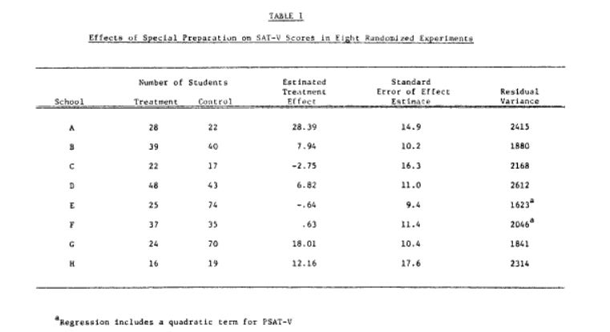

Data from Rubin (1981)

Slide 4
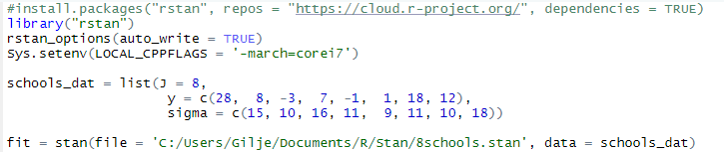
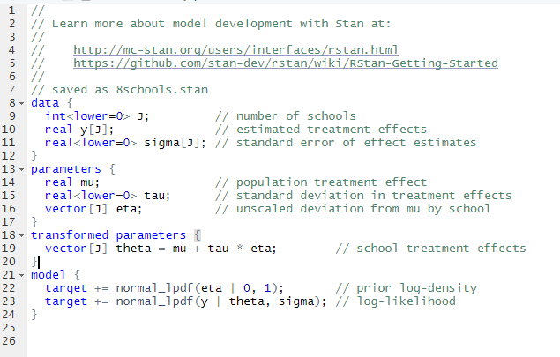
Running Stan in RStudio
rstan install
add to current session
optional /specialized
Data (Rubin 1981)
Run
Stan program for the model
RStudio version 1.2.x or later
Has good support for R-STAN
File -> New File -> Stan File
Be sure that your Stan programs ends in a blank line without any characters including spaces and comments.

Slide 5
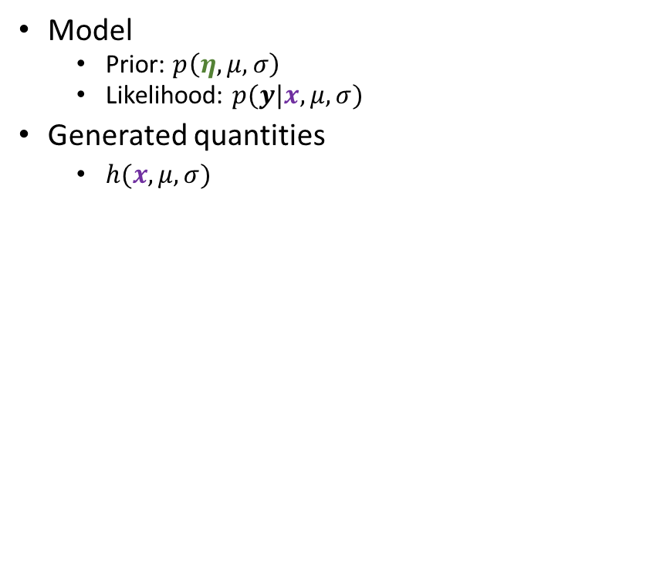
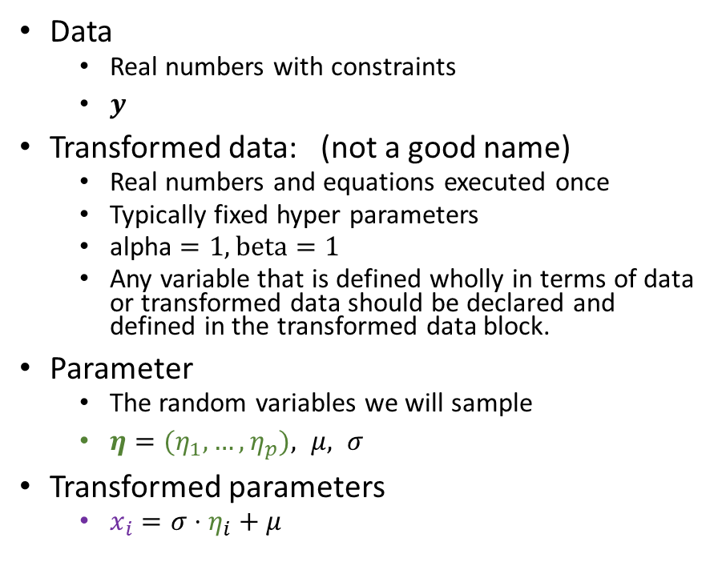
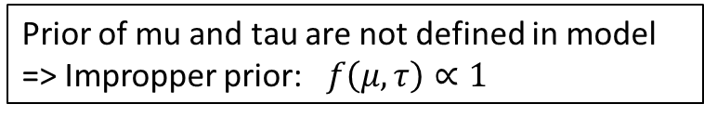
Content of .stan file
Data
  Real numbers with constraints
  $y$
Transformed data: (not a good name)
  Real numbers and equations executed once
  Typically fixed hyper parameters
  alpha $=1, beta=1$
  Any variable that is defined wholly in terms of data or transformed data should be declared and defined in the transformed data block.
Parameter
  The random variables we will sample
  $η={(η}_{1},…,η_{p}), μ, σ$
Transformed parameters
  $x_{i}={σ⋅η}_{i}+μ$
Model
  Prior: $p\left(η,μ,σ\right)$
  Likelihood: $p(y|x,μ,σ)$
Generated quantities
  $h(x,μ,σ)$
Prior of mu and tau are not defined in model
=> Impropper prior: $f\left(μ, τ\right)∝1$

Slide 6
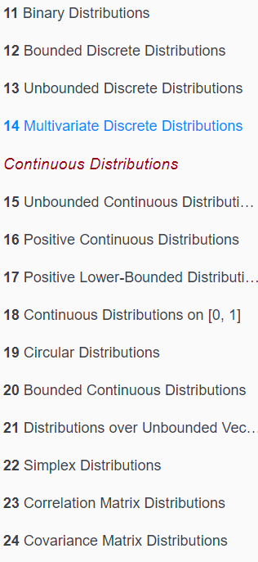
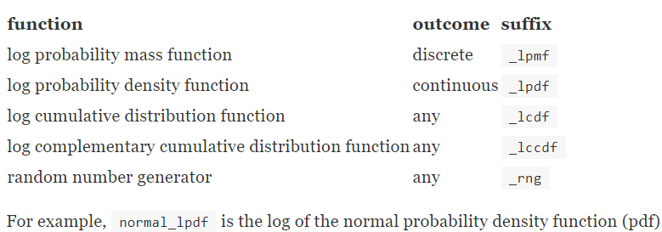
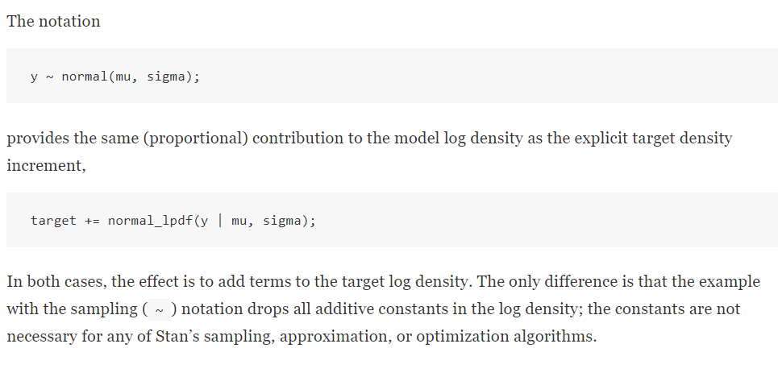
Model
https://mc-stan.org/docs/2_26/functions-reference/

Slide 7
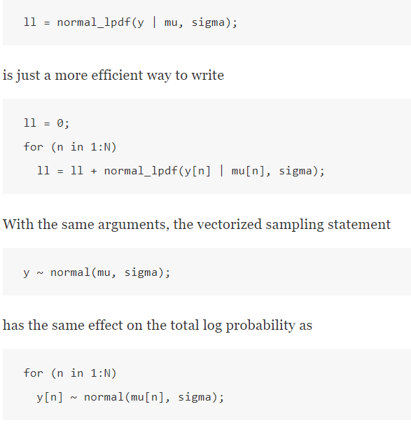




Vectorization of model conditional independence assumed
Conditional independence
$$p\left(y_{n} | y_{−n},μ,σ\right)=p\left(y_{n} | μ_{n},σ\right)$$
$$σ$$
$$y_{n}$$
$$μ_{n}$$
Dependency structure:
  Built in:
  Program it

Slide 8
Stan MCMC parameters
Alternative
Model
definitions
file: The path to the Stan program. Use a .stan extension on file
model_code: A character string either containing the model definition
fit: An instance of S4 class stanfit derived from a previous fit; Time for recompiling the C++ code for the model can be saved.
model_name: A string to use as the name of the model;
(affects the name used in printed messages),
data: A named list or environment providing the data for the model, or a character vector for all the names of objects to use as data.
Pars: A character vector specifying parameters of interest to be saved(or not).
The default is to save all parameters from the model.
include: include or exclude the parameters given by the pars argument
Iter: total number of iterations (including warmup). The default is 2000.
warmup: The number of samples in warmup (aka burnin)
(also controls the number of iterations for which adaptation is run)
chains: The number of Markov chains.
thin: A positive integer specifying the period for saving samples.
algorithm
  “NUTS", which is the No-U-Turn sampler variant of Hamiltonian Monte Carlo
  (Hoffman and Gelman 2011, Betancourt 2017).
  "HMC" (Hamiltonian Monte Carlo),
  "Fixed_param” no sampling is performed (e.g., for simulating with in the generated quantities block).
stan(file,
model_name = "anon_model",
model_code = "",
fit = NA,
data = list(),
pars = NA,
chains = 4,
iter = 2000,
warmup = floor(iter/2),
thin = 1,
init = "random",
seed = sample.int(.Machine$integer.max, 1),
algorithm = c("NUTS", "HMC", "Fixed_param"),
....)
… =
Specification of initial values
File name for diagnostics
Print out in R console
Save warmeup
Number of cores to use
Call to other than default libraries
Parameters to control the sampler's behavior.

Slide 9
What does a stan call do in R?
The stan function does all of the work of fitting a Stan model and returning the results as an instance of stanfit.
The steps are roughly as follows:
  Translate the Stan model to C++ code. (stanc)
  Compile the C++ code into a binary shared object, which is loaded into the current R session (an object of S4 class stanmodel is created). (stan_model)
  Draw samples and wrap them in an object of S4 class stanfit. (sampling)
The returned object can be used with methods such as print, summary, and plot to inspect and retrieve the results of the fitted model.
stan can also be used to sample again from a fitted model under different settings (e.g., different iter, data, etc.) by using the fit argument to specify an existing stanfit object. In this case, the compiled C++ code for the model is reused.
Stan keeps track of what he has already compiled, if you change file you get:
(not an error)

Slide 10
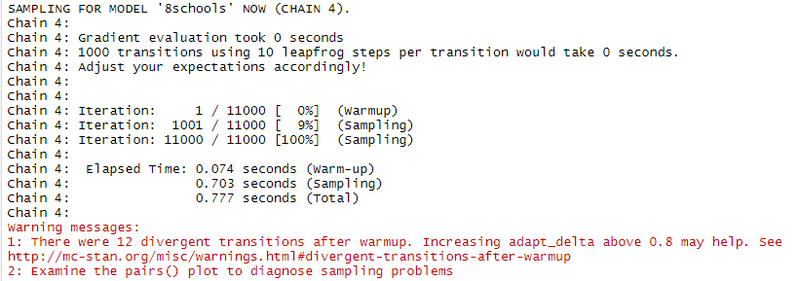
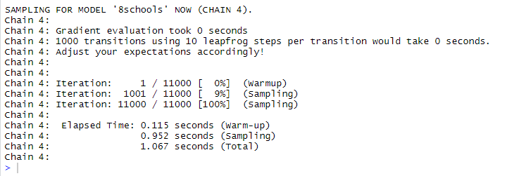
Running Stan
N=10000
fit1 = stan(file = '8schools.stan', data = schools_dat,
iter=1.1*N,
warmup=0.1*N,
thin=N/1000,
chains=4,
seed=231171,
refresh=10000)
fit1 = stan(file = '8schools.stan', data = schools_dat,
iter=1.1*N,
warmup=0.1*N,
thin=N/1000,
chains=4,
seed=231171,
refresh=10000,
control=list(adapt_delta=0.95))
😐
☺

Slide 11
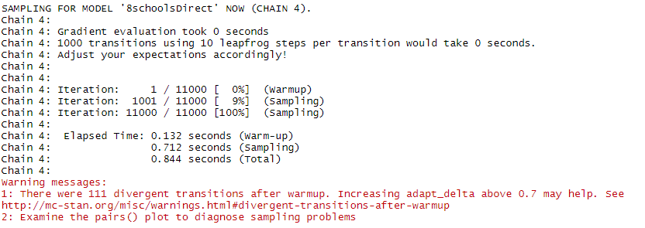
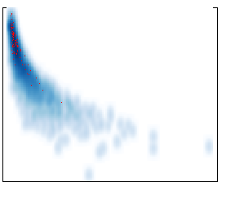
Runtime Reported divergence
Divergence: the simulated Hamiltonian trajectory departs does not conserve energy. (i.e. depart from the true trajectory)
Limits the ability to explore the posterior distribution.
(can cause irreducible issues)
When this divergence is too high, the simulation has gone off the rails and cannot be trusted
tau
log posterior

Slide 12
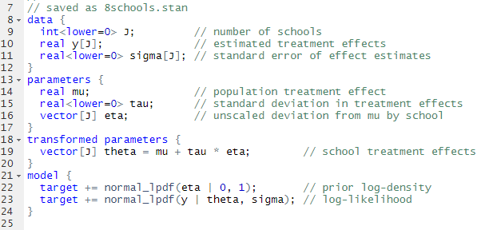
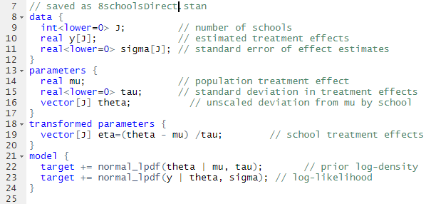



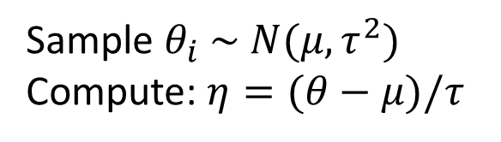
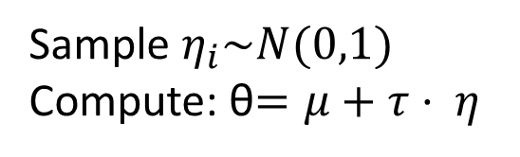

The effect of clever transformations
normalized
Sample $η_{i}\sim N(0,1)$
Compute: θ$=μ+τ⋅ η$
Sample $θ_{i} \sim N(μ,τ^{2})$
Compute: $η=(θ−μ)/τ$
$$η_{2}$$
$$θ_{2}$$
Identical models, but the difference is in correlations vs not Recap exercise 42 vs 39
$$η_{1}$$
$$θ_{1}$$

Slide 13
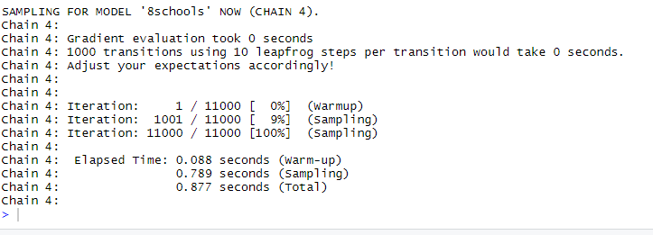
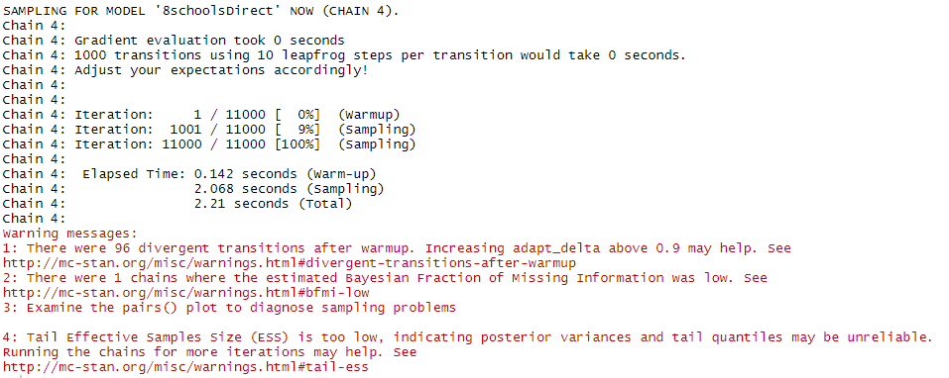

Running two models
No reported errors !
Bayesian Fraction of Missing Information (BFMI)
Related to
lag 1 correlation
of log posterior

Slide 14
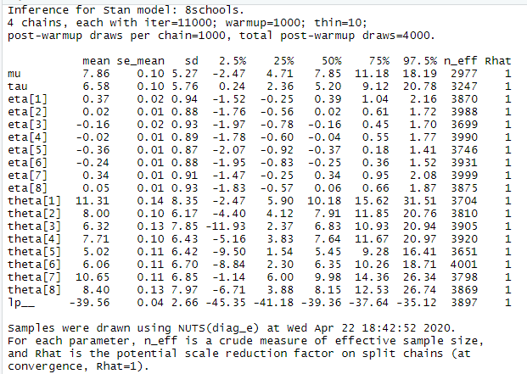
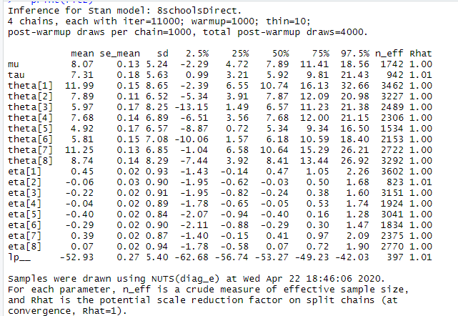
Result of chain:
Effective number of samples consistently high
Effective number of samples variable and low or some

Slide 15
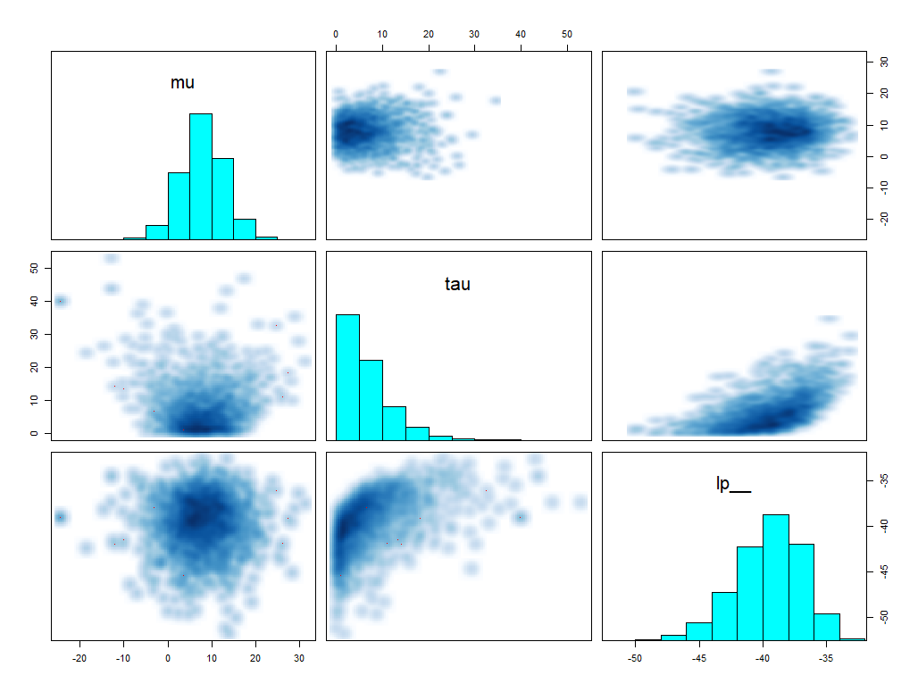
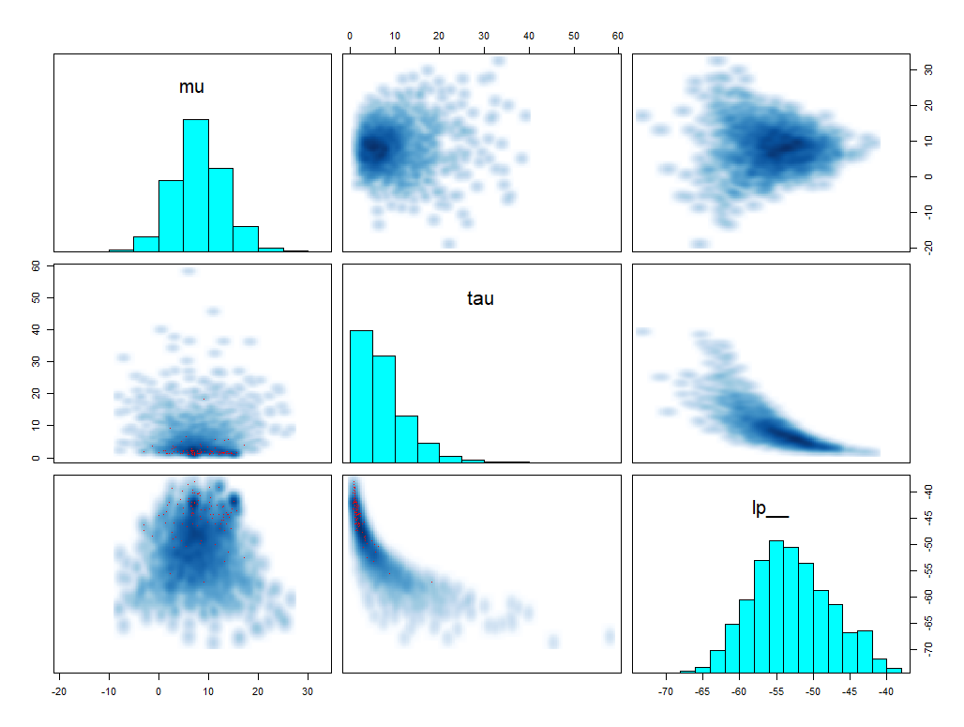
Output
Log posterior
Log posterior
The models are the same but log posterior is different why?

Slide 16
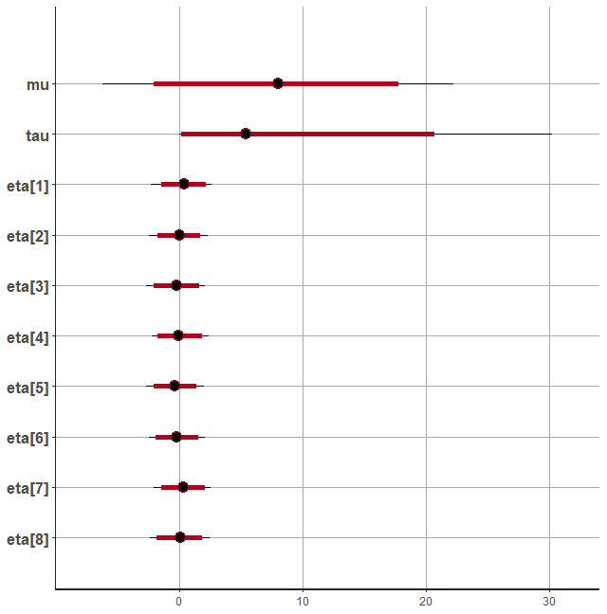
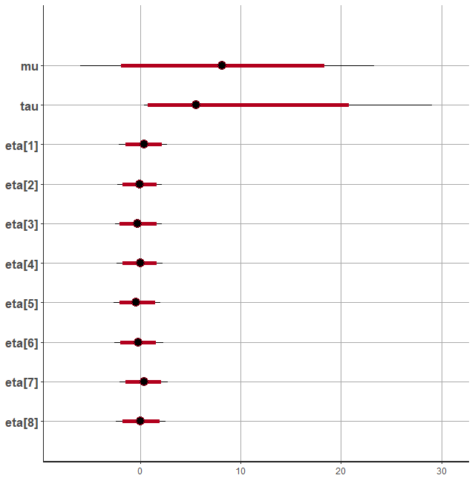
Credibility intervals
plot(fit1,pars = c("mu", "tau", "eta"),ci_level = 0.95,outer_level = 0.99) plot(fit2,pars = c("mu", "tau", "eta"),ci_level = 0.95,outer_level = 0.99)

Slide 17
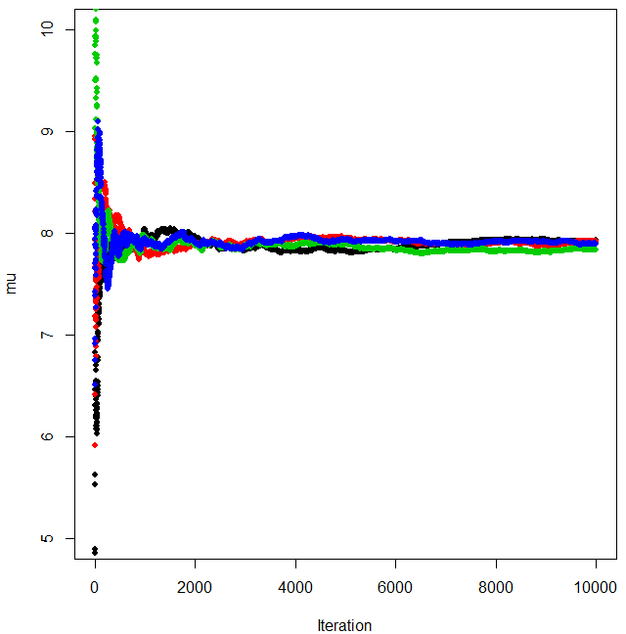
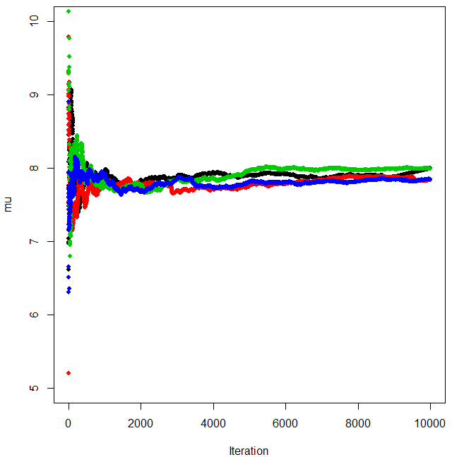
Convergence for MCMC, cumulative mean mu

Slide 18
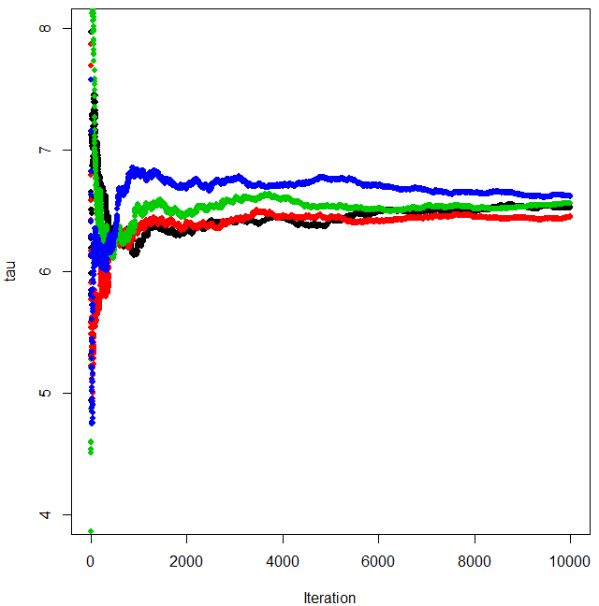
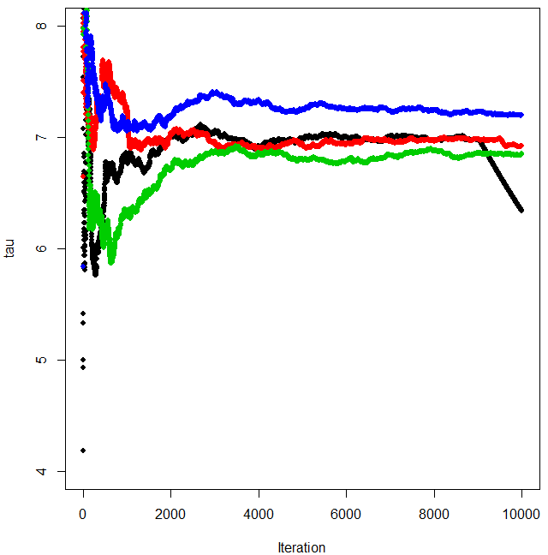
Convergence for MCMC, cumulative mean tau

Slide 19
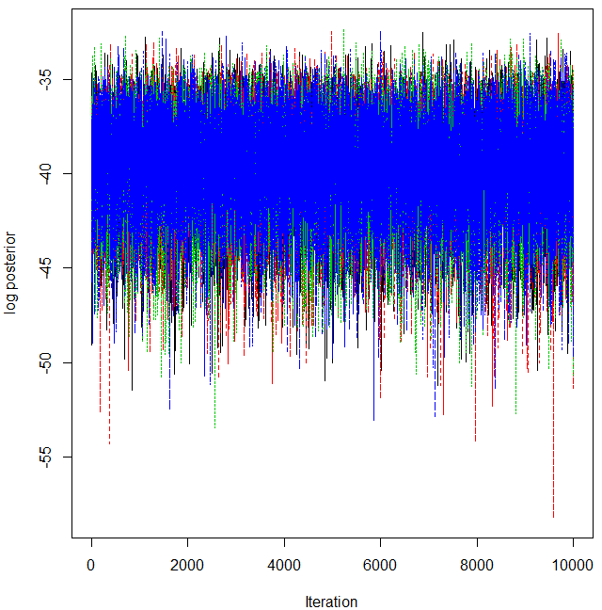
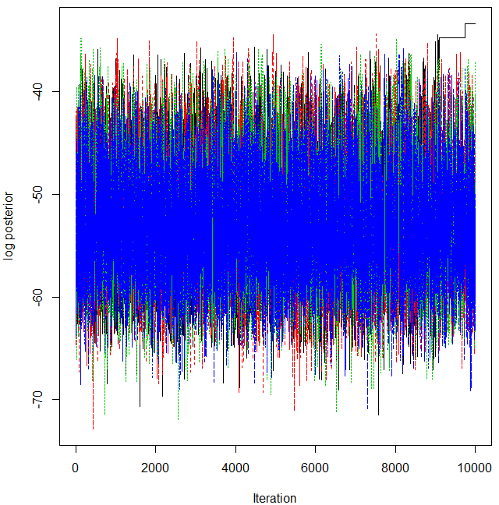
Likelihood

Slide 20
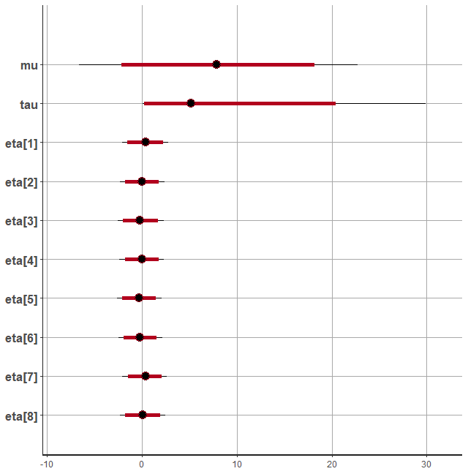
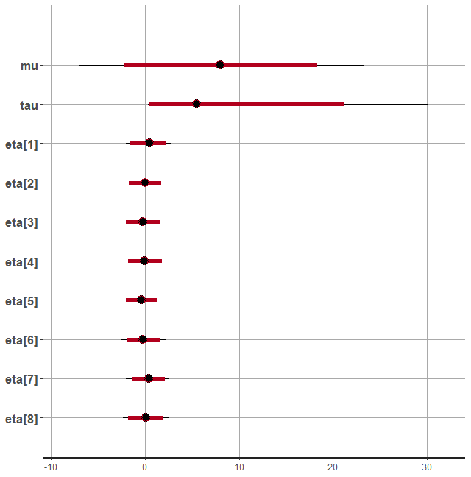
Result MCMC long
Transformed
Direct
The Transformed approach has better convergence properties
In a long run 100000 samples
The difference between the two chains is not large
Results
  The effect of coaching is not significant 5%-level, but has a strong indication
  The «good» school appears as a «lucky shot»

Slide 21
Variational Bayes in STAN
The same STAN program can be used to make inference by variational bayes
Rather than using stan()
Use vb()

Slide 22
Variational Bayes in STAN
vb(object,
data = list(),
pars = NA,
include = TRUE,
init = 'random',
check_data = TRUE,
sample_file = tempfile(fileext = '.csv'),
algorithm = c("meanfield", "fullrank"),
importance_resampling = FALSE,
keep_every = 1,
...)
Making a stanmodel
stan_model(file,
model_name = "anon_model",
model_code = "",
…)
object An object of class stanmodel.
data A named list or environment providing the data for the model
Check_data Logical, defaulting to TRUE. If TRUE the data will be preprocessed; otherwise not.
algorithm
  Either "meanfield" (the default) or The "meanfield" option uses a fully factorized Gaussian for the approximation
  "fullrank", indicating which variational inference algorithm is used. whereas the fullrank option uses a Gaussian with a full-rank covariance matrix for the approximation. Details and additional references are available in the Stan manual.
importance_resampling: Logical scalar (defaulting to FALSE) indicating whether to do importance resampling to adjust the draws at the optimum to be more like draws from the posterior distribution
StanModel
file: The path to the Stan program. Use a .stan extension on file
model_code: A character string either containing the model definition
model_name: A string to use as the name of the model; (affects the name used in printed messages)

Slide 23
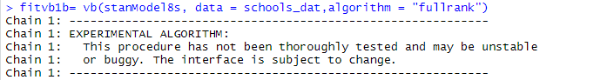
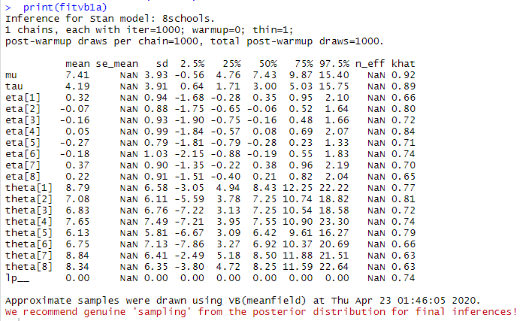
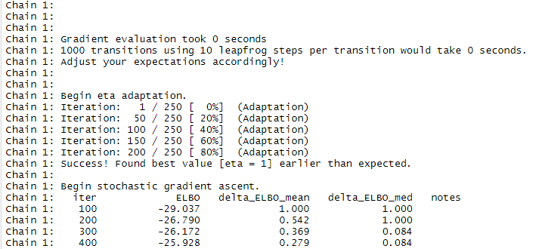
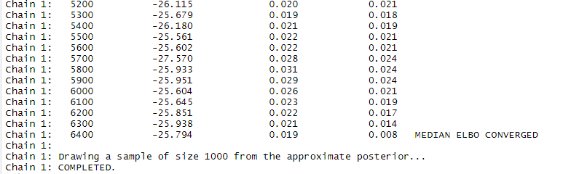
Running Variational Bayes
…
Results are not trusted by developer 😐

Slide 24
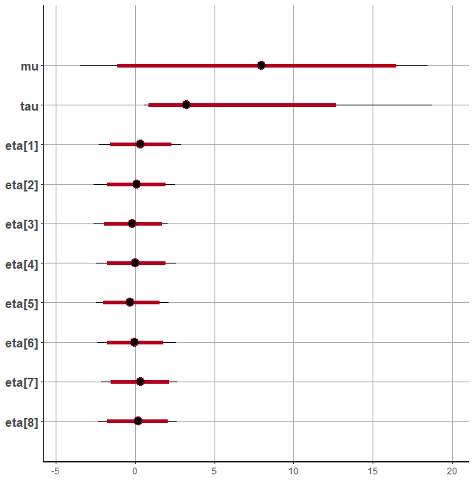
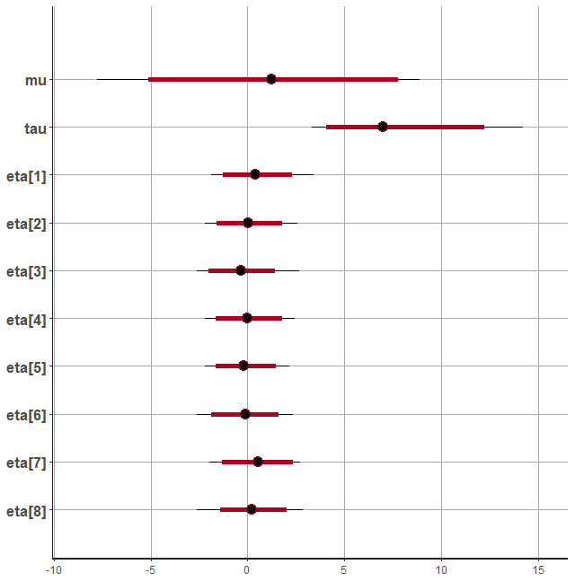
Full rank VB - compared to MCMC
Transformed
Direct
MCMC / VB full rank
MCMC / VB full rank

Slide 25
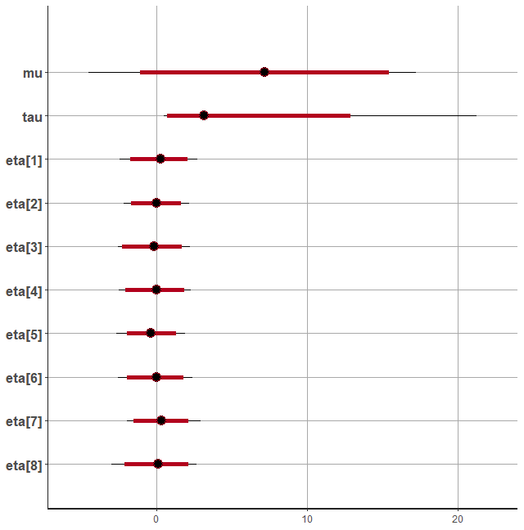
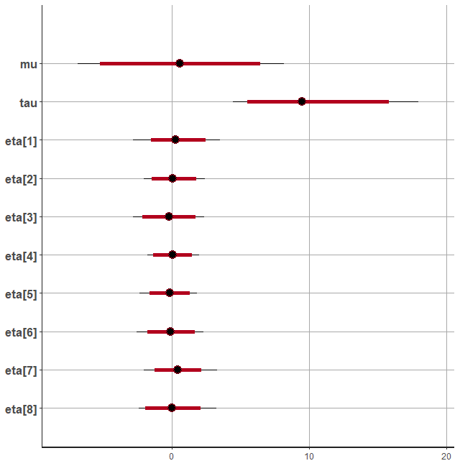
Mean field VB - compared to MCMC
Transformed
Direct
MCMC / VB mean field
MCMC / VB mean field

Slide 26
«Short» MCMC compared to MCMC
Transformed
Direct
MCMC long / MCMC short
MCMC long / MCMC short

Slide 27
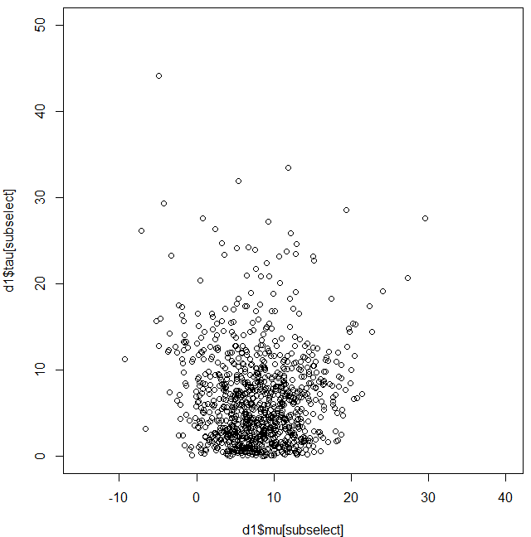
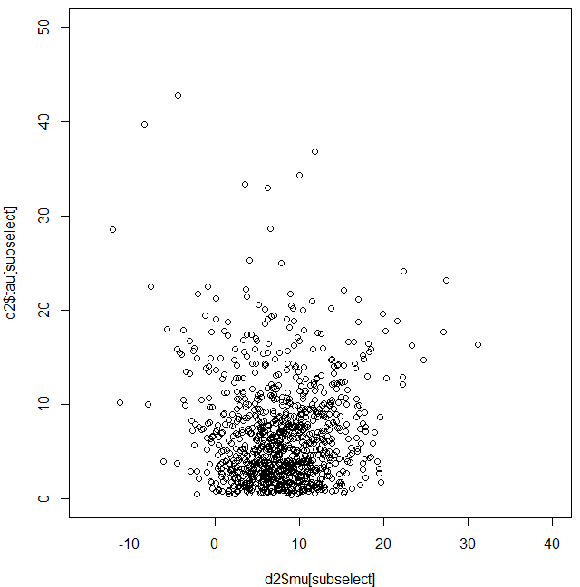
Joint distribution MCMC
Transformed
Direct

Slide 28
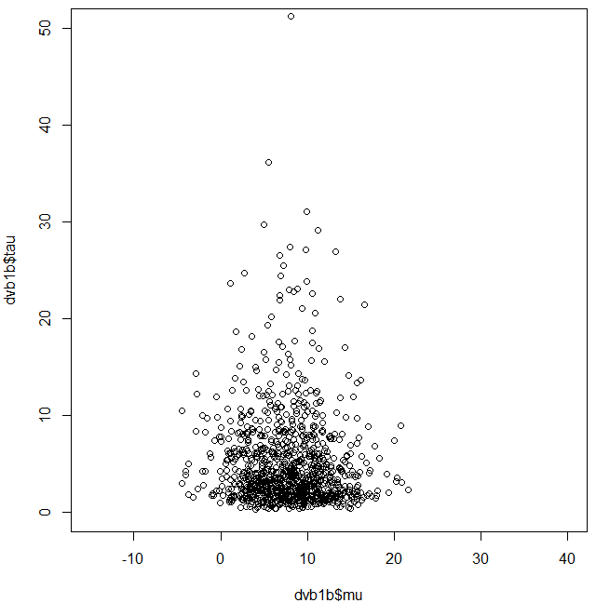
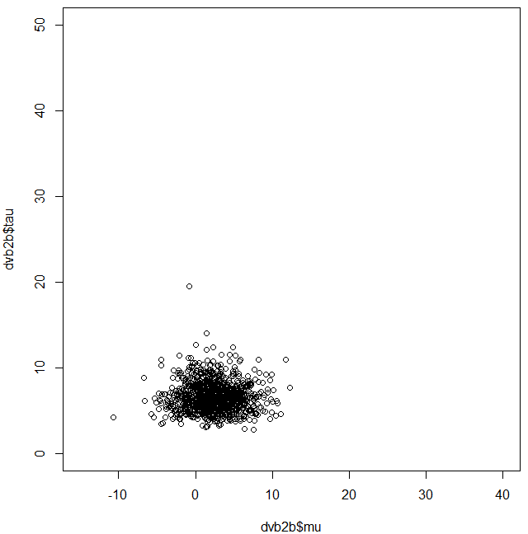
Joint distribution VB full rank
Transformed
Direct

Slide 29
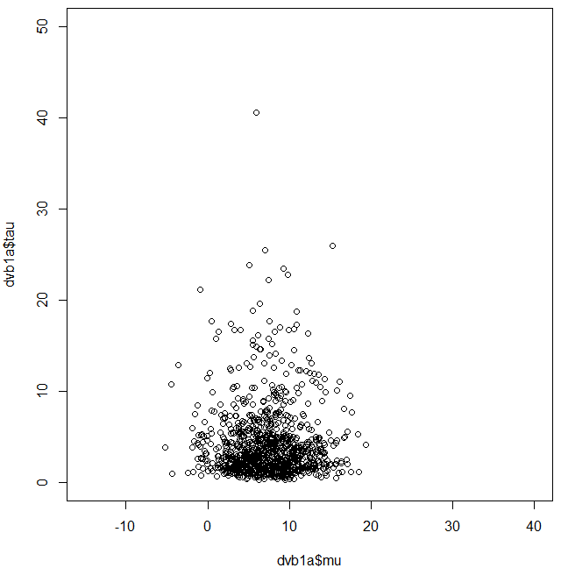
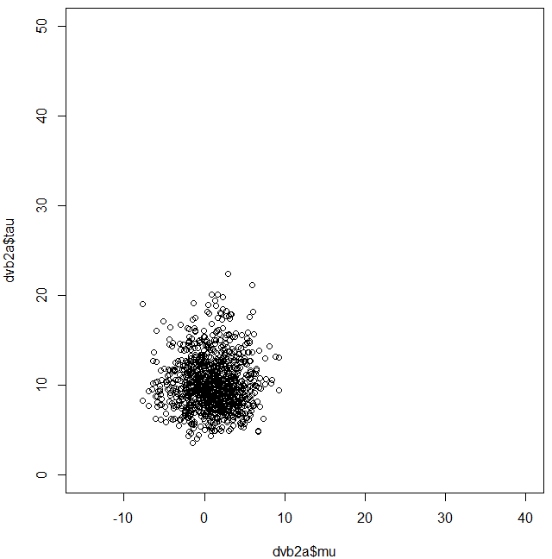
Joint distribution VB mean filed
Transformed
Direct

