Slide 1
STK3100 and STK4100
GLM models for count data
Covers the following material from chapter 7:
Sections 7.1.1, 7.1.3, 7.1.4, and 7.1.6
Department of Mathematics
University of Oslo

Slide 2
Grouped count data
Example: Lung cancer in Danish cities
The table shows the number of male lung cancer cases and the approximate number of male inhabitants in four Danish cities in the period 1968-1971
Age group | Fredericia | Horsens | Kolding | Vejle
40-54 | 11/3059 | 13/2879 | 4/3142 | 5/2520
55-59 | 11/800 | 6/1083 | 8/1050 | 7/878
60-64 | 11/710 | 15/923 | 7/895 | 10/839
65-69 | 10/581 | 10/834 | 11/702 | 14/631
70-74 | 11/509 | 12/634 | 9/535 | 8/539
How does the lung cancer risk depend on age?
Is the risk the same in all the cities?

Slide 3
Ungrouped count data
Example: Claims in car insurance
Consider data on the number of claims for about 22 000 vehicle insurance policies taken out in 2004 or 2005 (from de Jong & Heller: Generalized linear models for insurance data, 2008)
Data for the first four policies:
exposure veh_age gender agecat numclaims
0.4845996 3 M 6 1
0.3915127 2 M 4 0
0.9938398 3 F 4 1
0.5366188 4 M 5 0
Distribution of the number of claims
_ 0 1 2 3 _
20757 1361 108 7
How does the number of claims depend on the covariates?

Slide 4


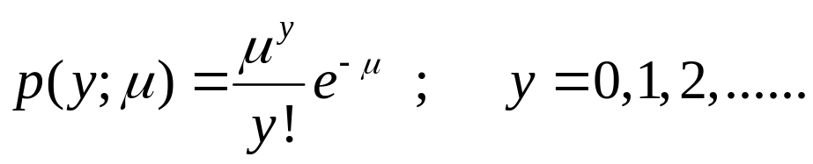
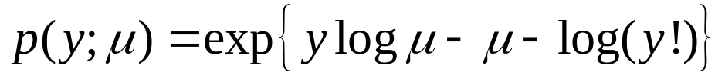





Poisson distribution
We assume that is Poisson distributed with mean ,
so its probability mass function (pmf) is given by
We may write
The Poisson distribution is in the exponential dispersion family (cf. Additional exercise 7)
, and we have
Further we have

Slide 5




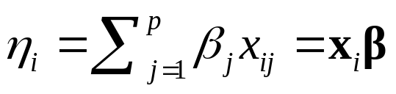

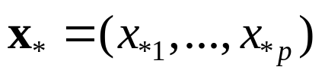
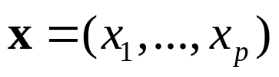
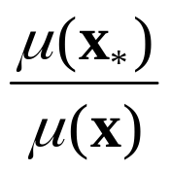
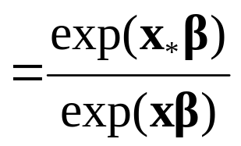



Poisson GLMs
We assume that are independent and that
is Poisson distributed with mean
We further assume that for a linear predictor
and a link function
The most common choice of is the canonical link
$$g\left(μ_{i}\right)=\log{μ_{i} ⇔ μ_{i}=\exp{(x_{i}β)}}$$
For the log link, the rate ratio corresponding to the values
and of the covariates is given by
In particular is rate ratio of one units increase in the j-th covariate when the other covariates remain the same

Slide 6


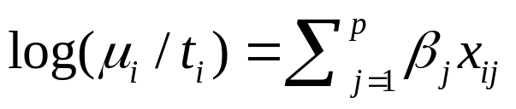
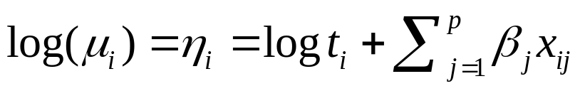

Offset
It is often the case that is proportional to a measure of «exposure»
In the lung cancer example, is the number of individuals
In the car insurance example, is the proportion of the period that a car has been insured
Then a loglinear model for the expected rate takes the form
which gives
Thus enters the linear predictor with a fixed coefficient equal to 1
We say that is an offset

Slide 7
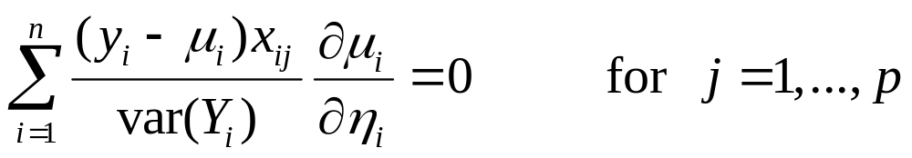
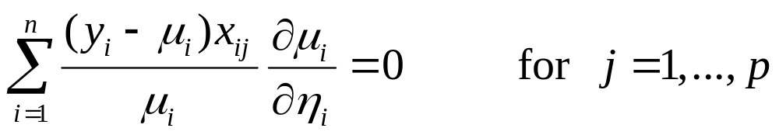
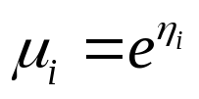
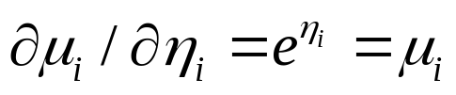
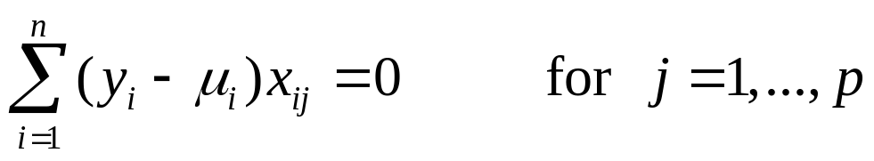
ML estimation
For general GLMs, the likelihood equations are given by
For Poisson GLMs they take the form (since $var\left(Y_{i}\right)=μ_{i}$)
, and
For the log link we have
Then the likelihood equations are given by

Slide 8
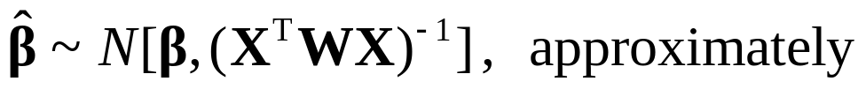
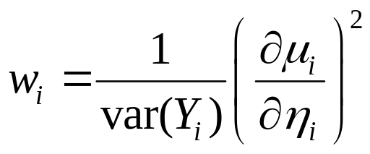


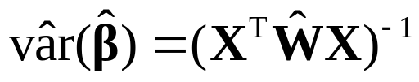
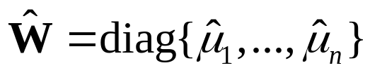

For general GLMs we have
where W is the diagonal matrix with diagonal elements
For a Poisson GLM with log link, since
and $var\left(Y_{i}\right)=μ_{i}$, we get
The covariance matrix of can be estimated by
where we for the log link then have

Slide 9

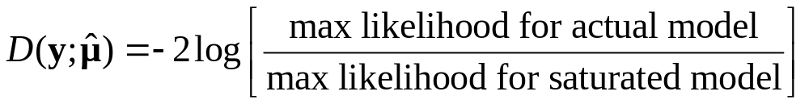
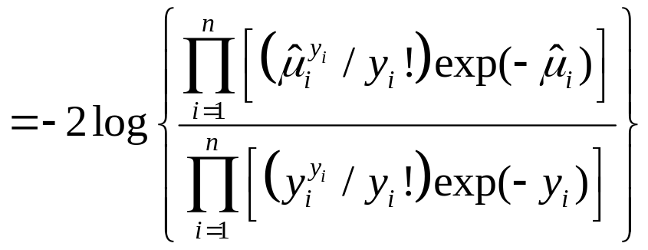
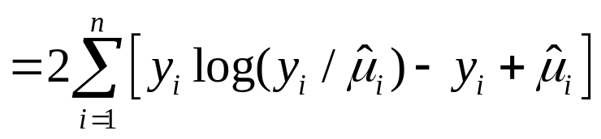
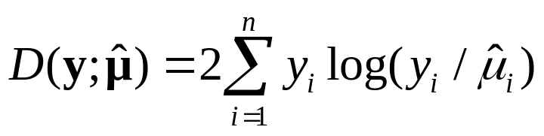
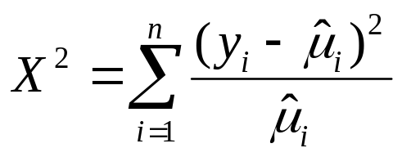
Deviance and Pearson statistic
For the Poisson model we have , so the deviance equals the scaled deviance
, and is given by
For a model with log link and an intercept, the deviance simplifies to
The Pearson statistic is

