Slide 1
Lecture 5 – Authenticated encryption
TEK4500
17.09.2025
Håkon Jacobsen
hakon.jacobsen@its.uio.no

Slide 2
Midterm exam
Available in Canvas from October 1
Due: October 15, 23:59 (two weeks); submission in Canvas
Individual: collaboration is not allowed
Mandatory: need to pass in order to be eligible for the exam
All sources allowed (save for explicitly searching for the solution)
Submission: Canvas (file type = PDF; strongly prefer if you use provided LaTex template)
Start early! The assignment may be more challenging than you expect

Slide 3
Basic goals of cryptography
 | Message privacy | Message integrity / authentication
Symmetric keys | Symmetric encryption | Message authentication codes (MAC)
Asymmetric keys | Asymmetric encryption (a.k.a. public-key encryption) | Digital signatures

Slide 4

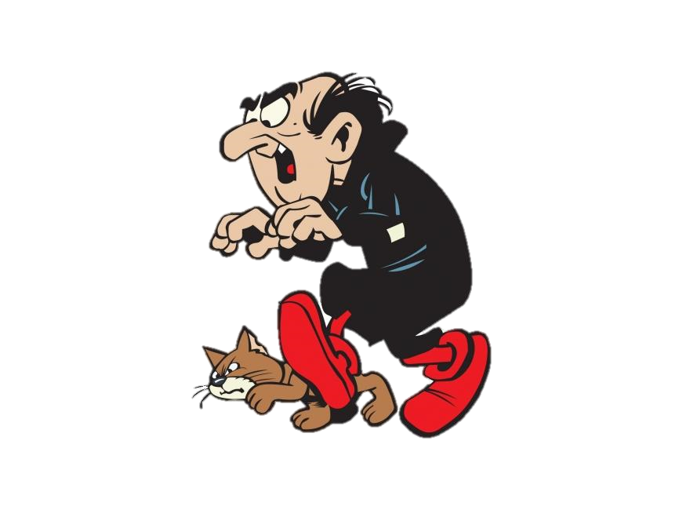
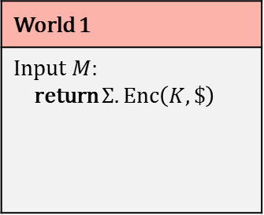
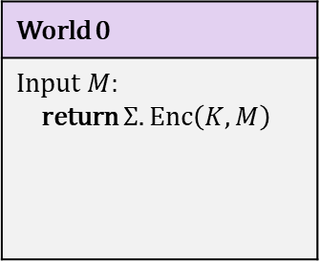

IND-CPA – indistinguishability against chosen-plaintext attacks
World 0
Input $M$: return $Σ.Enc\left(K, M\right)$
World 1
Input $M$: return $Σ.Enc\left(K, \$\right)$
I’m in World $b′$

Slide 5





Chosen-plaintext attacks
Public Internet
Google Search (internal)
C
M

Slide 6
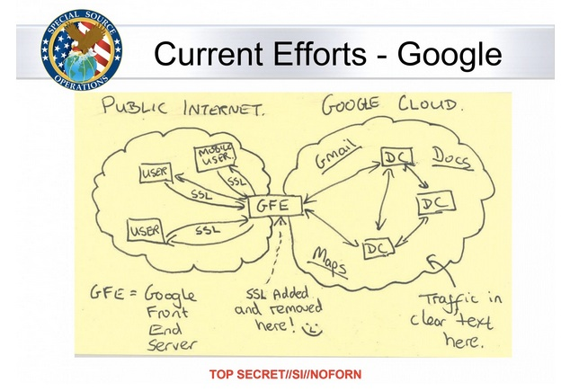
Chosen-plaintext attacks

Slide 7
IND-CPA – indistinguishability against chosen-plaintext attacks
World 0
Input $M$: return $Σ.Enc\left(K, M\right)$
World 1
Input $M$: return $Σ.Enc\left(K, \$\right)$
I’m in World $b′$

Slide 8
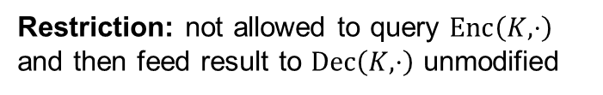
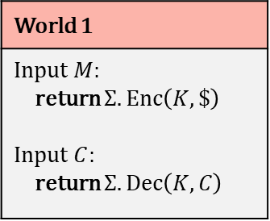
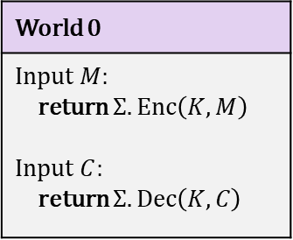
IND-CCA – indistinguishability against chosen-ciphertext attacks
World 0
Input $M$: return $Σ.Enc\left(K, M\right)$ Input $C$: return $Σ.Dec\left(K,C\right)$
World 1
Input $M$: return $Σ.Enc\left(K, \$\right)$ Input $C$: return $Σ.Dec\left(K,C\right)$
I’m in World $b′$
Restriction: not allowed to query $Enc\left(K,⋅\right)$ and then feed result to $Dec\left(K,⋅\right)$ unmodified

Slide 9
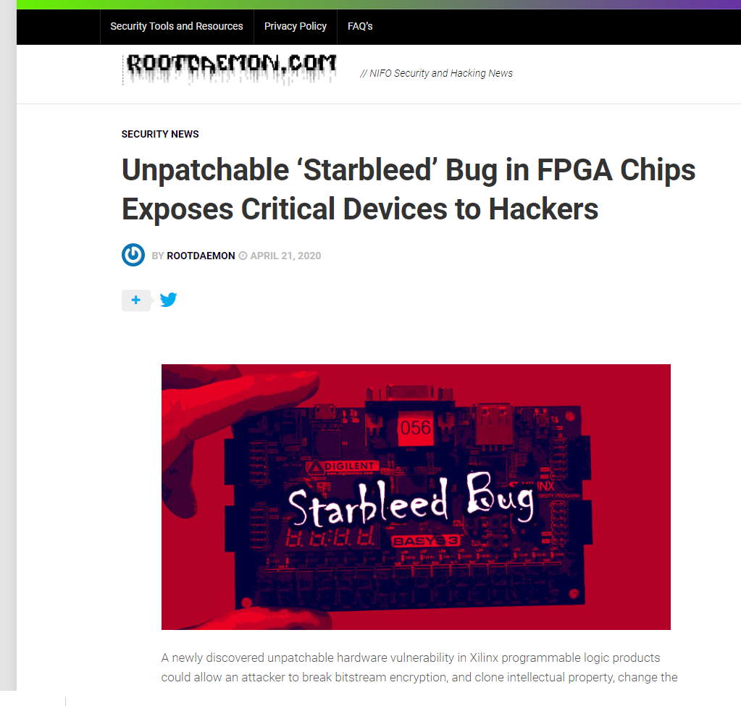
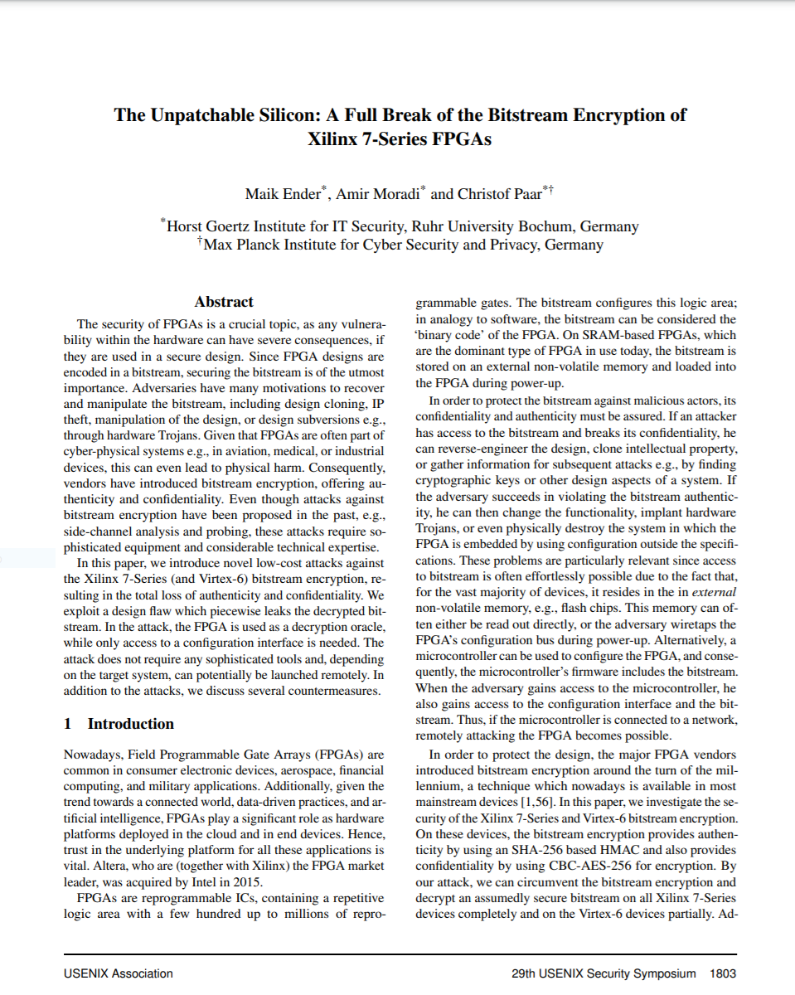
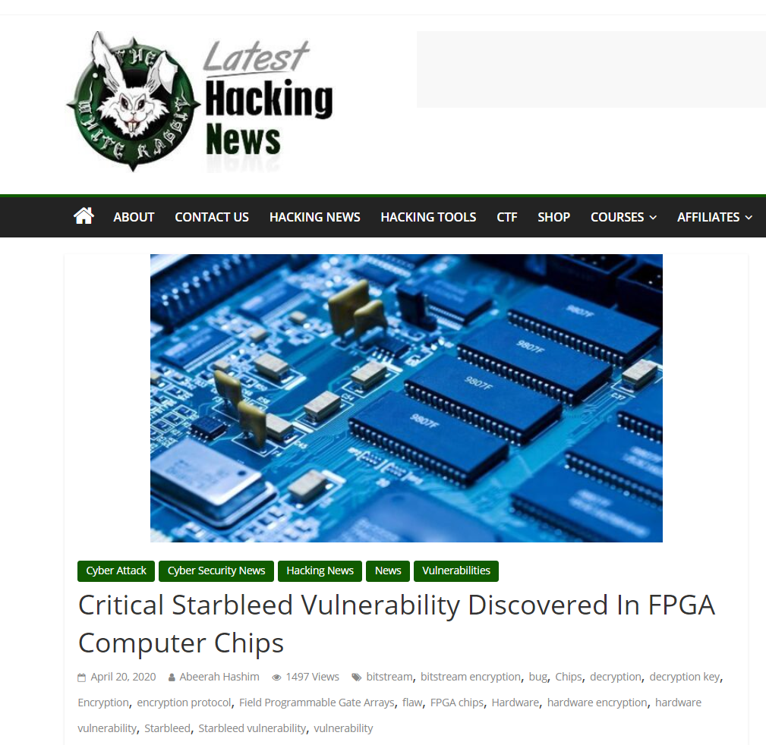
Xilinx FPGA – Starbleed attack

Slide 10


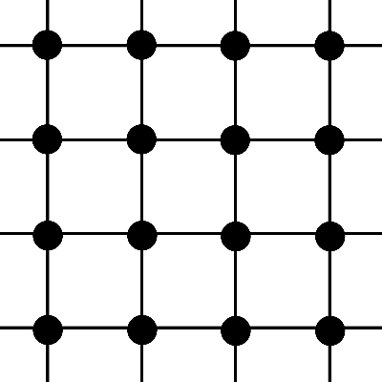
FPGA – Field Programmable Gate Array
Bitstream
Configure

Slide 11
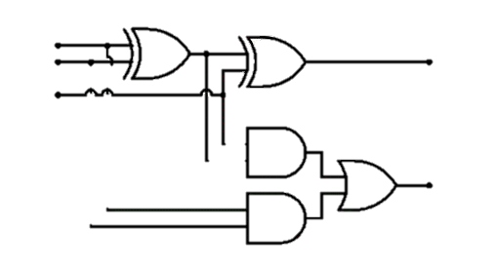
FPGA – Field Programmable Gate Array
Bitstream

Slide 12
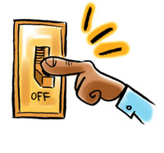
FPGA – Field Programmable Gate Array
Bitstream design typically a business secret
(or even a national/military secret)
Bitstream
FPGA applications:
  Aerospace and avionics
  Digital signal processors
  Defense and military
  Medical devices
  General hardware accelerators
  (e.g. cryptography)

Slide 13

FPGA – Field Programmable Gate Array
Bitstream
Decrypt bitstream with K
Configure
K

Slide 14
FPGA – Field Programmable Gate Array
Bitstream
Decrypt bitstream with K
K

Slide 15
Xilinx Starbleed attack
Bitstream
Decrypt bitstream with K
⋯ | ⋯ | ⋯
K_{MAC} | ⋯ | ⋯
⋯ | WRITE WBSTAR | 0x00000000
 |  | MAC TAG
Header
K
WBSTAR: 0x000000
AES-CBC encrypted
WBSTAR = Warm-Boot Start-address

Slide 16



Xilinx Starbleed attack
Bitstream
Decrypt bitstream with K
⋯ | ⋯ | ⋯
K_{MAC} | ⋯ | ⋯
⋯ | WRITE WBSTAR
 |  | BAD TAG
Reboot
K
Configure
WBSTAR: 0x23d001
AES-CBC decrypt

Slide 17
Xilinx Starbleed attack
Bitstream
“Read out WBSTAR”
Decrypt bitstream with K
Configure
K
WBSTAR: 0x23d001
0x23d001

Slide 18
Xilinx Starbleed attack
Bitstream
“Read out WBSTAR”
Decrypt bitstream with K
⋯ | ⋯ | ⋯
K_{MAC} | ⋯ | ⋯
⋯ | WRITE WBSTAR
 |  | BAD TAG
K
WBSTAR: 0x23d001

Slide 19
Xilinx Starbleed attack
Bitstream
“Read out WBSTAR”
Decrypt bitstream with K
Configure
⋯ | ⋯ | ⋯
K_{MAC} | ⋯ | ⋯
⋯ | WRITE WBSTAR
 |  | BAD TAG
Reboot
K
Configure
WBSTAR: 0xff0015
WBSTAR: 0x23d001
0xff0015
AES-CBC decrypt

Slide 20
Xilinx Starbleed attack
Bitstream
“Read out WBSTAR”
Decrypt bitstream with K
⋯ | ⋯ | ⋯
K_{MAC} | ⋯ | ⋯
⋯ | WRITE WBSTAR
 |  | BAD TAG
Reboot
K
Configure
WBSTAR: 0x6391dd
0x6391dd

Slide 21
Xilinx Starbleed attack
Bitstream
“Read out WBSTAR”
Decrypt bitstream with K
⋯ | ⋯ | ⋯
K_{MAC} | ⋯ | ⋯
⋯ | WRITE WBSTAR
 |  | BAD TAG
Reboot
K
Configure
WBSTAR: 0xba11c0
0xba11c0

Slide 22
Xilinx Starbleed attack
Bitstream
“Read out WBSTAR”
Decrypt bitstream with K
⋯ | ⋯ | ⋯
K_{MAC} | ⋯ | ⋯
⋯ | WRITE WBSTAR
 |  | BAD TAG
Reboot
K
Configure
WBSTAR: 0x833ad7
0x833ad7

Slide 23
Xilinx Starbleed attack
Bitstream
“Read out WBSTAR”
Decrypt bitstream with K
⋯ | ⋯ | ⋯
K_{MAC} | ⋯ | ⋯
⋯ | WRITE WBSTAR
 |  | BAD TAG
Reboot
K
Configure
WBSTAR: 0xfe4115
0xfe4115
Time to fully decrypt bitstream: 26 hours

Slide 24
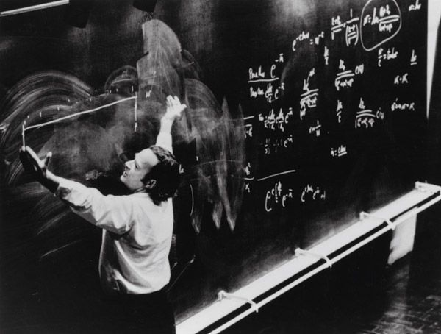
Authenticated encryption

Slide 25
Authenticated encryption
Authenticated encryption: privacy and integrity from a single primitive:
Syntactically (almost) the same as a normal encryption scheme

Slide 26






Authenticated encryption – syntax
$$Enc :𝒦×ℳ→𝒞$$
$$Enc(K,M)={Enc}_{K}\left(M\right)=C$$
$$Dec :𝒦×𝒞→ℳ$$
$$∪\left\{⊥\right\}$$
$$Dec\left(K, C\right)=Dec_{K}\left(C\right)=M$$
$$/ ⊥$$

Slide 27

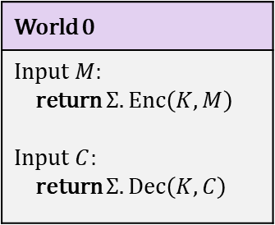
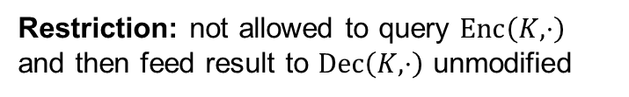
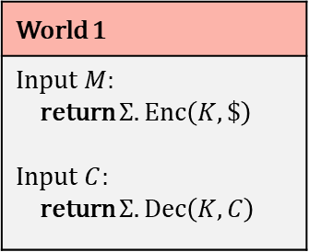
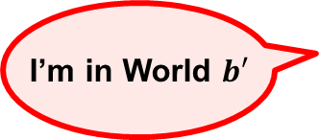
Authenticated encryption – security
World 0
Input $M$: return $Σ.Enc\left(K, M\right)$ Input $C$: return $Σ.Dec\left(K,C\right)$
World 1
Input $M$: return $Σ.Enc\left(K, \$\right)$ Input $C$: return $Σ.Dec\left(K,C\right)$
I’m in World $b′$
Restriction: not allowed to query $Enc\left(K,⋅\right)$ and then feed result to $Dec\left(K,⋅\right)$ unmodified

Slide 28
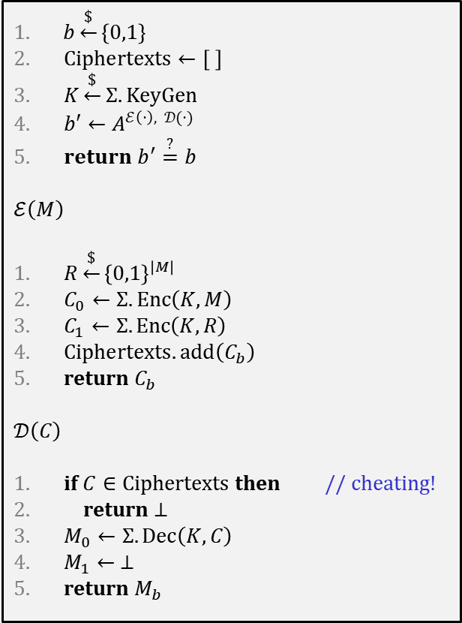

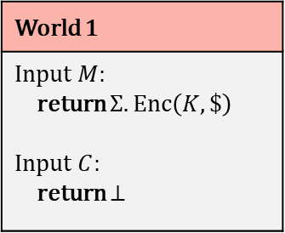
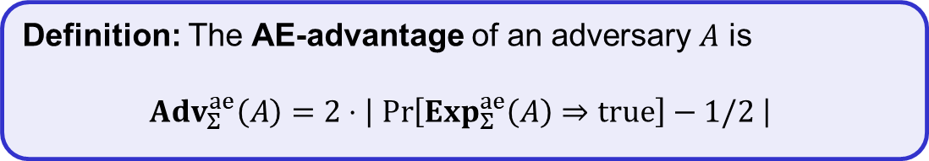
Authenticated encryption – security
$$Exp_{Σ}^{ae}\left(A\right)$$
World 0
Input $M$: return $Σ.Enc\left(K, M\right)$ Input $C$: return $Σ.Dec\left(K,C\right)$
World 1
Input $M$: return $Σ.Enc\left(K, \$\right)$ Input $C$: return $⊥$
$b\underset{←}{\$}\left\{0,1\right\}$
$Ciphertexts←\left[ \right]$
$K\underset{←}{\$}Σ.KeyGen$
$b′←A^{ℰ\left(⋅\right), 𝒟(⋅)}$
$return b^{′}\overset{?}{=}b$
$$ℰ\left(M\right)$$
$R\underset{←}{\$}{\left\{0,1\right\}}^{\left|M\right| }$
$C_{0}←Σ.Enc\left(K, M\right)$
$C_{1}←Σ.Enc\left(K, R\right)$
$Ciphertexts.add\left(C_{b}\right)$
return $C_{b}$
$$𝒟\left(C\right)$$
if $C∈Ciphertexts$ then // cheating!
return $⊥$
$M_{0}←Σ.Dec\left(K, C\right)$
$M_{1}← ⊥$
return $M_{b}$
I’m in World $b′$
Restriction: not allowed to query $Enc\left(K,⋅\right)$ and then feed result to $Dec\left(K,⋅\right)$ unmodified
Definition: The AE-advantage of an adversary $A$ is
$${Adv}_{Σ}^{ae}\left(A\right)=2⋅\left|\operatorname{Pr}\left[Exp_{Σ}^{ae}\left(A\right)⇒true\right]−1/2 \right|$$

Slide 29
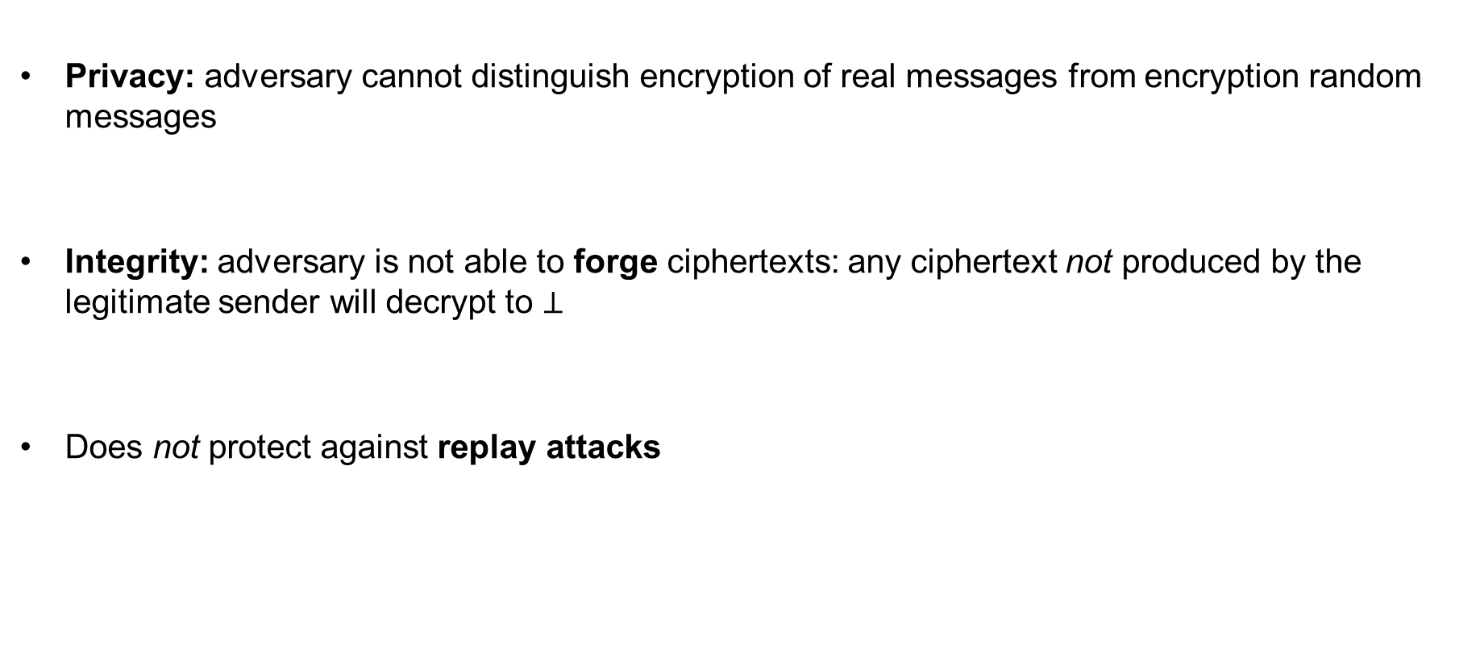
AE security definition – implications
Privacy: adversary cannot distinguish encryption of real messages from encryption random messages
Integrity: adversary is not able to forge ciphertexts: any ciphertext not produced by the legitimate sender will decrypt to $⊥$
Does not protect against replay attacks

Slide 30



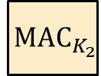
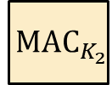

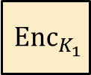
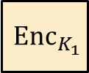






Generic composition: AE from Encryption + MAC
MAC-then-Encrypt (MtE)
Encrypt-and-MAC (E&M)
Encrypt-then-MAC (EtM)
$$M$$
$$M$$
$$M$$
$${ Enc}_{K_{1}}$$
$${ MAC}_{K_{2}}$$
$${ Enc}_{K_{1}}$$
$${ MAC}_{K_{2}}$$
$${ Enc}_{K_{1}}$$
$${ MAC}_{K_{2}}$$
$$C$$
$$C$$
$$T$$
$$C$$
$$T$$
Used in TLS 1.2
Used in SSH
Used in IPsec

Slide 31

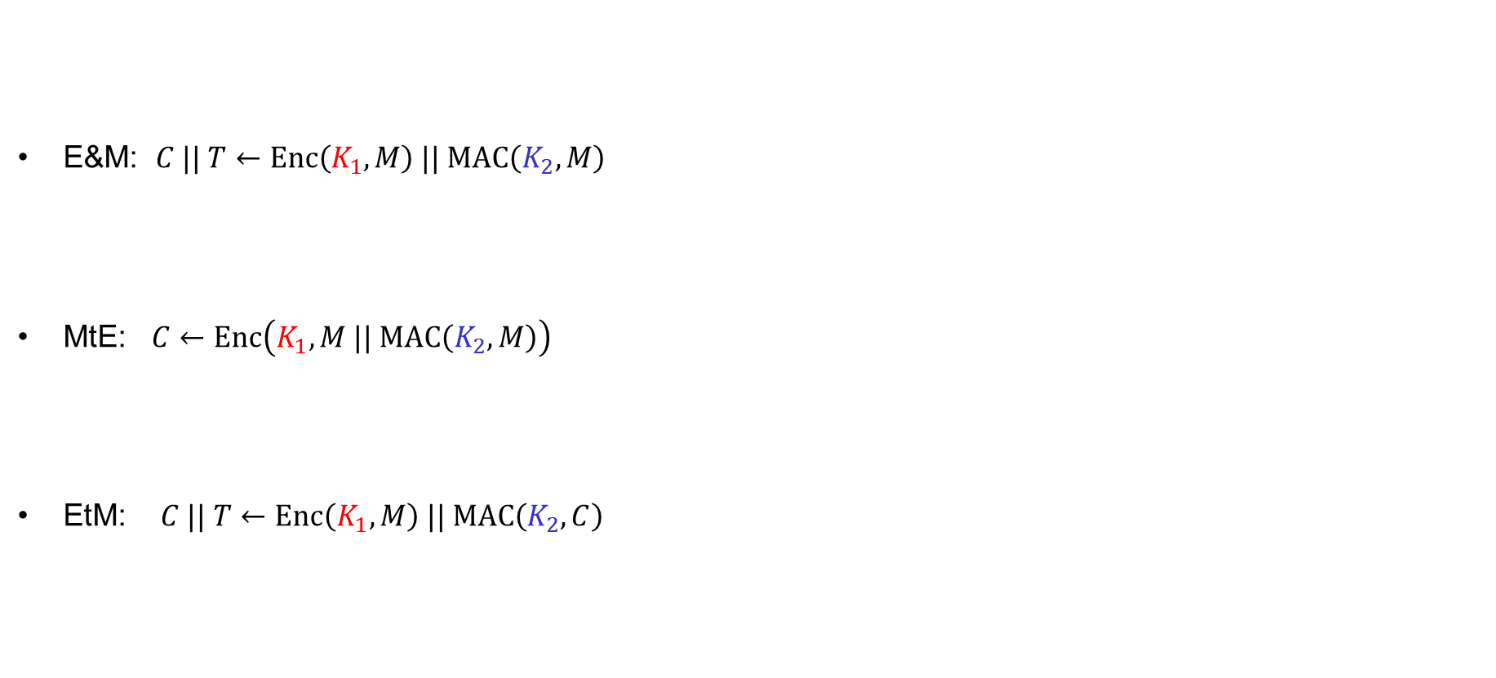



Generic composition: AE secure?
E&M: $C || T←Enc\left(K_{1}, M\right) || MAC\left(K_{2}, M\right)$
MtE: $C←Enc\left(K_{1}, M || MAC\left(K_{2}, M\right)\right)$
EtM: $C || T←Enc\left(K_{1}, M\right) || MAC\left(K_{2}, C\right)$
IND-CPA secure
UF-CMA secure
$$MAC\left(K_{2}, M\right)$$
✗
$$Enc\left(K_{1}, M\right) || M || T$$
AE secure?
✗
$$0000 || C$$
$$Enc\left(K_{1}, M || …\right)$$
✓

Slide 32

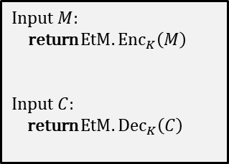


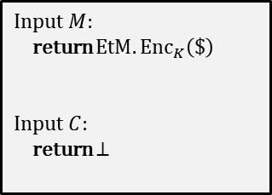
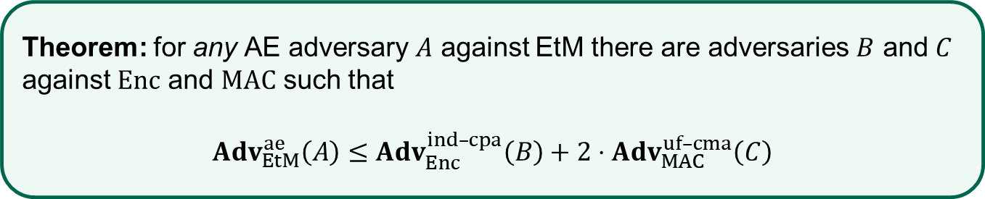

EtM – security
Theorem: for any AE adversary $A$ against EtM there are adversaries $B$ and $C$ against $Enc$ and $MAC$ such that
$Adv_{EtM}^{ae}\left(A\right)≤$ $Adv_{Enc}^{ind–cpa}\left(B\right)+2⋅Adv_{MAC}^{uf–cma}\left(C\right)$
Proof sketch:
$$\text{World}\text{ 0}$$
$$\text{World} \text{1}$$
Input $M$:
return $EtM.{Enc}_{K}\left(M\right)$
Input $C$:
return $EtM.{Dec}_{K}\left(C\right)$
IND-CPA
Input $M$:
return $EtM.{Enc}_{K}\left(\$\right)$
Input $C$:
return $⊥$
$$≈$$
$$≈$$
UF-CMA

Slide 33
CCA-attacks – revisited
MtE used in Starbleed attack
Gave rise to (partial) decryption oracle
Attack would not have been possible
with an AE secure scheme
Bitstream
“Read out WBSTAR”
Decrypt bitstream with K
⋯ | ⋯ | ⋯
K_{MAC} | ⋯ | ⋯
⋯ | WRITE WBSTAR
 |  | BAD TAG
K
Configure
WBSTAR: 0x833ad7
AES-CBC
0x833ad7

Slide 34


AEAD – Authenticated Encryption with Associated Data

Slide 35


AEAD – AE with associated data (AD)
AD – data that can't be encrypted but still need integrity protection
  Headers in protocols
  Configuration data
  Metadata
Integrity protected
Dst address
Src address
Payload
Tag
$$AD$$
$$M$$
Authenticated
Encrypted
Privacy protected
Notes:
Example: Filenames of (encrypted) files on disk

Slide 36








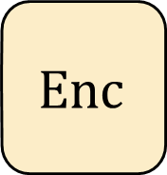
Authenticated encryption w/associated data (AEAD) – syntax
$$Enc :𝒦×ℳ→𝒞$$
$$Enc\left(K, M\right)=Enc_{K}\left(M\right)=C$$
$$Enc$$
$$\$$$
$$A$$
$$M$$
$$C$$
$$Dec :𝒦×𝒞→ℳ∪\left\{⊥\right\}$$
$$K$$
$$Dec\left(K, C\right)={Dec}_{K}\left(C\right)=M/⊥$$

Slide 37



Authenticated encryption w/associated data (AEAD) – syntax
$$Enc :𝒦×𝒜×ℳ→𝒞$$
$$Enc\left(K, A,M\right)=Enc_{K}\left(A,M\right)={Enc}_{K}^{A}\left(M\right)=C$$
$$N$$
$$Enc$$
$$\$$$
$$A$$
$$M$$
$$C$$
$$Dec :𝒦×𝒜×𝒞→ℳ∪\left\{⊥\right\}$$
$$K$$
$$Dec\left(K, A, C\right)={Dec}_{K}\left(A, C\right)={Dec}_{K}^{A}\left(C\right)=M/⊥$$

Slide 38
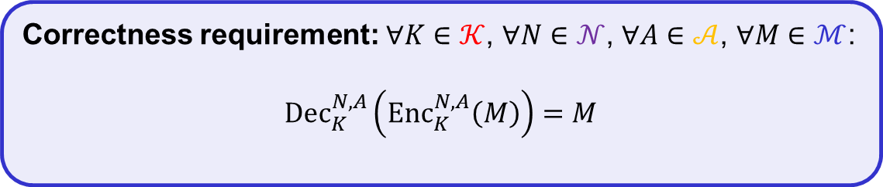

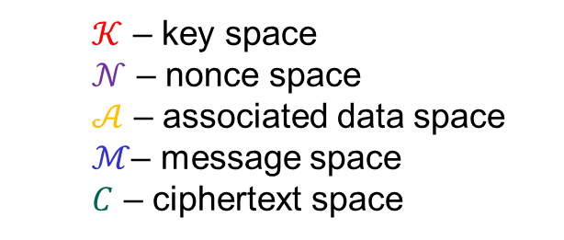
Authenticated encryption w/associated data (AEAD) – syntax
$$Enc :𝒦×𝒩×𝒜×ℳ→𝒞$$
$$Enc\left(K, N, A,M\right)={Enc}_{K}^{N}\left(A,M\right)={Enc}_{K}^{N,A}\left(M\right)=C$$
$$N$$
$$Enc$$
$$A$$
$$M$$
$$C$$
$$Dec :𝒦×𝒩×𝒜×𝒞→ℳ∪\left\{⊥\right\}$$
$$K$$
$$Dec\left(K, N, A,C\right)={Dec}_{K}^{N}\left(A, C\right)={Dec}_{K}^{N,A}\left(C\right)=M/⊥$$
  $𝒦$ – key space
  $𝒩$ – nonce space
  $𝒜$ – associated data space
  $ℳ$– message space
  $C$ – ciphertext space
Correctness requirement: $∀K∈𝒦$, $∀N∈𝒩$, $∀A∈𝒜$, $∀M∈ℳ$:
$${Dec}_{K}^{N,A}\left({Enc}_{K}^{N,A}\left(M\right)\right)=M$$

Slide 39
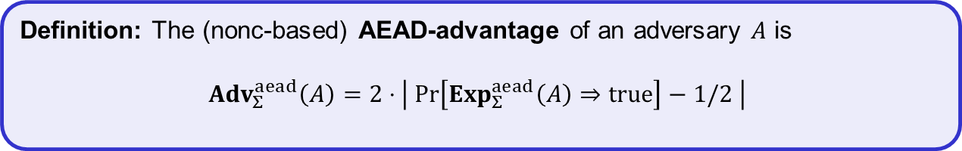
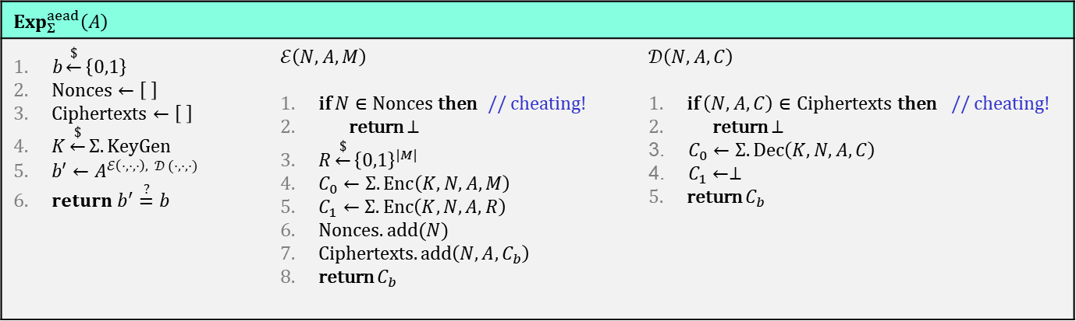
AEAD security (nonce-based)
$$Exp_{Σ}^{aead}\left(A\right)$$
$b\underset{←}{\$}\left\{0,1\right\}$ $Nonces←\left[ \right]$ $Ciphertexts←\left[ \right]$ $K\underset{←}{\$}Σ.KeyGen$ $b′←A^{ℰ\left(⋅,⋅,⋅\right), 𝒟 (⋅,⋅,⋅)}$ $return b^{′}\overset{?}{=}b$ | $$ℰ\left(N, A,M\right)$$ if $N∈Nonces$ then // cheating! return $⊥$ $R\underset{←}{\$}{\left\{0,1\right\}}^{|M|}$ $C_{0}←Σ.Enc\left(K, N, A,M\right)$ $C_{1}←Σ.Enc\left(K, N, A,R\right)$ $Nonces.add(N)$ Ciphertexts$.add\left({N,A,C}_{b}\right)$ return $C_{b}$ | $$𝒟\left(N, A, C\right)$$ if $\left(N,A,C\right)∈Ciphertexts$ then // cheating! return $⊥$ $C_{0}←Σ.Dec\left(K, N, A,C\right)$ $C_{1}←⊥$ return $C_{b}$
Definition: The (nonc-based) AEAD-advantage of an adversary $A$ is
$${Adv}_{Σ}^{aead}\left(A\right)=2⋅\left| \operatorname{Pr}\left[Exp_{Σ}^{aead}\left(A\right)⇒true\right]−1/2 \right|$$

Slide 40
Constructing AEAD schemes

Slide 41


























GCM – Galois/Counter Mode
ctr+1
ctr+2
ctr+3
$${ E}_{K}$$
$${ E}_{K}$$
$${ E}_{K}$$
$${ M}_{1}$$
$${ M}_{2}$$
$${ M}_{3}$$
$${ A}_{1}$$
$${ A}_{2}$$
$${ C}_{1}$$
$${ C}_{2}$$
$${ C}_{3}$$
$$\left|A\right|+\left|C\right|$$
$$⋇$$
$$⋇$$
$$⋇$$
$$⋇$$
$$⋇$$
$$⋇$$
$$H$$
$$H$$
$$H$$
$$H$$
$$H$$
$$H$$
$$S$$
$$T$$

Slide 42







GCM – Galois/Counter Mode
96 bit nonce
CTR-mode
$$ctr←N||0^{31}1$$
ctr+1
ctr+2
ctr+3
$${ E}_{K}$$
$${ E}_{K}$$
$${ E}_{K}$$
$${ M}_{1}$$
$${ M}_{2}$$
$${ M}_{3}$$
$${ A}_{1}$$
$${ A}_{2}$$
$${ C}_{1}$$
$${ C}_{2}$$
$${ C}_{3}$$
$$\left|A\right|+\left|C\right|$$
$$⋇$$
$$⋇$$
$$⋇$$
$$⋇$$
$$⋇$$
$$⋇$$
$$H$$
$$H$$
$$H$$
$$H$$
$$H$$
$$H$$
$$S$$
$$T$$

Slide 43












GCM – Galois/Counter Mode
ctr+1
ctr+2
ctr+3
$H←E_{K}\left(0^{128}\right)$
$${ E}_{K}$$
$${ E}_{K}$$
$${ E}_{K}$$
$$S←E_{K}(N||0^{31}1)$$
$${ M}_{1}$$
$${ M}_{2}$$
$${ M}_{3}$$
GMAC
$${ A}_{1}$$
$${ A}_{2}$$
$${ C}_{1}$$
$${ C}_{2}$$
$${ C}_{3}$$
$$\left|A\right|+\left|C\right|$$
$$⋇$$
$$⋇$$
$$⋇$$
$$⋇$$
$$⋇$$
$$⋇$$
$$H$$
$$H$$
$$H$$
$$H$$
$$H$$
$$H$$
$$A_{1}H$$
$$A_{1}H+A_{2}$$
$$A_{1}H^{2}+A_{2}H+C_{1}$$
$$S$$
$$A_{1}H^{3}+A_{2}H^{2}+C_{1}H+C_{2}$$
$$A_{1}H^{6}+A_{2}H^{5}+C_{1}H^{4}+C_{2}H^{3}+C_{3}H^{2}+\left(\left|A\right|+\left|C\right|\right)H+S=$$
$$T$$

Slide 44

GCM – Galois/Counter Mode
96 bit nonce
$$ctr←N||0^{31}1$$
ctr+1
ctr+2
ctr+3
$H←E_{K}\left(0^{128}\right)$
$${ E}_{K}$$
$${ E}_{K}$$
$${ E}_{K}$$
$$S←E_{K}(N||0^{31}1)$$
$${ M}_{1}$$
$${ M}_{2}$$
$${ M}_{3}$$
$${ A}_{1}$$
$${ A}_{2}$$
$${ C}_{1}$$
$${ C}_{2}$$
$${ C}_{3}$$
$$\left|A\right|+\left|C\right|$$
$$⋇$$
$$⋇$$
$$⋇$$
$$⋇$$
$$⋇$$
$$⋇$$
$$H$$
$$H$$
$$H$$
$$H$$
$$H$$
$$H$$
$$S$$
$$T$$

Slide 45



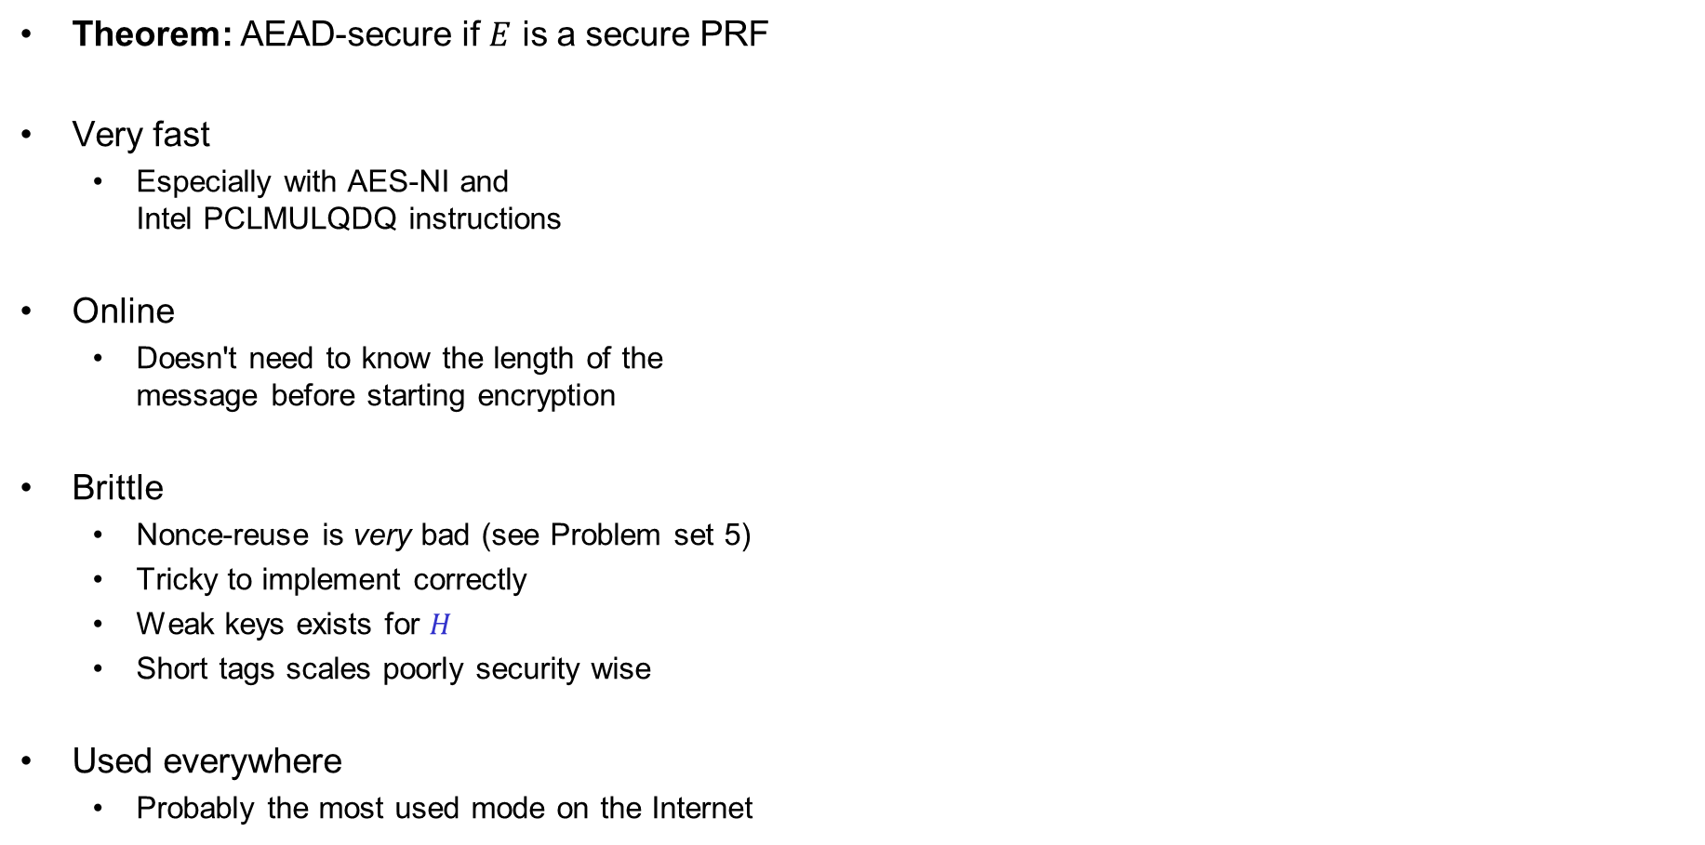


GCM – properties
Theorem: AEAD-secure if $E$ is a secure PRF
Very fast
  Especially with AES-NI and
  Intel PCLMULQDQ instructions
Online
  Doesn't need to know the length of the
  message before starting encryption
Brittle
  Nonce-reuse is very bad (see Problem set 5)
  Tricky to implement correctly
  Weak keys exists for $H$
  Short tags scales poorly security wise
Used everywhere
  Probably the most used mode on the Internet
$ctr←N||0^{31}1$
$H←E_{K}\left(0^{128}\right)$
$$S←E_{K}(N||0^{31}1)$$
ctr+1
ctr+2
ctr+3
$${ E}_{K}$$
$${ E}_{K}$$
$${ E}_{K}$$
$${ M}_{1}$$
$${ M}_{2}$$
$${ M}_{3}$$
$${ A}_{1}$$
$${ A}_{2}$$
$${ C}_{1}$$
$${ C}_{2}$$
$${ C}_{3}$$
$$\left|A\right|+\left|C\right|$$
$$⋇$$
$$⋇$$
$$⋇$$
$$⋇$$
$$⋇$$
$$⋇$$
$$H$$
$$H$$
$$H$$
$$H$$
$$H$$
$$H$$
$$S$$
$$T$$

Slide 46

Ideal solution: secure channels
Internet
How to build?
Alice
Bob
M
Adversary
Security goals:
Data privacy: adversary should not be able to read message M ✓
Data integrity: adversary should not be able to modify message M ✓
Data authenticity: message M really originated from Alice ✓

Slide 47
Ideal solution: secure channels
AES-GCM?
Internet
Alice
Bob
M
Adversary
Security goals:
Data privacy: adversary should not be able to read message M ✓
Data integrity: adversary should not be able to modify message M ✓
Data authenticity: message M really originated from Alice ✓

Slide 48



AES-GCM = secure channel?
"Send Bob $10"
AES-GCM
AES-GCM
+10
AES-GCM
+10
AES-GCM
+10

Slide 49



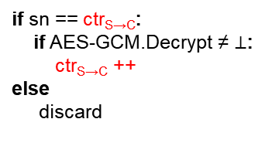
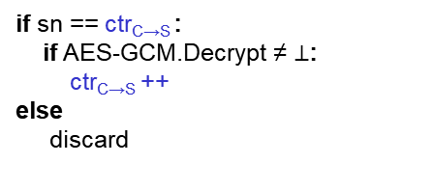
Secure channels – TLS / IPsec
increment on send
increment on receive
ctr_{C→S} =
ctr_{S→C} =
103
ctr_{C→S} =
ctr_{S→C} =
104
105
103
104
AD
105
395
396
397
398
395
396
397
AES-GCM
398
increment on receive
sn = 103
data
increment on send
if sn == ctr_{S→C}:
if AES-GCM.Decrypt ≠ $⊥$:
ctr_{S→C} ++
else
discard
sn = 395
data
if sn == ctr_{C→S} :
if AES-GCM.Decrypt ≠ $⊥$:
ctr_{C→S} ++
else
discard
sn = 396
data
sn = 397
data
sn = 104
data
sn = 103
data
103 < ctr_{C→S}
Notes:
Why can't the attacker just change sn to 105? Because of AES-GCM!

Slide 50
Other AEAD schemes

Slide 51


























OCBv3 – Offset Codebook Mode
$${ A}_{1}$$
$${ A}_{2}$$
$${ M}_{1}$$
$${ M}_{2}$$
$${ M}_{3}$$
$$M_{1}⊕M_{2}⊕M_{3}$$
$$Δ_{1}$$
$$Δ_{2}$$
$$Δ_{3}$$
$$Δ_{4}$$
$$Δ_{5}$$
$$Δ_{6}$$
$${ E}_{K}$$
$${ E}_{K}$$
$${ E}_{K}$$
$${ E}_{K}$$
$${ E}_{K}$$
$${ E}_{K}$$
$$Δ_{3}$$
$$Δ_{4}$$
$$Δ_{5}$$
Auth
Auth
$${ C}_{1}$$
$${ C}_{2}$$
$${ C}_{3}$$
$$T$$
$Δ_{i}$ - derived from 96-bit nonce $N$

Slide 52
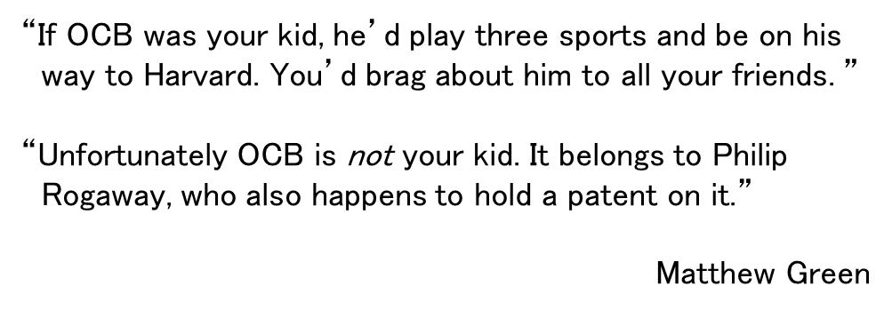
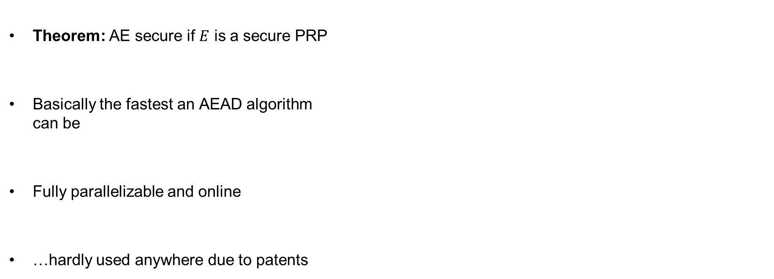


OCBv3 – properties
Theorem: AE secure if $E$ is a secure PRP
Basically the fastest an AEAD algorithm
can be
Fully parallelizable and online
…hardly used anywhere due to patents
“If OCB was your kid, he’d play three sports and be on his
way to Harvard. You’d brag about him to all your friends. ”
“Unfortunately OCB is not your kid. It belongs to Philip
Rogaway, who also happens to hold a patent on it.”
Matthew Green
$${ A}_{1}$$
$${ A}_{2}$$
$${ M}_{1}$$
$${ M}_{2}$$
$${ M}_{3}$$
$$M_{1}⊕M_{2}⊕M_{3}$$
$$Δ_{1}$$
$$Δ_{2}$$
$$Δ_{3}$$
$$Δ_{4}$$
$$Δ_{5}$$
$$Δ_{6}$$
$${ E}_{K}$$
$${ E}_{K}$$
$${ E}_{K}$$
$${ E}_{K}$$
$${ E}_{K}$$
$${ E}_{K}$$
$$Δ_{3}$$
$$Δ_{4}$$
$$Δ_{5}$$
Auth
Auth
$${ C}_{1}$$
$${ C}_{2}$$
$${ C}_{3}$$
$$T$$

Slide 53














CCM – Counter Mode with CBC-MAC
$${ E}_{K}$$
$${ E}_{K}$$
$${ E}_{K}$$
$${ E}_{K}$$
$${ E}_{K}$$
$$T$$
$$IV$$
$${ A}_{1}$$
$${ M}_{1}$$
$${ M}_{2}$$
$${ M}_{3}$$
ctr+1
$${ E}_{K}$$
ctr+2
$${ E}_{K}$$
ctr+3
$${ E}_{K}$$
ctr
$${ E}_{K}$$
$${ C}_{1}$$
$${ C}_{2}$$
$${ C}_{3}$$
$${ C}_{T}$$

Slide 54








CCM – Counter Mode with CBC-MAC
$${ E}_{K}$$
$${ E}_{K}$$
$${ E}_{K}$$
$${ E}_{K}$$
$${ E}_{K}$$
$$T$$
CTR-mode
$$IV$$
$${ A}_{1}$$
$${ M}_{1}$$
$${ M}_{2}$$
$${ M}_{3}$$
ctr+1
$${ E}_{K}$$
ctr+2
$${ E}_{K}$$
ctr+3
$${ E}_{K}$$
ctr
$${ E}_{K}$$
$${ C}_{1}$$
$${ C}_{2}$$
$${ C}_{3}$$
$${ C}_{T}$$
ctr $←F_{1}||N|| 0^{16}$

Slide 55




CCM – Counter Mode with CBC-MAC
CBC-MAC
$${ E}_{K}$$
$${ E}_{K}$$
$${ E}_{K}$$
$${ E}_{K}$$
$${ E}_{K}$$
$$T$$
$$IV$$
$${ A}_{1}$$
$${ M}_{1}$$
$${ M}_{2}$$
$${ M}_{3}$$
ctr+1
$${ E}_{K}$$
ctr+2
$${ E}_{K}$$
ctr+3
$${ E}_{K}$$
ctr
$${ E}_{K}$$
$${ C}_{1}$$
$${ C}_{2}$$
$${ C}_{3}$$
$${ C}_{T}$$

Slide 56

CCM – Counter Mode with CBC-MAC
CBC-MAC
Length-prepended-
$${ E}_{K}$$
$${ E}_{K}$$
$${ E}_{K}$$
$${ E}_{K}$$
$${ E}_{K}$$
$$T$$
$$IV$$
$${ A}_{1}$$
$${ M}_{1}$$
$${ M}_{2}$$
$${ M}_{3}$$
ctr+1
$${ E}_{K}$$
ctr+2
$${ E}_{K}$$
ctr+3
$${ E}_{K}$$
ctr
$${ E}_{K}$$
$${ C}_{1}$$
$${ C}_{2}$$
$${ C}_{3}$$
$${ C}_{T}$$
$$IV←F_{2}||N|| {len}_{16}\left(AD+M\right)$$

Slide 57

CCM – Counter Mode with CBC-MAC
≈ ECBC-MAC
$${ E}_{K}$$
$${ E}_{K}$$
$${ E}_{K}$$
$${ E}_{K}$$
$${ E}_{K}$$
$$T$$
$$IV$$
$${ A}_{1}$$
$${ M}_{1}$$
$${ M}_{2}$$
$${ M}_{3}$$
ctr+1
$${ E}_{K}$$
ctr+2
$${ E}_{K}$$
ctr+3
$${ E}_{K}$$
ctr
$${ E}_{K}$$
$${ C}_{1}$$
$${ C}_{2}$$
$${ C}_{3}$$
$${ C}_{T}$$
$$IV←F_{2}||N|| {len}_{16}\left(AD+M\right)$$

Slide 58
CCM – Counter Mode with CBC-MAC
$${ E}_{K}$$
$${ E}_{K}$$
$${ E}_{K}$$
$${ E}_{K}$$
$${ E}_{K}$$
$$T$$
$$IV$$
$${ A}_{1}$$
$${ M}_{1}$$
$${ M}_{2}$$
$${ M}_{3}$$
ctr+1
$${ E}_{K}$$
ctr+2
$${ E}_{K}$$
ctr+3
$${ E}_{K}$$
ctr
$${ E}_{K}$$
$${ C}_{1}$$
$${ C}_{2}$$
$${ C}_{3}$$
$${ C}_{T}$$
ctr $←F_{1}||N|| 0^{16}$
$$IV←F_{2}||N|| {len}_{16}\left(AD+M\right)$$

Slide 59

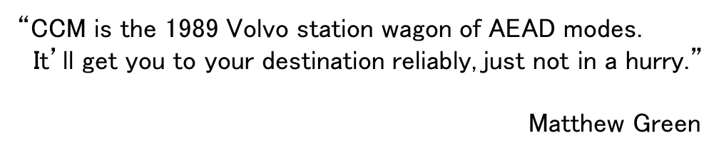
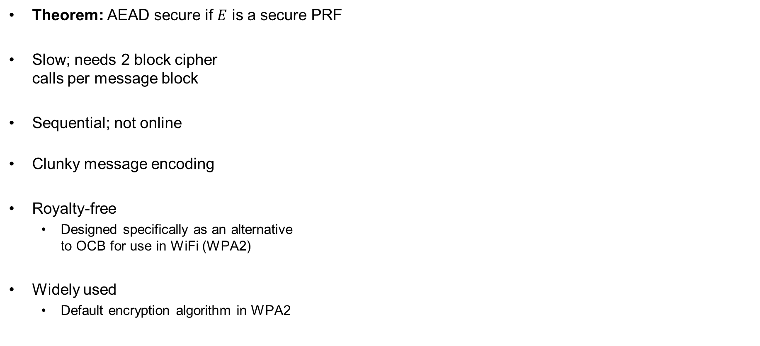





CCM – properties
Theorem: AEAD secure if $E$ is a secure PRF
Slow; needs 2 block cipher
calls per message block
Sequential; not online
Clunky message encoding
Royalty-free
  Designed specifically as an alternative
  to OCB for use in WiFi (WPA2)
Widely used
  Default encryption algorithm in WPA2
“CCM is the 1989 Volvo station wagon of AEAD modes.
It’ll get you to your destination reliably, just not in a hurry.”
Matthew Green
$${ E}_{K}$$
$${ E}_{K}$$
$${ E}_{K}$$
$${ E}_{K}$$
$${ E}_{K}$$
$$T$$
$$IV$$
$${ A}_{1}$$
$${ M}_{1}$$
$${ M}_{2}$$
$${ M}_{3}$$
ctr+1
$${ E}_{K}$$
ctr+2
$${ E}_{K}$$
ctr+3
$${ E}_{K}$$
ctr
$${ E}_{K}$$
$$ctr←F_{1}||N|| 0^{16}$$
$${ C}_{1}$$
$${ C}_{2}$$
$${ C}_{3}$$
$${ C}_{T}$$
$$IV←F_{2}||N|| {len}_{16}\left(AD+M\right)$$

Slide 60
Summary
Authenticated encryption: privacy + intergrity in one primitive
AEAD: AE + associated data: data that gets integrity protection, but not privacy protection
(e.g. protocol headers)
AEAD examples:
  GCM
  CCM
  OCB
AEAD is not a secure channel!
  Does not provide replay protection
  Secure channels from AEAD: add counters/nonces/timers
Next week: hash functions

