Slide 1
Lecture 5 – Authenticated encryption
TEK4500
22.09.2021
Håkon Jacobsen
hakon.jacobsen@its.uio.no

Slide 2
Midterm exam
Available next week (Wednesday 29. September, 14:00)
Due: two weeks later (Wednesday 13. October, 23:59)
Take-home exam
Individual: corporation is not allowed
Mandatory: need to pass in order to be eligible for the exam
All sources allowed (save for explicitly searching for the solution)
Submission: Canvas (file type = PDF; strongly prefer if you use provided LaTex template)
Start early! The assignment may be more challenging than you expect

Slide 3
Basic goals of cryptography
 | Message privacy | Message integrity / authentication
Symmetric keys | Symmetric encryption | Message authentication codes (MAC)
Asymmetric keys | Asymmetric encryption (a.k.a. public-key encryption) | Digital signatures

Slide 4

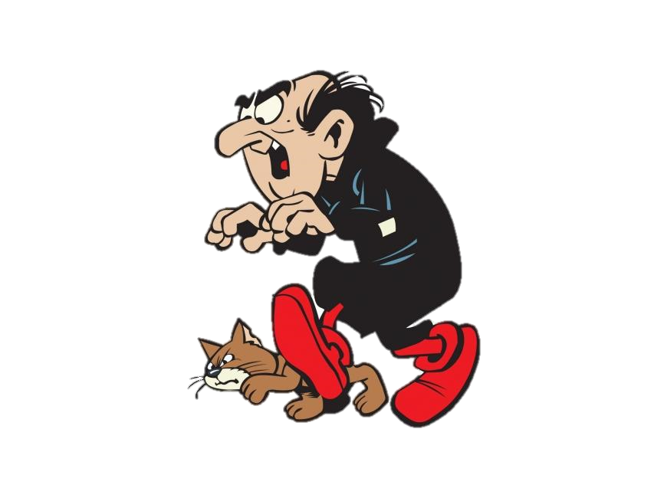
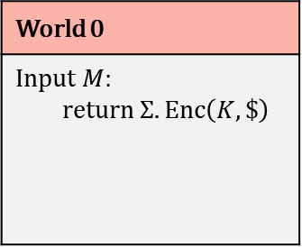
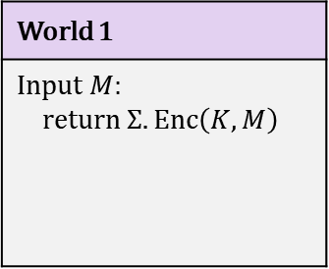

IND-CPA – Indistinguishability against chosen-plaintext attacks
World 1
Input $M$: return $Σ.Enc\left(K, M\right)$
World 0
Input $M$: return $Σ.Enc\left(K, \$\right)$
I’m in World $b′$

Slide 5
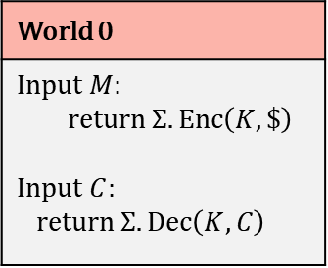
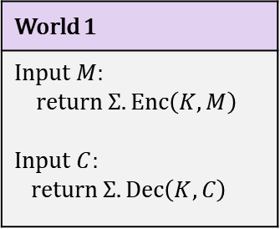
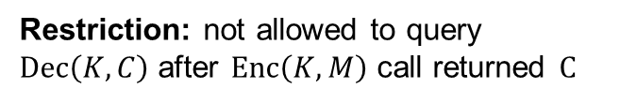
IND-CCA – Indistinguishability against chosen-ciphertext attacks
World 1
Input $M$: return $Σ.Enc\left(K, M\right)$ Input $C$: return $Σ.Dec\left(K,C\right)$
World 0
Input $M$: return $Σ.Enc\left(K, \$\right)$ Input $C$: return $Σ.Dec\left(K,C\right)$
I’m in World $b′$
Restriction: not allowed to query $Dec\left(K,C\right)$ after $Enc\left(K,M\right)$ call returned $C$

Slide 6
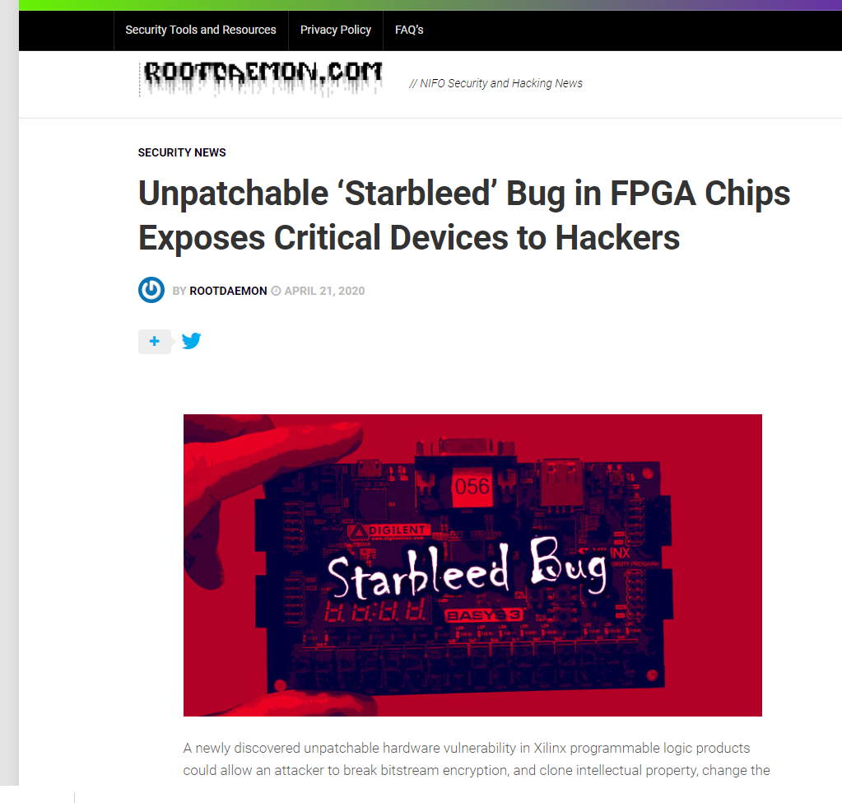
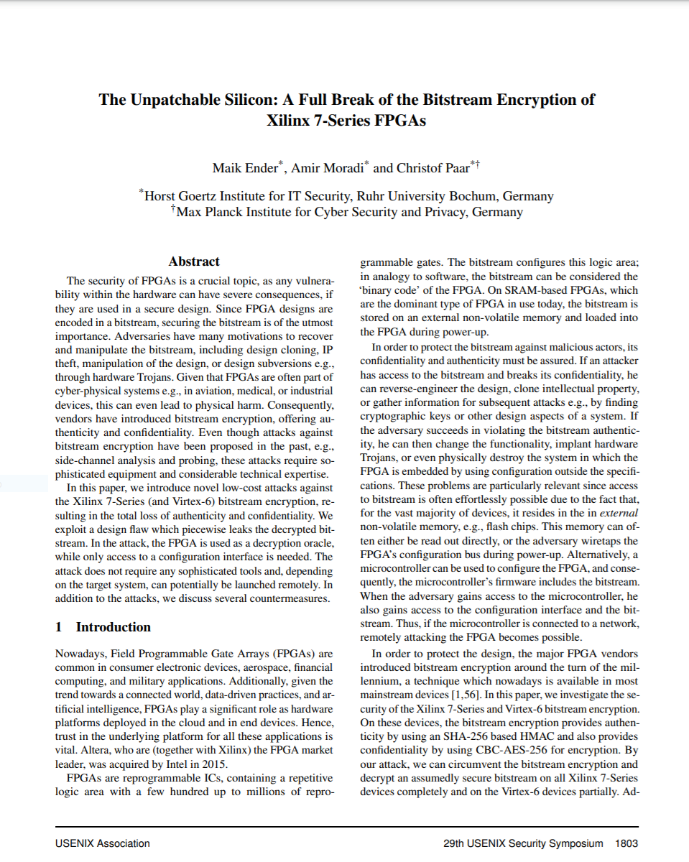
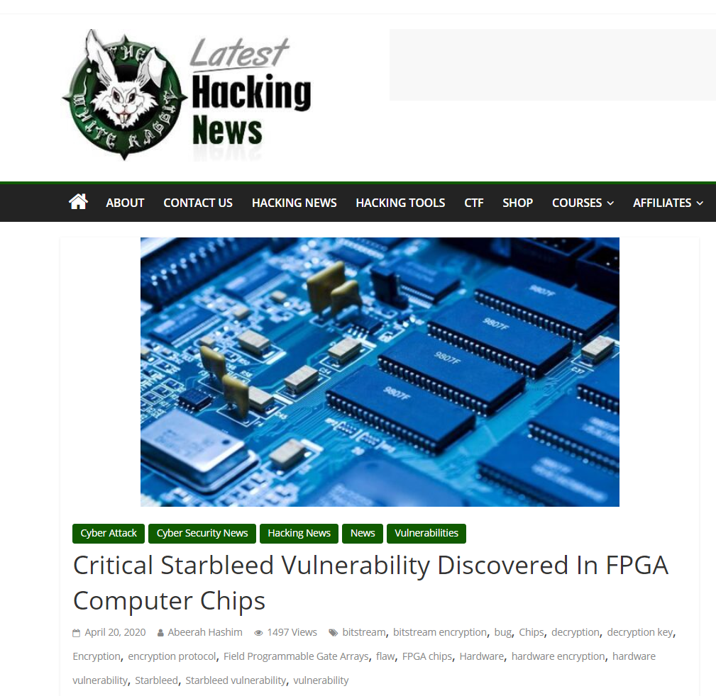
Xilinx FPGA – Starbleed attack

Slide 7


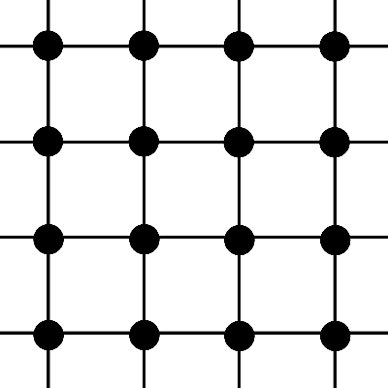
FPGA – Field Programmable Gate Array
Bitstream
Configure

Slide 8
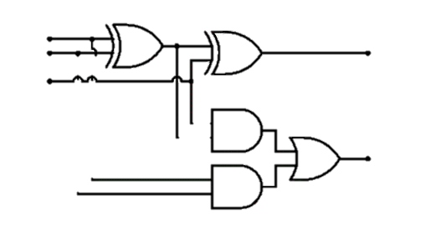
FPGA – Field Programmable Gate Array
Bitstream

Slide 9
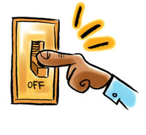
FPGA – Field Programmable Gate Array
Bitstream design typically a business secret
(or even a national/military secret)
Bitstream
FPGA applications:
  Aerospace and avionics
  Digital signal processors
  Defense and military
  Medical devices
  General hardware accelerators
  (e.g. cryptography)

Slide 10

FPGA – Field Programmable Gate Array
Bitstream
Decrypt bitstream with K
Configure
K

Slide 11
FPGA – Field Programmable Gate Array
Bitstream
Decrypt bitstream with K
K

Slide 12
Xilinx Starbleed attack
Bitstream
Decrypt bitstream with K
⋯ | ⋯ | ⋯
K_{MAC} | ⋯ | ⋯
⋯ | WRITE WBSTAR | 0x00000000
 |  | MAC TAG
Header
K
WBSTAR: 0x000000
AES-CBC encrypted
WBSTAR = Warm-Boot Start-address

Slide 13



Xilinx Starbleed attack
Bitstream
Decrypt bitstream with K
⋯ | ⋯ | ⋯
⋯ | ⋯ | ⋯
⋯ | WRITE WBSTAR
 |  | BAD TAG
Reboot
K
Configure
WBSTAR: 0x23d001
Decrypted

Slide 14
Xilinx Starbleed attack
Bitstream
“Read out WBSTAR”
Decrypt bitstream with K
Configure
K
WBSTAR: 0x23d001
0x23d001

Slide 15
Xilinx Starbleed attack
Bitstream
“Read out WBSTAR”
Decrypt bitstream with K
⋯ | ⋯ | ⋯
⋯ | ⋯ | ⋯
⋯ | WRITE WBSTAR
 |  | BAD TAG
K
WBSTAR: 0x23d001

Slide 16
Xilinx Starbleed attack
Bitstream
“Read out WBSTAR”
Decrypt bitstream with K
⋯ | ⋯ | ⋯
⋯ | ⋯ | ⋯
⋯ | WRITE WBSTAR
 |  | BAD TAG
Reboot
K
Configure
WBSTAR: 0xff0015
0xff0015

Slide 17
Xilinx Starbleed attack
Bitstream
“Read out WBSTAR”
Decrypt bitstream with K
⋯ | ⋯ | ⋯
⋯ | ⋯ | ⋯
⋯ | WRITE WBSTAR
 |  | BAD TAG
Reboot
K
Configure
WBSTAR: 0x6391dd
0x6391dd

Slide 18
Xilinx Starbleed attack
Bitstream
“Read out WBSTAR”
Decrypt bitstream with K
⋯ | ⋯ | ⋯
⋯ | ⋯ | ⋯
⋯ | WRITE WBSTAR
 |  | BAD TAG
Reboot
K
Configure
WBSTAR: 0xba11c0
0xba11c0

Slide 19
Xilinx Starbleed attack
Bitstream
“Read out WBSTAR”
Decrypt bitstream with K
⋯ | ⋯ | ⋯
⋯ | ⋯ | ⋯
⋯ | WRITE WBSTAR
 |  | BAD TAG
Reboot
K
Configure
WBSTAR: 0x833ad7
0x833ad7

Slide 20
Xilinx Starbleed attack
Bitstream
“Read out WBSTAR”
Decrypt bitstream with K
⋯ | ⋯ | ⋯
⋯ | ⋯ | ⋯
⋯ | WRITE WBSTAR
 |  | BAD TAG
Reboot
K
Configure
WBSTAR: 0xfe4115
0xfe4115
Time to fully decrypt 48 MB bitstream: 26 hours

Slide 21
Padding oracles
Full decryption oracles are not always available/needed
Padding attacks:
  Chosen-ciphertext attacks that exploit small timing variations when decrypting different ciphertexts
  Only a limited "decryption" oracle available to the attacker
  First described by Serge Vaudenay (2002) based on CBC-encryption in TLS and IPsec

Slide 22


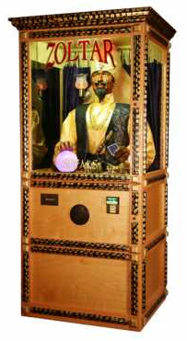





DTLS padding oracle attack
DTLS padding
Valid
$${ C}_{0}$$
$${ C}_{1}$$
$${ C}_{2}$$
$${ C}_{3}$$
 |  |  |  |  |  |  | 01
 |  |  |  |  |  | 02 | 02
Decrypt
 |  |  |  |  | 03 | 03 | 03
 |  |  |  |  | 03 | 03 | 03
$$C=CBC\left(K, M || {MAC}_{K}\left(M\right) || pad\right)$$

Slide 23





DTLS padding oracle attack
DTLS padding
Invalid
$${ C}_{0}$$
$${ C}_{1}$$
$${ C}_{2}$$
$${ C}_{3}$$
 |  |  |  |  |  |  | 01
 |  |  |  |  |  | 02 | 02
 |  |  |  |  | 03 | 03 | 03
$$R$$
 |  |  |  |  |  |  | 00
Decrypt
$$C=CBC\left(K, M || {MAC}_{K}\left(M\right) || pad\right)$$
 |  | …
 |  |  |  |  |  |  | b3

Slide 24
DTLS padding oracle attack
DTLS padding
Invalid
$${ C}_{0}$$
$${ C}_{1}$$
$${ C}_{2}$$
$${ C}_{3}$$
 |  |  |  |  |  |  | 01
 |  |  |  |  |  | 02 | 02
 |  |  |  |  | 03 | 03 | 03
$$R$$
 |  |  |  |  |  |  | 01
Decrypt
$$C=CBC\left(K, M || {MAC}_{K}\left(M\right) || pad\right)$$
 |  | …
 |  |  |  |  |  |  | 90

Slide 25
DTLS padding oracle attack
DTLS padding
Invalid
$${ C}_{0}$$
$${ C}_{1}$$
$${ C}_{2}$$
$${ C}_{3}$$
 |  |  |  |  |  |  | 01
 |  |  |  |  |  | 02 | 02
 |  |  |  |  | 03 | 03 | 03
$$R$$
 |  |  |  |  |  |  | 02
Decrypt
$$C=CBC\left(K, M || {MAC}_{K}\left(M\right) || pad\right)$$
 |  | …
 |  |  |  |  |  |  | 77

Slide 26
DTLS padding oracle attack
DTLS padding
Invalid
$${ C}_{0}$$
$${ C}_{1}$$
$${ C}_{2}$$
$${ C}_{3}$$
 |  |  |  |  |  |  | 01
 |  |  |  |  |  | 02 | 02
 |  |  |  |  | 03 | 03 | 03
$$R$$
 |  |  |  |  |  |  | 03
Decrypt
$$C=CBC\left(K, M || {MAC}_{K}\left(M\right) || pad\right)$$
 |  | …
 |  |  |  |  |  |  | 32

Slide 27
DTLS padding oracle attack
DTLS padding
Invalid
$${ C}_{0}$$
$${ C}_{1}$$
$${ C}_{2}$$
$${ C}_{3}$$
 |  |  |  |  |  |  | 01
 |  |  |  |  |  | 02 | 02
 |  |  |  |  | 03 | 03 | 03
$$R$$
 |  |  |  |  |  |  | 04
Decrypt
$$C=CBC\left(K, M || {MAC}_{K}\left(M\right) || pad\right)$$
 |  | …
 |  |  |  |  |  |  | b9

Slide 28
DTLS padding oracle attack
DTLS padding
Invalid
$${ C}_{0}$$
$${ C}_{1}$$
$${ C}_{2}$$
$${ C}_{3}$$
 |  |  |  |  |  |  | 01
 |  |  |  |  |  | 02 | 02
 |  |  |  |  | 03 | 03 | 03
$$R$$
 |  |  |  |  |  |  | 05
Decrypt
$$C=CBC\left(K, M || {MAC}_{K}\left(M\right) || pad\right)$$
 |  | …
 |  |  |  |  |  |  | a3

Slide 29
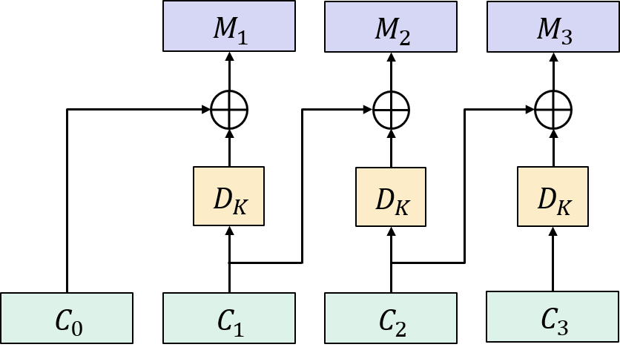





DTLS padding oracle attack
DTLS padding
Valid!
$${ C}_{0}$$
$${ C}_{1}$$
$${ C}_{2}$$
$${ C}_{3}$$
 |  |  |  |  |  |  | 01
 |  |  |  |  |  | 02 | 02
$$R\left[0\right]$$
 |  |  |  |  | 03 | 03 | 03
$$R$$
 |  |  |  |  |  |  | 06
Decrypt
$$C=CBC\left(K, M || {MAC}_{K}\left(M\right) || pad\right)$$
 |  | …
 |  |  |  |  |  |  | 01
$$M_{3}\left[0\right]=R\left[0\right]⊕C_{2}\left[0\right]⊕01$$
$$R\left[0\right]⊕Z[0]=01$$
$$Z$$
$$R\left[0\right]⊕\left(C_{2}\left[0\right]⊕M_{3}\left[0\right]\right)=01$$

Slide 30

DTLS padding oracle attack
DTLS padding
Valid!
$${ C}_{0}$$
$${ C}_{1}$$
$${ C}_{2}$$
$${ C}_{3}$$
 |  |  |  |  |  |  | 01
 |  |  |  |  |  | 02 | 02
 |  |  |  |  | 03 | 03 | 03
$$R$$
 |  |  |  |  |  |  | 06
Decrypt
$$C=CBC\left(K, M || {MAC}_{K}\left(M\right) || pad\right)$$
 |  | …
 |  |  |  |  |  |  | 01
$$M_{3}\left[0\right]=R\left[0\right]⊕C_{2}\left[0\right]⊕01$$
$$R\left[0\right]⊕Z[0]=01$$
$$Z$$
$$R\left[0\right]←R\left[0\right]⊕01⊕02 (=05)$$

Slide 31
DTLS padding oracle attack
DTLS padding
$${ C}_{0}$$
$${ C}_{1}$$
$${ C}_{2}$$
$${ C}_{3}$$
 |  |  |  |  |  |  | 01
 |  |  |  |  |  | 02 | 02
 |  |  |  |  | 03 | 03 | 03
$$R$$
 |  |  |  |  |  |  | 05
$$C=CBC\left(K, M || {MAC}_{K}\left(M\right) || pad\right)$$
$$M_{3}\left[0\right]=R\left[0\right]⊕C_{2}\left[0\right]⊕01$$
$$Z$$

Slide 32
DTLS padding oracle attack
DTLS padding
Invalid
$${ C}_{0}$$
$${ C}_{1}$$
$${ C}_{2}$$
$${ C}_{3}$$
 |  |  |  |  |  |  | 01
 |  |  |  |  |  | 02 | 02
 |  |  |  |  | 03 | 03 | 03
$$R$$
 |  |  |  |  |  | 00 | 05
Decrypt
$$C=CBC\left(K, M || {MAC}_{K}\left(M\right) || pad\right)$$
 |  | …
 |  |  |  |  |  | 83 | 02
$$M_{3}\left[0\right]=R\left[0\right]⊕C_{2}\left[0\right]⊕01$$
$$Z$$

Slide 33
DTLS padding oracle attack
DTLS padding
Invalid
$${ C}_{0}$$
$${ C}_{1}$$
$${ C}_{2}$$
$${ C}_{3}$$
 |  |  |  |  |  |  | 01
 |  |  |  |  |  | 02 | 02
 |  |  |  |  | 03 | 03 | 03
$$R$$
 |  |  |  |  |  | 01 | 05
Decrypt
$$C=CBC\left(K, M || {MAC}_{K}\left(M\right) || pad\right)$$
 |  | …
 |  |  |  |  |  | 96 | 02
$$M_{3}\left[0\right]=R\left[0\right]⊕C_{2}\left[0\right]⊕01$$
$$Z$$

Slide 34
DTLS padding oracle attack
DTLS padding
Invalid
$${ C}_{0}$$
$${ C}_{1}$$
$${ C}_{2}$$
$${ C}_{3}$$
 |  |  |  |  |  |  | 01
 |  |  |  |  |  | 02 | 02
 |  |  |  |  | 03 | 03 | 03
$$R$$
 |  |  |  |  |  | 02 | 05
Decrypt
$$C=CBC\left(K, M || {MAC}_{K}\left(M\right) || pad\right)$$
 |  | …
 |  |  |  |  |  | de | 02
$$M_{3}\left[0\right]=R\left[0\right]⊕C_{2}\left[0\right]⊕01$$
$$Z$$

Slide 35




DTLS padding oracle attack
DTLS padding
Valid!
$${ C}_{0}$$
$${ C}_{1}$$
$${ C}_{2}$$
$${ C}_{3}$$
 |  |  |  |  |  |  | 01
 |  |  |  |  |  | 02 | 02
$$R\left[1\right]$$
 |  |  |  |  | 03 | 03 | 03
$$R$$
 |  |  |  |  |  | 03 | 05
Decrypt
$$C=CBC\left(K, M || {MAC}_{K}\left(M\right) || pad\right)$$
 |  | …
 |  |  |  |  |  | 02 | 02
$$M_{3}\left[0\right]=R\left[0\right]⊕C_{2}\left[0\right]⊕01$$
$$R\left[1\right]⊕Z[1]=02$$
$$Z$$
$$M_{3}\left[1\right]=R\left[1\right]⊕C_{2}\left[1\right]⊕02$$
$$R\left[1\right]⊕\left(C_{2}\left[1\right]⊕M_{3}\left[1\right]\right)=02$$

Slide 36


DTLS padding oracle attack
DTLS padding
Valid!
$${ C}_{0}$$
$${ C}_{1}$$
$${ C}_{2}$$
$${ C}_{3}$$
 |  |  |  |  |  |  | 01
 |  |  |  |  |  | 02 | 02
 |  |  |  |  | 03 | 03 | 03
$$R$$
 |  |  |  |  |  | 02 | 06
Decrypt
$$C=CBC\left(K, M || {MAC}_{K}\left(M\right) || pad\right)$$
 |  | …
 |  |  |  |  |  | 02 | 02
$$M_{3}\left[0\right]=R\left[0\right]⊕C_{2}\left[0\right]⊕01$$
$$R\left[1\right]⊕Z[1]=02$$
$$Z$$
$$M_{3}\left[1\right]=R\left[1\right]⊕C_{2}\left[1\right]⊕02$$
$$R\left[0\right]←R\left[0\right]⊕02⊕03 (=06)$$
$$R\left[1\right]←R\left[1\right]⊕02⊕03 (=02)$$

Slide 37
DTLS padding oracle attack
DTLS padding
Invalid
$${ C}_{0}$$
$${ C}_{1}$$
$${ C}_{2}$$
$${ C}_{3}$$
 |  |  |  |  |  |  | 01
 |  |  |  |  |  | 02 | 02
 |  |  |  |  | 03 | 03 | 03
$$R$$
 |  |  |  |  | 00 | 02 | 06
Decrypt
$$C=CBC\left(K, M || {MAC}_{K}\left(M\right) || pad\right)$$
 |  | …
 |  |  |  |  | 5d | 03 | 03
$$M_{3}\left[0\right]=R\left[0\right]⊕C_{2}\left[0\right]⊕01$$
$$Z$$
$$M_{3}\left[1\right]=R\left[1\right]⊕C_{2}\left[1\right]⊕02$$

Slide 38
DTLS padding oracle attack
DTLS padding
Invalid
$${ C}_{0}$$
$${ C}_{1}$$
$${ C}_{2}$$
$${ C}_{3}$$
 |  |  |  |  |  |  | 01
 |  |  |  |  |  | 02 | 02
 |  |  |  |  | 03 | 03 | 03
$$R$$
 |  |  |  |  | 01 | 02 | 06
Decrypt
$$C=CBC\left(K, M || {MAC}_{K}\left(M\right) || pad\right)$$
 |  | …
 |  |  |  |  | 87 | 03 | 03
$$M_{3}\left[0\right]=R\left[0\right]⊕C_{2}\left[0\right]⊕01$$
$$Z$$
$$M_{3}\left[1\right]=R\left[1\right]⊕C_{2}\left[1\right]⊕02$$

Slide 39
DTLS padding oracle attack
DTLS padding
Invalid
$${ C}_{0}$$
$${ C}_{1}$$
$${ C}_{2}$$
$${ C}_{3}$$
 |  |  |  |  |  |  | 01
 |  |  |  |  |  | 02 | 02
 |  |  |  |  | 03 | 03 | 03
$$R$$
 |  |  |  |  | 02 | 02 | 06
Decrypt
$$C=CBC\left(K, M || {MAC}_{K}\left(M\right) || pad\right)$$
 |  | …
 |  |  |  |  | 43 | 03 | 03
$$M_{3}\left[0\right]=R\left[0\right]⊕C_{2}\left[0\right]⊕01$$
$$Z$$
$$M_{3}\left[1\right]=R\left[1\right]⊕C_{2}\left[1\right]⊕02$$

Slide 40
DTLS padding oracle attack
DTLS padding
Invalid
$${ C}_{0}$$
$${ C}_{1}$$
$${ C}_{2}$$
$${ C}_{3}$$
 |  |  |  |  |  |  | 01
 |  |  |  |  |  | 02 | 02
 |  |  |  |  | 03 | 03 | 03
$$R$$
 |  |  |  |  | 03 | 02 | 06
Decrypt
$$C=CBC\left(K, M || {MAC}_{K}\left(M\right) || pad\right)$$
 |  | …
 |  |  |  |  | 66 | 03 | 03
$$M_{3}\left[0\right]=R\left[0\right]⊕C_{2}\left[0\right]⊕01$$
$$Z$$
$$M_{3}\left[1\right]=R\left[1\right]⊕C_{2}\left[1\right]⊕02$$

Slide 41

DTLS padding oracle attack
DTLS padding
Valid!
$${ C}_{0}$$
$${ C}_{1}$$
$${ C}_{2}$$
$${ C}_{3}$$
 |  |  |  |  |  |  | 01
 |  |  |  |  |  | 02 | 02
 |  |  |  |  | 03 | 03 | 03
$$R$$
 |  |  |  |  | f7 | 02 | 06
Decrypt
$$C=CBC\left(K, M || {MAC}_{K}\left(M\right) || pad\right)$$
 |  | …
 |  |  |  |  | 03 | 03 | 03
$$M_{3}\left[0\right]=R\left[0\right]⊕C_{2}\left[0\right]⊕01$$
$$Z$$
$$M_{3}\left[1\right]=R\left[1\right]⊕C_{2}\left[1\right]⊕02$$
…continue process until we've found all of $M_{3}$
$$M_{3}\left[2\right]=R\left[2\right]⊕C_{2}\left[2\right]⊕03$$

Slide 42

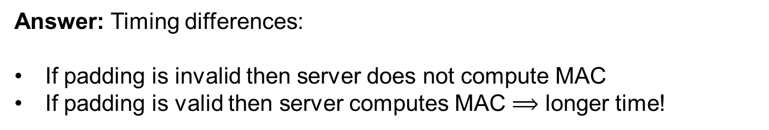

DTLS padding oracle attack
DTLS padding
Valid!
$${ C}_{0}$$
$${ C}_{1}$$
$${ C}_{2}$$
$${ C}_{3}$$
 |  |  |  |  |  |  | 01
 |  |  |  |  |  | 02 | 02
 |  |  |  |  | 03 | 03 | 03
But how do we get to act like ?
$$C=CBC\left(K, M || {MAC}_{K}\left(M\right) || pad\right)$$
Answer: Timing differences:
If padding is invalid then server does not compute MAC
If padding is valid then server computes MAC $⟹$ longer time!
Repeat attack to decrypt $C_{2},$ $C_{1}, …$

Slide 43
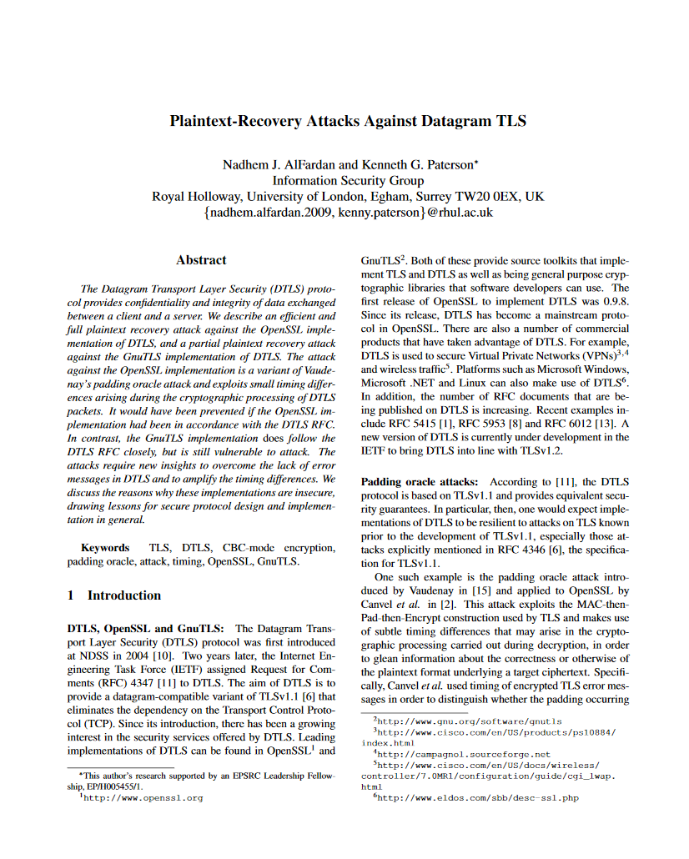
DTLS padding oracle attack
DTLS padding
Valid!
$${ C}_{0}$$
$${ C}_{1}$$
$${ C}_{2}$$
$${ C}_{3}$$
 |  |  |  |  |  |  | 01
 |  |  |  |  |  | 02 | 02
 |  |  |  |  | 03 | 03 | 03
But how do we get to act like ?
$$C=CBC\left(K, M || {MAC}_{K}\left(M\right) || pad\right)$$
Answer: Timing differences:
If padding is invalid then server does not compute MAC
If padding is valid then server computes MAC $⟹$ longer time!
Repeat attack to decrypt $C_{2},$ $C_{1}, …$

Slide 44
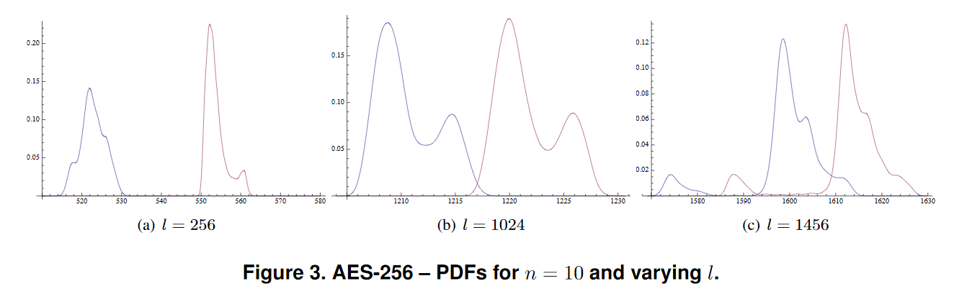
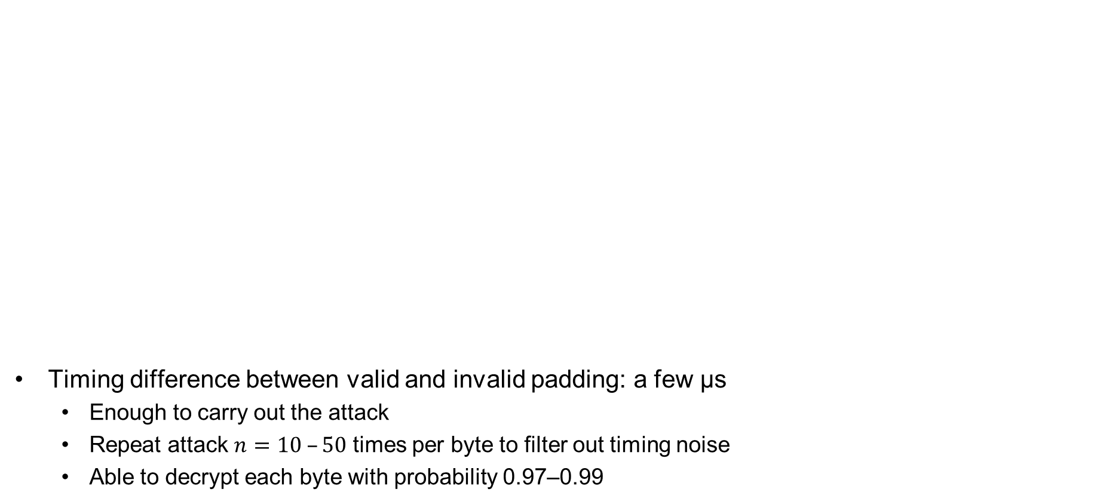
DTLS padding oracle attack
Timing difference between valid and invalid padding: a few μs
  Enough to carry out the attack
  Repeat attack $n=10 –50$ times per byte to filter out timing noise
  Able to decrypt each byte with probability 0.97–0.99
Valid padding
Invalid padding
Notes:
X-axis: RTT in us
Y-axis: probability of observing RTT for n = 10

Slide 45
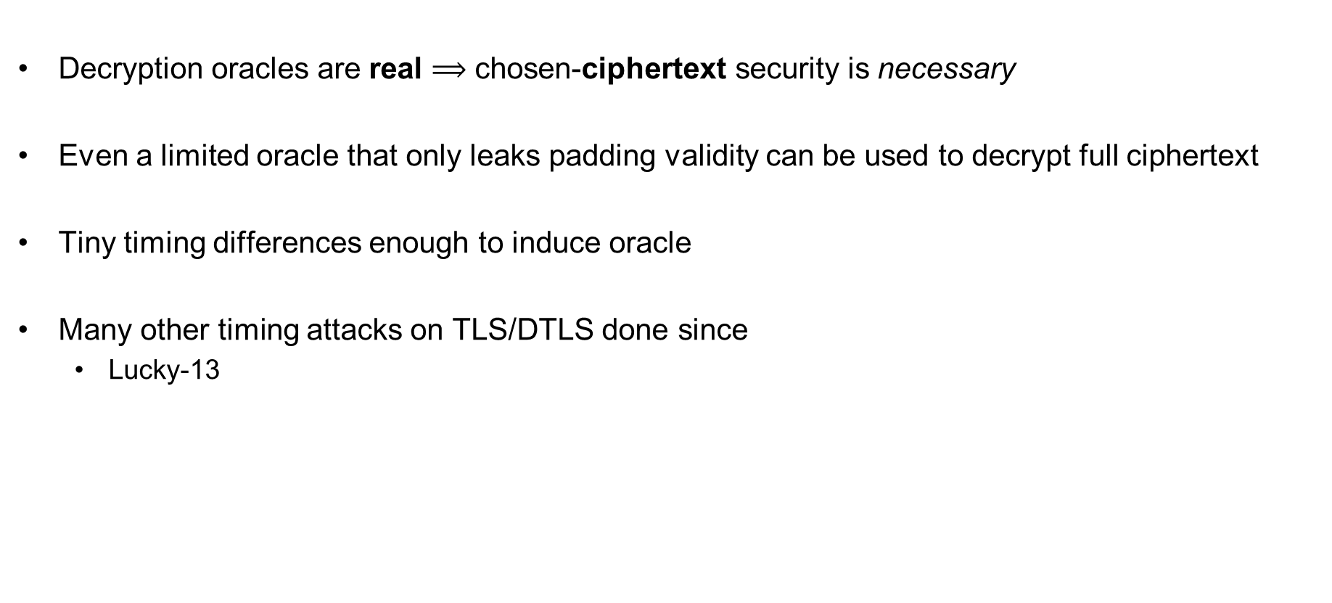
DTLS padding oracle attack – conclusions
Decryption oracles are real $⟹$ chosen-ciphertext security is necessary
Even a limited oracle that only leaks padding validity can be used to decrypt full ciphertext
Tiny timing differences enough to induce oracle
Many other timing attacks on TLS/DTLS done since
  Lucky-13

Slide 46
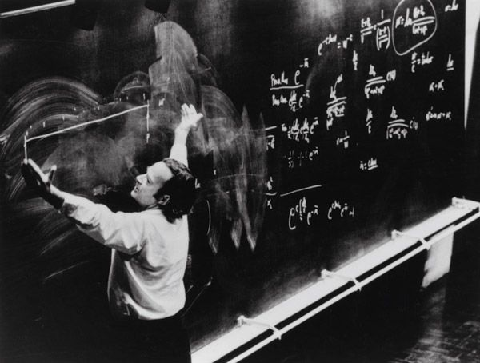
Authenticated encryption

Slide 47
Authenticated encryption
Want privacy and integrity from a single primitive:
an authenticated encryption scheme
Syntactically (almost) the same as a normal encryption scheme

Slide 48






Authenticated encryption – syntax
$$Enc :𝒦×ℳ→𝒞$$
$$Enc(K,M)={Enc}_{K}\left(M\right)=C$$
$$Dec :𝒦×𝒞→ℳ$$
$$∪\left\{⊥\right\}$$
$$Dec\left(K, C\right)=Dec_{K}\left(C\right)=M$$
$$/ ⊥$$

Slide 49
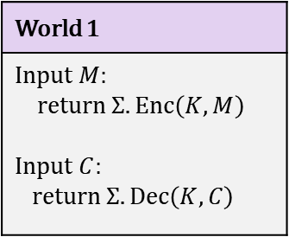
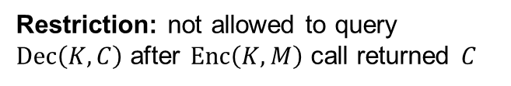
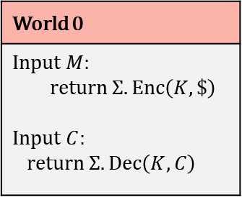

Authenticated encryption – security
World 1
Input $M$: return $Σ.Enc\left(K, M\right)$ Input $C$: return $Σ.Dec\left(K,C\right)$
World 0
Input $M$: return $Σ.Enc\left(K, \$\right)$ Input $C$: return $Σ.Dec\left(K,C\right)$
I’m in World $b′$
Restriction: not allowed to query $Dec\left(K,C\right)$ after $Enc\left(K,M\right)$ call returned $C$

Slide 50
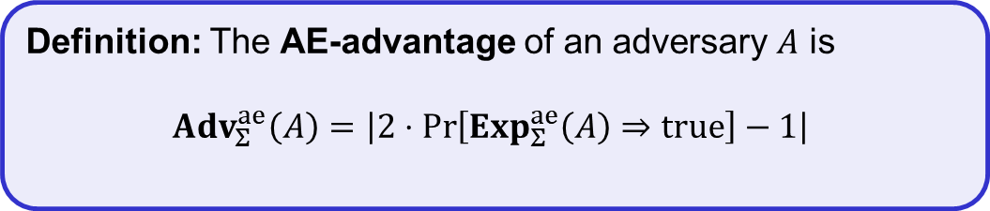
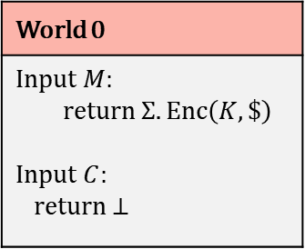
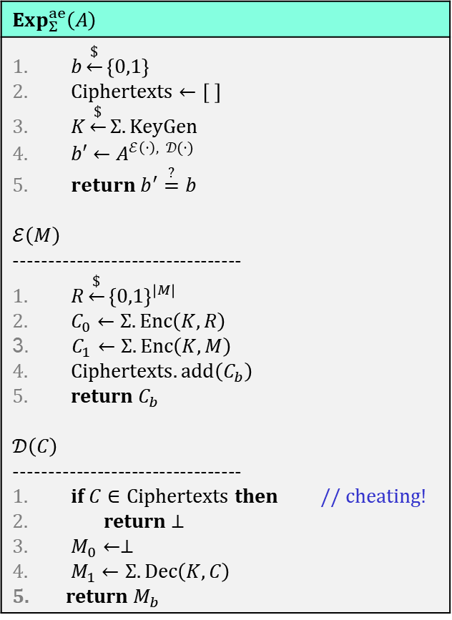
Authenticated encryption – security
$$Exp_{Σ}^{ae}\left(A\right)$$
$b\underset{←}{\$}\left\{0,1\right\}$ $Ciphertexts←\left[ \right]$ $K\underset{←}{\$}Σ.KeyGen$ $b′←A^{ℰ\left(⋅\right), 𝒟(⋅)}$ $return b^{′}\overset{?}{=}b$ $$ℰ\left(M\right)$$ --------------------------------- $R\underset{←}{\$}{\left\{0,1\right\}}^{\left|M\right| }$ $C_{0}←Σ.Enc\left(K, R\right)$ $C_{1}←Σ.Enc\left(K, M\right)$ $Ciphertexts.add\left(C_{b}\right)$ return $C_{b}$ $$𝒟\left(C\right)$$ --------------------------------- if $C∈Ciphertexts$ then // cheating! return $⊥$ $M_{0}←⊥$ $M_{1}←Σ.Dec\left(K, C\right)$ return $M_{b}$
World 1
Input $M$: return $Σ.Enc\left(K, M\right)$ Input $C$: return $Σ.Dec\left(K,C\right)$
World 0
Input $M$: return $Σ.Enc\left(K, \$\right)$ Input $C$: return $⊥$
I’m in World $b′$
Restriction: not allowed to query $Dec\left(K,C\right)$ after $Enc\left(K,M\right)$ call returned $C$
Definition: The AE-advantage of an adversary $A$ is
$${Adv}_{Σ}^{ae}\left(A\right)=\left|2⋅\operatorname{Pr}\left[Exp_{Σ}^{ae}\left(A\right)⇒true\right]−1\right|$$

Slide 51
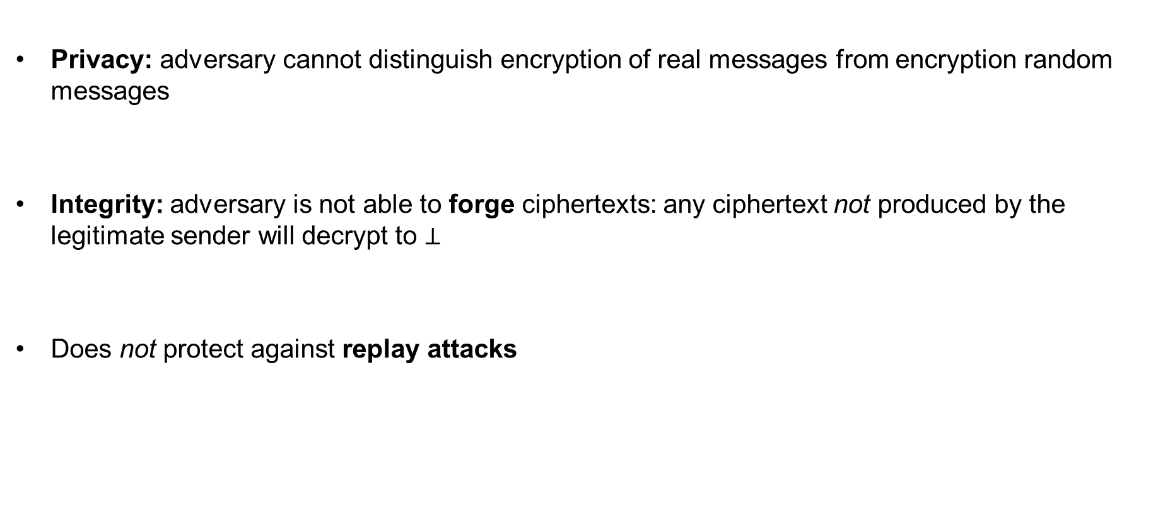
AE security definition – implications
Privacy: adversary cannot distinguish encryption of real messages from encryption random messages
Integrity: adversary is not able to forge ciphertexts: any ciphertext not produced by the legitimate sender will decrypt to $⊥$
Does not protect against replay attacks

Slide 52
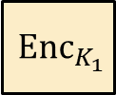
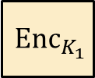









Generic composition: AE from Encryption + MAC
MAC-then-Encrypt (MtE)
Encrypt-and-MAC (E&M)
Encrypt-then-MAC (EtM)
$$M$$ | $${MAC}_{K_{2}}\left(M\right)$$
$$M$$
$$M$$
$${ Enc}_{K_{1}}$$
$${ Enc}_{K_{1}}$$
$${ Enc}_{K_{1}}$$
$$C$$
$$C$$
$${ MAC}_{K_{2}}\left(M\right)$$
$$C$$
$${MAC}_{K_{2}}\left(C\right)$$

Slide 53

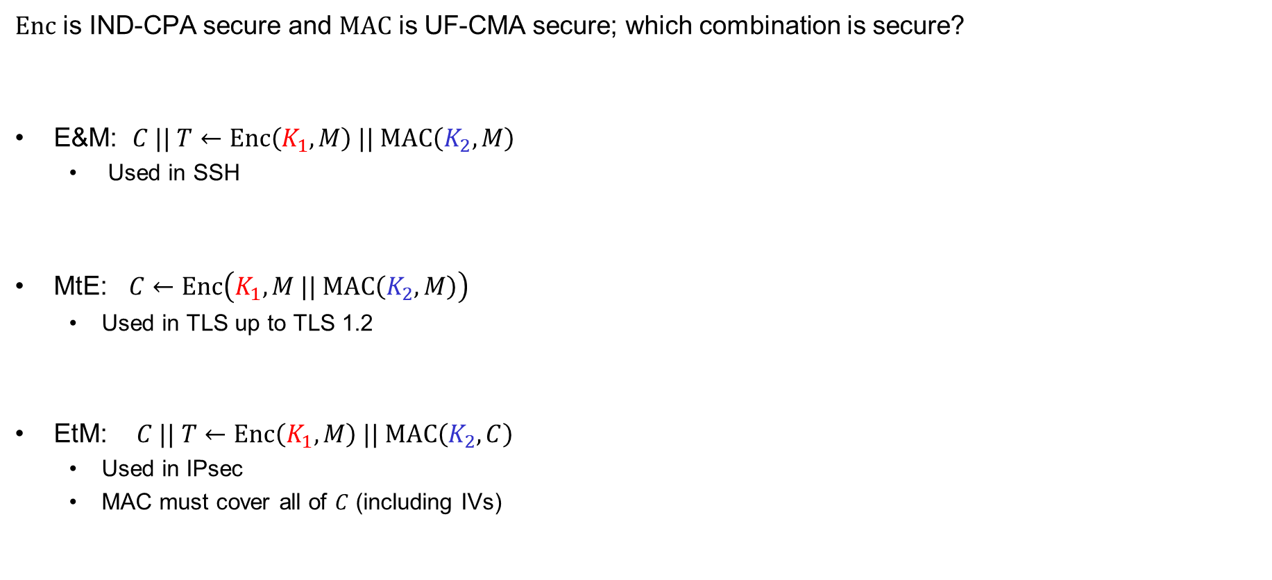



Generic composition: secure?
$Enc$ is IND-CPA secure and $MAC$ is UF-CMA secure; which combination is secure?
E&M: $C || T←Enc\left(K_{1}, M\right) || MAC\left(K_{2}, M\right)$
  Used in SSH
MtE: $C←Enc\left(K_{1}, M || MAC\left(K_{2}, M\right)\right)$
  Used in TLS up to TLS 1.2
EtM: $C || T←Enc\left(K_{1}, M\right) || MAC\left(K_{2}, C\right)$
  Used in IPsec
  MAC must cover all of $C$ (including IVs)
✗
$$Enc\left(K_{1}, M\right) || M || {MAC}^{′}\left(K_{2}, M\right)$$
$$MAC\left(K_{2}, M\right)$$
✗
$$0000 || Enc\left(K_{1}, M,MAC\left(K_{2}, M\right)\right)$$
$$C$$
✓

Slide 54


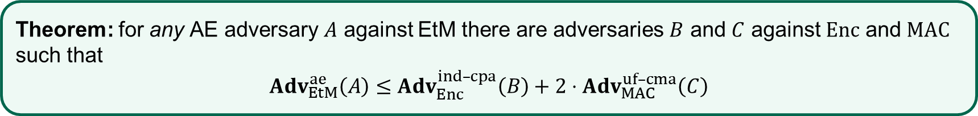
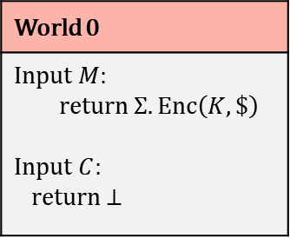
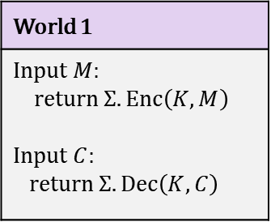
EtM – security
Theorem: for any AE adversary $A$ against EtM there are adversaries $B$ and $C$ against $Enc$ and $MAC$ such that
$Adv_{EtM}^{ae}\left(A\right)≤$ $Adv_{Enc}^{ind–cpa}\left(B\right)+2⋅Adv_{MAC}^{uf–cma}\left(C\right)$
Proof:
World 1
Input $M$: return $Σ.Enc\left(K, M\right)$ Input $C$: return $Σ.Dec\left(K,C\right)$
World 0
Input $M$: return $Σ.Enc\left(K, \$\right)$ Input $C$: return $⊥$
IND-CPA
$$≈$$
$$≈$$
UF-CMA

Slide 55
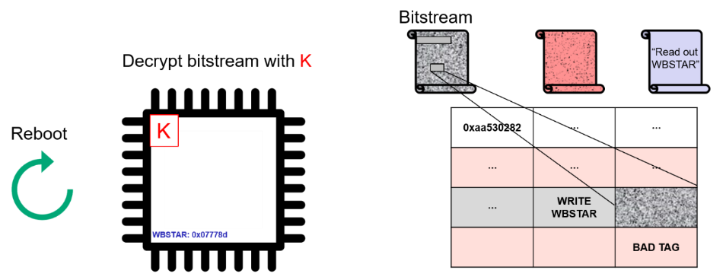
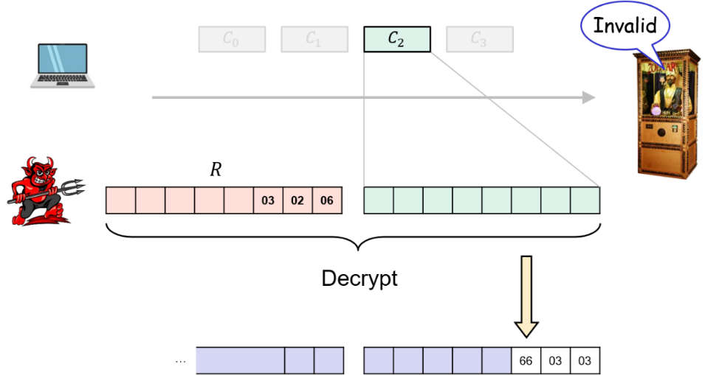
CCA-attacks – revisited
MtE used in both Starbleed attack
and in DTLS padding oracle attack
Gave rise to (partial) decryption oracles
Attacks would not have been possible
with an AE secure scheme

Slide 56


AEAD – Authenticated encryption with associated data

Slide 57
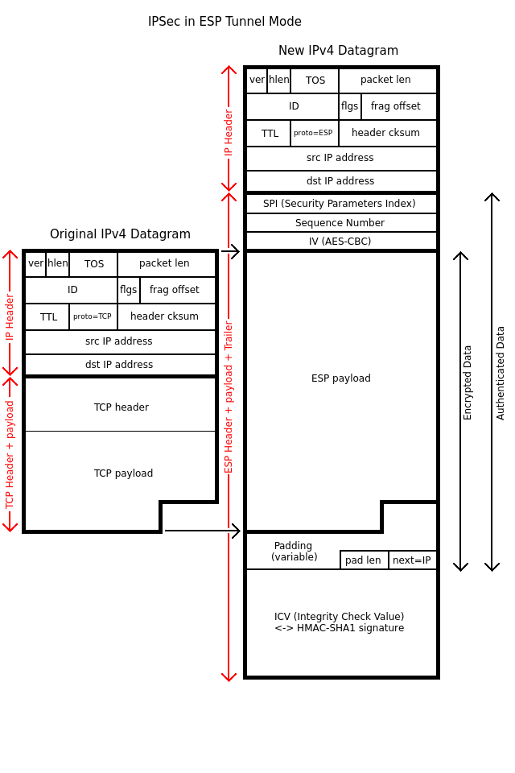


AEAD – AE with associated data (AD)
AD – data that can't be encrypted but still need integrity protection
  Headers in protocols
  Configuration data
  Metadata
Integrity protected
$$AD$$
$$M$$
Privacy protected
Notes:
Example: Filenames of (encrypted) files on disk

Slide 58









Authenticated encryption w/associated data (AEAD) – syntax
$$Enc :𝒦×ℳ→𝒞$$
$$Enc\left(K, M\right)=Enc_{K}\left(M\right)=C$$
$$Enc$$
$$\$$$
$$A$$
$$M$$
$$C$$
$$Dec :𝒦×𝒞→ℳ∪\left\{⊥\right\}$$
$$K$$
$$Dec\left(K, C\right)={Dec}_{K}\left(C\right)=M/⊥$$

Slide 59



Authenticated encryption w/associated data (AEAD) – syntax
$$Enc :𝒦×𝒜×ℳ→𝒞$$
$$Enc\left(K, A,M\right)=Enc_{K}\left(A,M\right)={Enc}_{K}^{A}\left(M\right)=C$$
$$N$$
$$Enc$$
$$\$$$
$$A$$
$$M$$
$$C$$
$$Dec :𝒦×𝒜×𝒞→ℳ∪\left\{⊥\right\}$$
$$K$$
$$Dec\left(K, A, C\right)={Dec}_{K}\left(A, C\right)={Dec}_{K}^{A}\left(C\right)=M/⊥$$

Slide 60
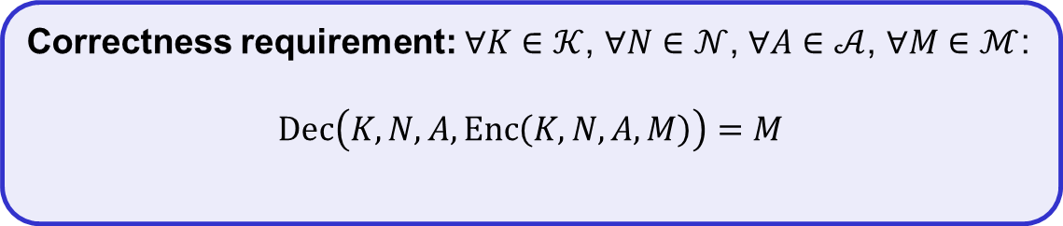

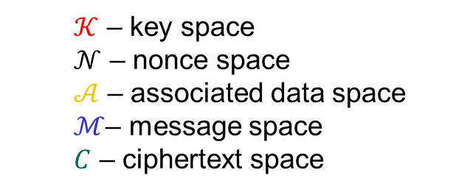
Authenticated encryption w/associated data (AEAD) – syntax
$$Enc :𝒦×𝒩×𝒜×ℳ→𝒞$$
$$Enc\left(K, N, A,M\right)={Enc}_{K}^{N}\left(A,M\right)={Enc}_{K}^{N,A}\left(M\right)=C$$
$$N$$
$$Enc$$
$$A$$
$$M$$
$$C$$
$$Dec :𝒦×𝒩×𝒜×𝒞→ℳ∪\left\{⊥\right\}$$
$$K$$
$$Dec\left(K, N, A,C\right)={Dec}_{K}^{N}\left(A, C\right)={Dec}_{K}^{N,A}\left(C\right)=M/⊥$$
  $𝒦$ – key space
  $𝒩$ – nonce space
  $𝒜$ – associated data space
  $ℳ$– message space
  $C$ – ciphertext space
Correctness requirement: $∀K∈𝒦$, $∀N∈𝒩$, $∀A∈𝒜$, $∀M∈ℳ$:
$$Dec\left(K, N, A, Enc\left(K, N, A, M\right)\right)=M$$

Slide 61
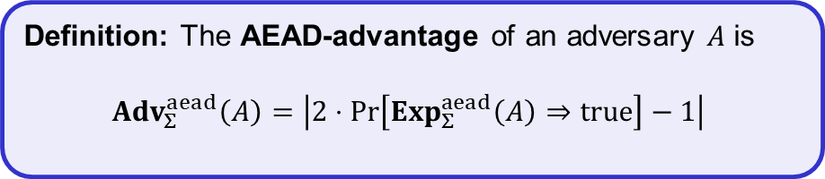
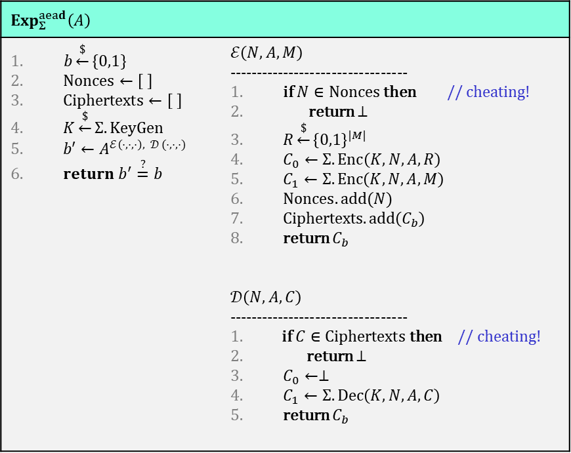
AEAD security (nonce-based)
$$Exp_{Σ}^{aead}\left(A\right)$$
$b\underset{←}{\$}\left\{0,1\right\}$ $Nonces←\left[ \right]$ $Ciphertexts←\left[ \right]$ $K\underset{←}{\$}Σ.KeyGen$ $b′←A^{ℰ\left(⋅,⋅,⋅\right), 𝒟 (⋅,⋅,⋅)}$ $return b^{′}\overset{?}{=}b$ | $$ℰ\left(N, A,M\right)$$ --------------------------------- if $N∈Nonces$ then // cheating! return $⊥$ $R\underset{←}{\$}{\left\{0,1\right\}}^{|M|}$ $C_{0}←Σ.Enc\left(K, N, A,R\right)$ $C_{1}←Σ.Enc\left(K, N, A,M\right)$ $Nonces.add(N)$ Ciphertexts$.add\left(C_{b}\right)$ return $C_{b}$ $$𝒟\left(N, A, C\right)$$ --------------------------------- if $C∈Ciphertexts$ then // cheating! return $⊥$ $C_{0}←⊥$ $C_{1}←Σ.Dec\left(K, N, A,C\right)$ return $C_{b}$
Definition: The AEAD-advantage of an adversary $A$ is
$${Adv}_{Σ}^{aead}\left(A\right)=\left|2⋅\operatorname{Pr}\left[Exp_{Σ}^{aead}\left(A\right)⇒true\right]−1\right|$$

Slide 62
Constructing AEAD schemes

Slide 63


























GCM – Galois/Counter Mode
ctr+1
ctr+2
ctr+3
$${ E}_{K}$$
$${ E}_{K}$$
$${ E}_{K}$$
$${ M}_{1}$$
$${ M}_{2}$$
$${ M}_{3}$$
$${ A}_{1}$$
$${ A}_{2}$$
$${ C}_{1}$$
$${ C}_{2}$$
$${ C}_{3}$$
$$\left|A\right|+\left|C\right|$$
$$⋇$$
$$⋇$$
$$⋇$$
$$⋇$$
$$⋇$$
$$⋇$$
$$H$$
$$H$$
$$H$$
$$H$$
$$H$$
$$H$$
$$S$$
$$T$$

Slide 64








GCM – Galois/Counter Mode
$N=96 bit nonce$
CTR-mode
ctr+1
ctr+2
ctr+3
$$ctr=N||0^{31}1$$
$${ E}_{K}$$
$${ E}_{K}$$
$${ E}_{K}$$
$${ M}_{1}$$
$${ M}_{2}$$
$${ M}_{3}$$
$${ A}_{1}$$
$${ A}_{2}$$
$${ C}_{1}$$
$${ C}_{2}$$
$${ C}_{3}$$
$$\left|A\right|+\left|C\right|$$
$$⋇$$
$$⋇$$
$$⋇$$
$$⋇$$
$$⋇$$
$$⋇$$
$$H$$
$$H$$
$$H$$
$$H$$
$$H$$
$$H$$
$$S$$
$$T$$

Slide 65













GCM – Galois/Counter Mode
$N=96 bit nonce$
ctr+1
ctr+2
ctr+3
$$ctr=N||0^{31}1$$
$H=E_{K}\left(0^{128}\right)$
$${ E}_{K}$$
$${ E}_{K}$$
$${ E}_{K}$$
$$S=E_{K}(N||0^{31}1)$$
$${ M}_{1}$$
$${ M}_{2}$$
$${ M}_{3}$$
GMAC
$${ A}_{1}$$
$${ A}_{2}$$
$${ C}_{1}$$
$${ C}_{2}$$
$${ C}_{3}$$
$$\left|A\right|+\left|C\right|$$
$$⋇$$
$$⋇$$
$$⋇$$
$$⋇$$
$$⋇$$
$$⋇$$
$$H$$
$$H$$
$$H$$
$$H$$
$$H$$
$$H$$
$$A_{1}H$$
$$A_{1}H^{2}+A_{2}H$$
$$A_{1}H^{3}+A_{2}H^{2}+C_{1}H$$
$$S$$
$$A_{1}H^{4}+A_{2}H^{3}+C_{1}H^{2}+C_{2}H$$
$$T$$
$$A_{1}H^{5}+A_{2}H^{4}+C_{1}H^{3}+C_{2}H^{2}+C_{3}H$$

Slide 66


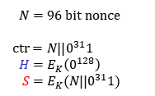
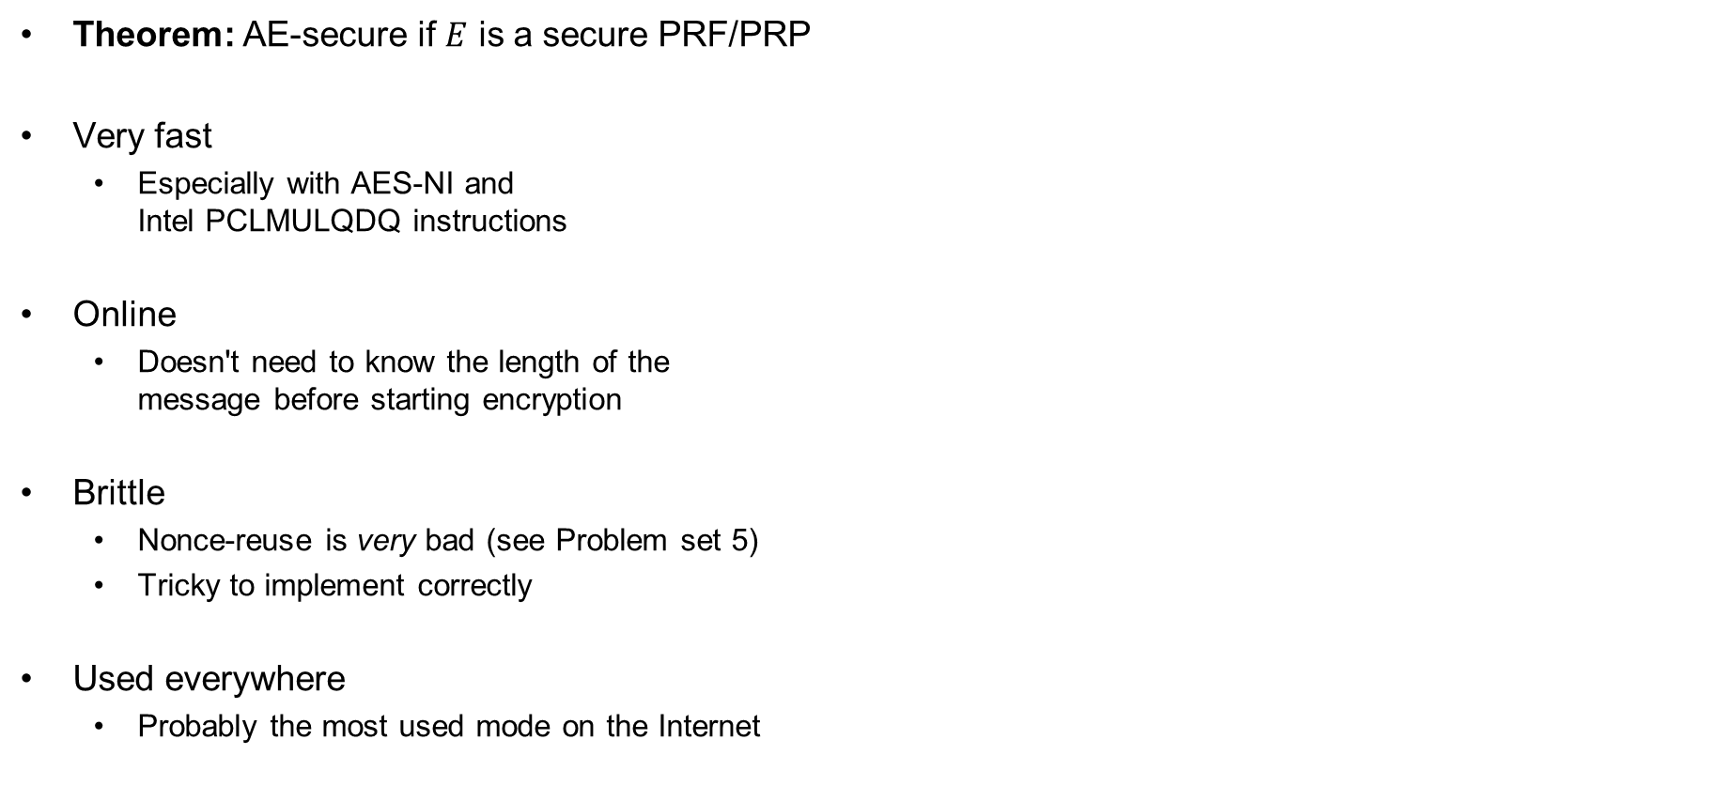


GCM – properties
Theorem: AE-secure if $E$ is a secure PRF/PRP
Very fast
  Especially with AES-NI and
  Intel PCLMULQDQ instructions
Online
  Doesn't need to know the length of the
  message before starting encryption
Brittle
  Nonce-reuse is very bad (see Problem set 5)
  Tricky to implement correctly
Used everywhere
  Probably the most used mode on the Internet
$N=96 bit nonce$
$$ctr=N||0^{31}1$$
$H=E_{K}\left(0^{128}\right)$
$$S=E_{K}(N||0^{31}1)$$
ctr+1
ctr+2
ctr+3
$${ E}_{K}$$
$${ E}_{K}$$
$${ E}_{K}$$
$${ M}_{1}$$
$${ M}_{2}$$
$${ M}_{3}$$
$${ A}_{1}$$
$${ A}_{2}$$
$${ C}_{1}$$
$${ C}_{2}$$
$${ C}_{3}$$
$$\left|A\right|+\left|C\right|$$
$$⋇$$
$$⋇$$
$$⋇$$
$$⋇$$
$$⋇$$
$$⋇$$
$$H$$
$$H$$
$$H$$
$$H$$
$$H$$
$$H$$
$$S$$
$$T$$

Slide 67

Ideal solution: secure channels
Internet
How to build?
Alice
Bob
M
Adversary
Security goals:
Data privacy: adversary should not be able to read message M ✓
Data integrity: adversary should not be able to modify message M ✓
Data authenticity: message M really originated from Alice ✓

Slide 68
Ideal solution: secure channels
AES-GCM?
Internet
Alice
Bob
M
Adversary
Security goals:
Data privacy: adversary should not be able to read message M ✓
Data integrity: adversary should not be able to modify message M ✓
Data authenticity: message M really originated from Alice ✓

Slide 69



AES-GCM = secure channel?
"Send Bob $10"
AES-GCM
AES-GCM
+10
AES-GCM
+10
AES-GCM
+10

Slide 70
Secure channels – TLS / IPsec
expected_counter
associated data
expected_counter
103
AES-GCM
if 103 == expected_counter:
AES-GCM.decrypt
expected_counter++
else
discard
if 231 == expected_counter:
AES-GCM.decrypt
expected_counter++
else
discard
231
AES-GCM
if 232 == expected_counter:
AES-GCM.decrypt
expected_counter++
else
discard
232
AES-GCM
if 233 == expected_counter:
AES-GCM.decrypt
expected_counter++
else
discard
233
AES-GCM
104
AES-GCM
if 104 == expected_counter:
AES-GCM.decrypt
expected_counter++
else
discard

Slide 71


























OCBv3 – Offset Codebook Mode
$${ A}_{1}$$
$${ A}_{2}$$
$${ M}_{1}$$
$${ M}_{2}$$
$${ M}_{3}$$
Checksum
$$Δ_{1}$$
$$Δ_{2}$$
$$Δ_{3}$$
$$Δ_{4}$$
$$Δ_{5}$$
$$Δ_{6}$$
$${ E}_{K}$$
$${ E}_{K}$$
$${ E}_{K}$$
$${ E}_{K}$$
$${ E}_{K}$$
$${ E}_{K}$$
$$Δ_{3}$$
$$Δ_{4}$$
$$Δ_{5}$$
Auth
Auth
$${ C}_{1}$$
$${ C}_{2}$$
$${ C}_{3}$$
$$T$$
$Δ_{i}$ - derived from 96-bit nonce $N$
Checksum $=M_{1}⊕M_{2}⊕M_{3}$

Slide 72


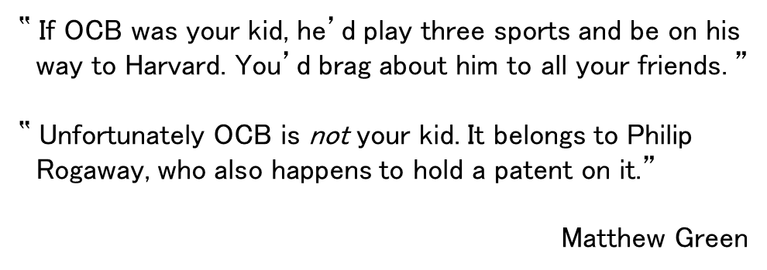

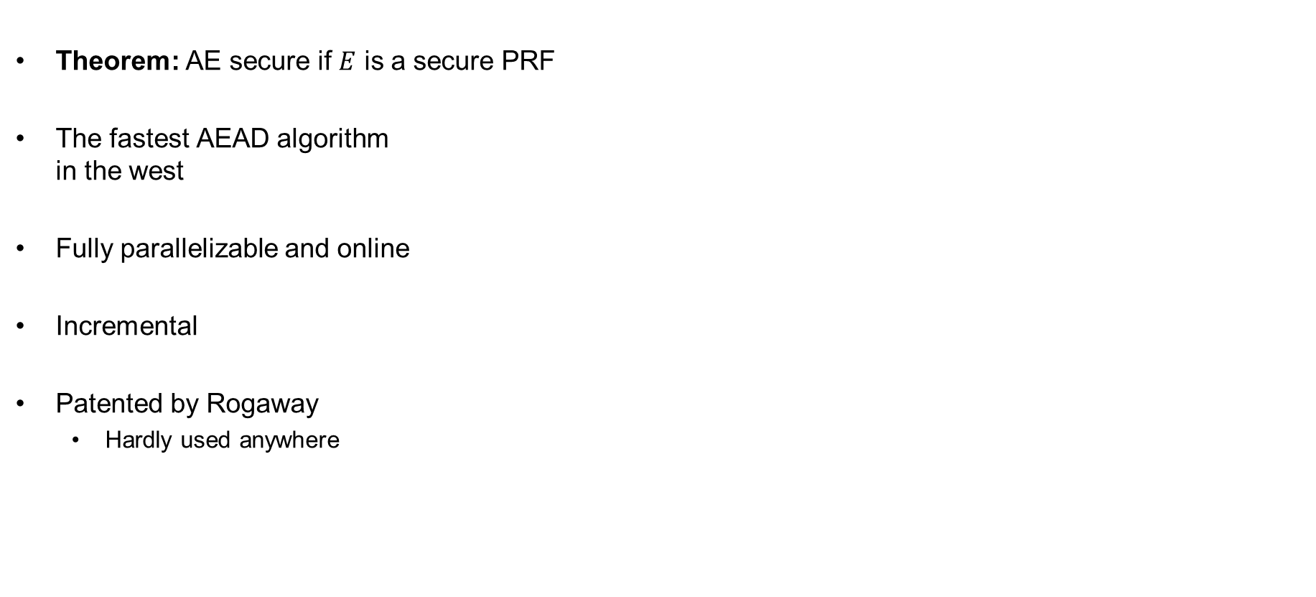



OCBv3 – properties
Theorem: AE secure if $E$ is a secure PRF
The fastest AEAD algorithm
in the west
Fully parallelizable and online
Incremental
Patented by Rogaway
  Hardly used anywhere
‟ If OCB was your kid, he’d play three sports and be on his
way to Harvard. You’d brag about him to all your friends. ”
‟ Unfortunately OCB is not your kid. It belongs to Philip
Rogaway, who also happens to hold a patent on it.”
Matthew Green
$${ A}_{1}$$
$${ A}_{2}$$
$${ M}_{1}$$
$${ M}_{2}$$
$${ M}_{3}$$
Checksum
$$Δ_{1}$$
$$Δ_{2}$$
$$Δ_{3}$$
$$Δ_{4}$$
$$Δ_{5}$$
$$Δ_{6}$$
$${ E}_{K}$$
$${ E}_{K}$$
$${ E}_{K}$$
$${ E}_{K}$$
$${ E}_{K}$$
$${ E}_{K}$$
$$Δ_{3}$$
$$Δ_{4}$$
$$Δ_{5}$$
Auth
Auth
$${ C}_{1}$$
$${ C}_{2}$$
$${ C}_{3}$$
$$T$$
$Δ_{i}$ - derived from 96-bit nonce $N$
Checksum $=M_{1}⊕M_{2}⊕M_{3}$

Slide 73






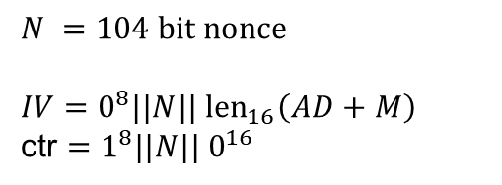








CCM – Counter Mode with CBC-MAC
$${ E}_{K}$$
$${ E}_{K}$$
$${ E}_{K}$$
$${ E}_{K}$$
$${ E}_{K}$$
$$T$$
$$IV$$
$${ A}_{1}$$
$${ M}_{1}$$
$${ M}_{2}$$
$${ M}_{3}$$
ctr+1
$${ E}_{K}$$
ctr+2
$${ E}_{K}$$
ctr+3
$${ E}_{K}$$
ctr
$${ E}_{K}$$
$${ C}_{1}$$
$${ C}_{2}$$
$${ C}_{3}$$
$${ C}_{T}$$
$$N =104 bit nonce$$
$$IV=0^{8}||N|| {len}_{16}\left(AD+M\right)$$
ctr $=1^{8}||N|| 0^{16}$

Slide 74







CCM – Counter Mode with CBC-MAC
$${ E}_{K}$$
$${ E}_{K}$$
$${ E}_{K}$$
$${ E}_{K}$$
$${ E}_{K}$$
$$T$$
CTR-mode
$$IV$$
$${ A}_{1}$$
$${ M}_{1}$$
$${ M}_{2}$$
$${ M}_{3}$$
ctr+1
$${ E}_{K}$$
ctr+2
$${ E}_{K}$$
ctr+3
$${ E}_{K}$$
ctr
$${ E}_{K}$$
$${ C}_{1}$$
$${ C}_{2}$$
$${ C}_{3}$$
$${ C}_{T}$$
$$N =104 bit nonce$$
$$IV=0^{8}||N|| {len}_{16}\left(AD+M\right)$$
ctr $=1^{8}||N|| 0^{16}$

Slide 75
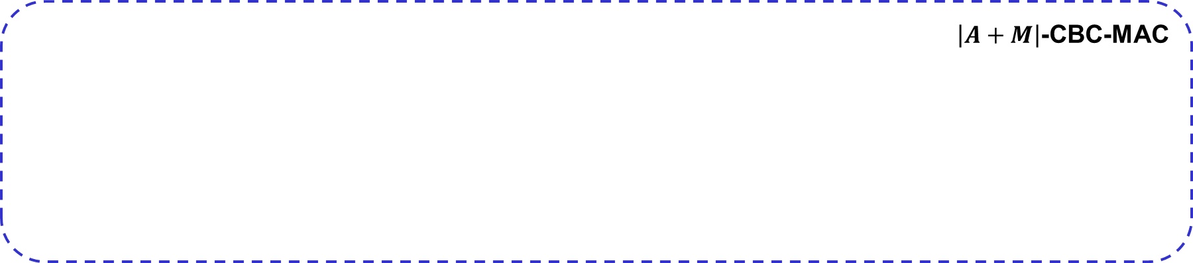

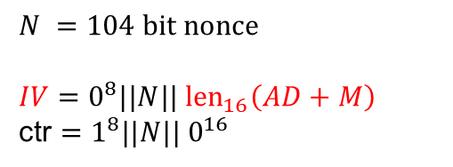




CCM – Counter Mode with CBC-MAC
$\left|A+M\right|$-CBC-MAC
$${ E}_{K}$$
$${ E}_{K}$$
$${ E}_{K}$$
$${ E}_{K}$$
$${ E}_{K}$$
$$T$$
$$IV$$
$${ A}_{1}$$
$${ M}_{1}$$
$${ M}_{2}$$
$${ M}_{3}$$
ctr+1
$${ E}_{K}$$
ctr+2
$${ E}_{K}$$
ctr+3
$${ E}_{K}$$
ctr
$${ E}_{K}$$
$${ C}_{1}$$
$${ C}_{2}$$
$${ C}_{3}$$
$${ C}_{T}$$
$$N =104 bit nonce$$
$$IV=0^{8}||N|| {len}_{16}\left(AD+M\right)$$
ctr $=1^{8}||N|| 0^{16}$

Slide 76
CCM – Counter Mode with CBC-MAC
≈ XCBC-MAC
$${ E}_{K}$$
$${ E}_{K}$$
$${ E}_{K}$$
$${ E}_{K}$$
$${ E}_{K}$$
$$T$$
$$IV$$
$${ A}_{1}$$
$${ M}_{1}$$
$${ M}_{2}$$
$${ M}_{3}$$
ctr+1
$${ E}_{K}$$
ctr+2
$${ E}_{K}$$
ctr+3
$${ E}_{K}$$
ctr
$${ E}_{K}$$
$${ C}_{1}$$
$${ C}_{2}$$
$${ C}_{3}$$
$${ C}_{T}$$
$$N =104 bit nonce$$
$$IV=0^{8}||N|| {len}_{16}\left(AD+M\right)$$
ctr $=1^{8}||N|| 0^{16}$

Slide 77


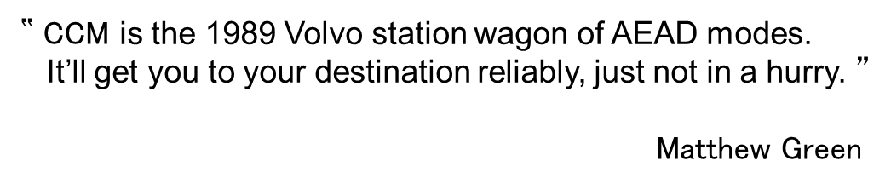



CCM – properties
Slow; needs 2 block cipher
calls per message block
Sequential; not online
Clunky message encoding
Royalty-free
  Designed specifically as an alternative
  to OCB for use in WiFi (WPA2)
Widely used
  Default encryption algorithm in WPA2
‟ CCM is the 1989 Volvo station wagon of AEAD modes.
It’ll get you to your destination reliably, just not in a hurry. ”
Matthew Green
$${ E}_{K}$$
$${ E}_{K}$$
$${ E}_{K}$$
$${ E}_{K}$$
$${ E}_{K}$$
$$T$$
$$IV$$
$${ A}_{1}$$
$${ M}_{1}$$
$${ M}_{2}$$
$${ M}_{3}$$
ctr+1
$${ E}_{K}$$
ctr+2
$${ E}_{K}$$
ctr+3
$${ E}_{K}$$
ctr
$${ E}_{K}$$
$${ C}_{1}$$
$${ C}_{2}$$
$${ C}_{3}$$
$${ C}_{T}$$
$$N =104 bit nonce$$
$$IV=0^{8}||N|| {len}_{16}\left(AD+M\right)$$
ctr $=1^{8}||N|| 0^{16}$

Slide 78
Summary
Authenticated encryption: privacy + intergrity in one primitive
AEAD: AE + associated data: data that gets integrity protection, but not privacy protection
(e.g. protocol headers)
AEAD examples:
  GCM
  CCM
  OCB
AEAD is not a secure channel!
  Does not provide replay protection
  Secure channels from AEAD: add counters/nonces/timers
Next week: hash functions

