Slide 1
Digital Platforms for Development: A Road to Justice?
Silvia Masiero
silvima@ifi.uio.no
IN5390 – ICT for Development: Building a Better World?
30.09.2022

Slide 2
Overview
Digital platforms: core components and a typology
The theoretical link: digital platforms for development
Guest lecture!

Slide 3
After this lecture, you can…
Define digital platforms, distinguishing between transaction and innovation platforms and recognising the properties of each
Explain the theoretical foundations of the «digital platforms for development» orthodoxy, applying them to examine cases of digital platforms built for social purposes beyond the commercial domain
Problematise the «digital platforms for development» orthodoxy, by theoretical and empirical insights on the detrimental outcomes produced by the adoption of digital platforms in relation to development.

Slide 4
Digital Platforms for Development

Slide 5
Digital Platforms for Development
Digital platforms: “the extensible codebase of a software-based system shared by apps that interoperate with it, and the interfaces through which they interoperate” (Tiwana, 2013)
Etymologically, from plat-forme – a foundation on which to build
Occupy a central position in today’s world economy!

Slide 6
Digital Platforms: A Typology
From Bonina et al. (2021):
Transaction platforms: matchers of supply and demand for a product or service, where the value for users increases with the number of users in a user group
Innovation platforms: “technological building blocks” for the development of complements from third parties. They enable the creation of applications and services based on combining and recombining functionality sourced from a platform core.

Slide 7
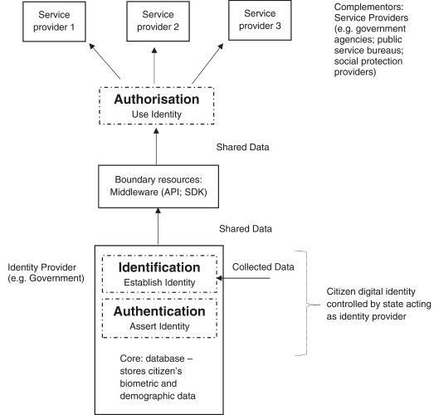
Digital Platforms: Components
Digital ID platforms:
Core – database where user data are stored
Boundary resources – enablers of the construction of third-party complements
Complementors - service providers: governments agencies, public service offices; social protection agencies

Slide 8
Digital platforms for development: The orthodoxy
Are digital platforms «good» for development?
Transaction platforms: yes, because they generate employment and, enabling the matching between supply and demand, they facilitate transactions that benefit the whole economy
Innovation platforms: yes, because they enable the construction of apps and services that can be tailored to the particular needs of countries and communities within them. This enables local implementers to emancipate from dependency of technologies produced elsewhere.

Slide 9
…is it really so?

Slide 10
Guest lecture!

Slide 11
Thank you!
silvima@ifi.uio.no

Slide 12
Readings
Core Reading
Bonina, C., Koskinen, K., Eaton, B., & Gawer, A. (2021). Digital platforms for development: Foundations and research agenda. Information Systems Journal, 31(6), 869-902.
Madon, S., & Schoemaker, E. (2021). Digital identity as a platform for improving refugee management. Information Systems Journal, 31(6), 929-953.
Supplementary Reading
Madon, S., Ranjini, C. R., & Anantha Krishnan, R. K. (2022). Aadhaar and social assistance programming: local bureaucracies as critical intermediary. Information Technology for Development, 1-16.
Weitzberg, K., Cheesman, M., Martin, A., & Schoemaker, E. (2021). Between surveillance and recognition: Rethinking digital identity in aid. Big Data & Society, 8(1), 1-6.

