Slide 1
A better world with ICTs: Theoretical perspectives
Silvia Masiero
silvima@ifi.uio.no
IN5390 – ICT for Development: Building a Better World?
22.09.2022

Slide 2
Overview
What is a «better» world?
A multidimensional perspective on «development»
Theories of ICT4D: three critical discourses

Slide 3
After this lecture, you can…
Compare and contrast perspectives on the notion of a «better» world centred on economic growth and human development
Use Sen’s (2001) capabilities approach to articulate different dimensions of «development», discussing different ways in which ICTs can participate in their achievement
Theorise the role of ICTs in development according to three discourses – technology transfer, social embeddedness, and transformative intervention – theorised by Avgerou (2008), explaining the tenets of each discourse.

Slide 4
What is a «better» world?

Slide 5
On economic growth…
Modernisation theory (1950s-1960s): modernisation defined as a linear path towards a developed industrial society.
Underpinned by the idea of development as growth, to be achieved through the industrial transformation of the so-called “developing” countries.
Core tenet: traditional societies can only develop through the adoption of more modern industrial practices, boosting economic growth and, on the basis of that, progress and prosperity.
Achieving modernisation implies a process of Westernisation, where the so-called “developing countries” follow into the industrialising path previously adopted by Western nations.

Slide 6
On economic growth…
Some problematisations of modernisation theory:
Dependency theory (1970s-1980s) – highlights the relations of dependency that modernisation has created, generating systematic capitalistic exploitation of countries at the global periphery
New forms of dependency (Wade, 2002): rather than breaking them, digital technologies crystallise existing forms of dependency of poor countries on rich ones, strengthening dependency instead of challenging it
Rather than liberating historically marginalised countries from oppression, efforts to bridge the “digital divide” may lock developing countries into a new form of dependency on the West.

Slide 7
On economic growth…
Some problematisations of modernisation theory:
Data colonialism (Couldry & Mejias, 2019): processes of datafication (the conversion of existing processes into data) are instrumental to the exploitation of people at the global periphery.
Couldry and Mejias (2019) theorise the advent of a new form of colonialism: just as historic colonialism appropriated territory and resources for profit, data colonialism appropriates data of people for capitalistic exploitation
Data colonialism relies on the stream of data that people produce largely involuntarily, e.g. from mobile devices, and that are appropriated by the private sector in the name of “development” (Taylor & Broeders, 2015).

Slide 8
The digital divide
Digital divide: “the gap between demographics and regions that have access to modern information and communications technology (ICT), and those that don't or have restricted access.”
Defined in terms of different technologies over time: initially telephone, television, personal computers and internet connectivity; now inclusion in different digital systems (e.g. identification; civil registration…)
Early ICT4D research: centred on combating the digital divide, directly linking ICT access with the opportunity for economic prosperity.

Slide 9
Is it all about growth?

Slide 10
On human development…
Amartya Sen (2001): challenges the growth-centred notion of development with a notion of human development, centred on freedom.
Development can be seen as a process of expanding the real freedoms that people enjoy. […] Focusing particularly on people’s capability to choose the lives they have reason to value (Sen, 2001).
Freedom has both intrinsic and instrumental value!

Slide 11
Amartya Sen: The Capabilities Approach
An approach based on two key concepts: “functionings” and “capabilities”
“A functioning is an achievement, whereas a capability is the ability to achieve. Functionings are, in a sense, more directly related to living conditions, since they are different aspects of living conditions.”
Capabilities, in contrast, are notions of freedom, in the positive sense: what real opportunities you have regarding the life you may lead.

Slide 12
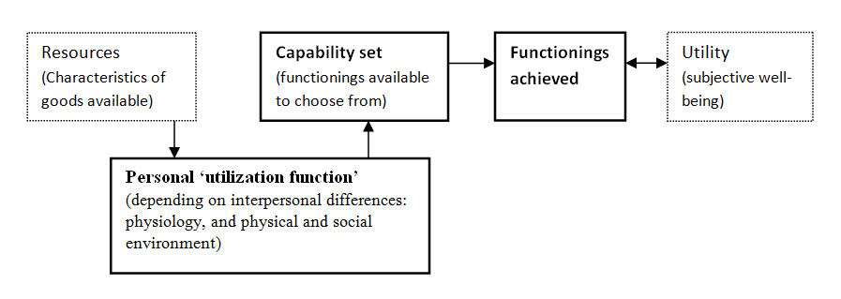
Amartya Sen: The Capabilities Approach
Outline of the core relationships in the Capabilities Approach

Slide 13
Amartya Sen: The Capabilities Approach
Human Development Index (UNDP, 1992): human development as a composite measure, transcending the parameters of economic growth
Three key parameters, calculated on countries:
Health – life expectancy (years)
Education – expected years of schooling (years) / mean years of schooling (years)
Income – gross national income per capita (PPP $)
Translates into action the multidimensional idea of development proposed by Sen’s capabilities approach.

Slide 14
So…
What is a “better” world if, with Sen (2001), we conceptualise “development” as the ability to achieve the freedoms that human beings value?
A growth-centred perspective (a “better” world as one where economic growth and prosperity are achieved) challenged by a human development perspective, where a “better” world sees improvement in key human dimensions such as health, education and income.
Not an exhaustive list of dimensions of development – but the HDI seeks to capture the main ones!

Slide 15
Questions?

Slide 16
Critical discourses in ICT4D!
Just as different perspectives exist on what a «better» world is, different views exist on how ICTs should be involved in building it.
How should ICTs participate in the construction of a better world?

Slide 17
Critical discourses in ICT4D!
Avgerou (2008): three discourses (i.e. sets of assumptions) on the interconnection of ICTs and development
Starting point: ICT4D studies often take an implicit perspective, on whose basis they draw conclusions on the role that ICTs play, and/or should be playing, in a socioeconomically disadvantaged context.
Three discourses centred on: technology and knowledge transfer; socially embedded action, and transformative intervention.

Slide 18
Critical discourses in ICT4D!
Technology and knowledge transfer
Core assumption: ICT innovation in developing countries is mainly concerned with catching up with the advanced rich economies.
This catching-up process occurs through transferring technologies and knowledge from industrially advanced countries, imitating their institutions.
Theories of technology diffusion and acceptance: studies of how, and how fast, a Western technology diffuses in a “developing country” setting
Underlying assumption: development happens through technology and knowledge transfer, in a modernisation theory logic
Studies tend to take the point of view of the “moderniser”, meaning the country or organisation that initiates and fosters technology diffusion.

Slide 19
Critical discourses in ICT4D!
Socially embedded action
Technological innovation is not transferred, but socially constructed and reinterpreted by local communities.
Innovation is studied as a locally constituted process of technology construction and organizational change.
Its purpose arises from local problematisations; its course is determined by the way local actors make sense of it and accommodate it in their lives
For example: HISP research, where a platform (DHIS2) is embedded in the local context of the over 70 countries that adopt it
“Development” stems from innovation that, generated by the communities that it is for, is capable of meeting local community needs.

Slide 20
Critical discourses in ICT4D!
Transformative intervention
Increasingly important in the ICT4D landscape!
ICT innovation is associated with processes of change of the social, economic, and political conditions in developing countries
By doing so, ICT innovation directly addresses the development struggle, challenging institutions that prevent core dimensions of development from being achieved.
Unlike the socially embedded discourse, the transformative intervention discourse is explicitly concerned with the way ICT is implicated in the dynamics of social, economic and political change.

Slide 21
But…
Adverse digital incorporation:
Transformation is not necessarily for the «good» of society!

Slide 22
As you read ICT4D literature…
…it can be helpful to try and identify which perspective is taken by the authors in the papers you read!
Are the authors (implicitly) taking a perspective centred on technology transfer, or one more oriented to socially embedded change or transformative intervention?
Different perspectives generate different standpoints on what constitutes valid knowledge in ICT4D.

Slide 23
So…
In this lecture we have examined different approaches to what is meant by «better», centered respectively on economic growth and multi-dimensional human development.
We have then conceptualised the relation between ICTs an development according to three discourses (sets of assumptions): technological transfer, social embeddedness and transformative intervention, examining the tenets of each perspective.
This equips us to study present-day topics of ICT4D research, answering the question on what it takes to make a better world with ICTs!

Slide 24
Thank you!
silvima@ifi.uio.no

Slide 25
Readings
Core Readings
Avgerou, C. (2008). Information systems in developing countries: a critical research review. Journal of information Technology, 23(3), 133-146.
Zheng, Y., & Walsham, G. (2008). Inequality of what? Social exclusion in the e‐society as capability deprivation. Information Technology & People, 21(3), 222-243.
Supplementary Readings
Couldry, N., & Mejias, U. A. (2019). Data colonialism: Rethinking big data’s relation to the contemporary subject. Television & New Media, 20(4), 336-349.
Wade, R. H. (2002). Bridging the digital divide: new route to development or new form of dependency. Global Governance, 8, 443-466.

