Slide 1
Digital Technologies and Global Health: Building a healthier world, but for whom and where?
Tony Sandset, PhD, Center for Sustainable Healthcare Education (SHE), Faculty of Medicine, University of Oslo

Slide 2
Introduction
Me: research on HIV/AIDS prevention; research on the politics and policies of HIV and other infectious diseases; focus on the intersections of ethnicity, class, gender and sexuality in health; research on ‘epidemic endings’ and what that means
Of relevance to ICT4D: Just finished a multi-national research collaboration over 3 years on digital health rights in Vietnam, Kenya, Ghana, Bangladesh and Colombia
Health equity and structural determinants of health; structural violence and power in global health

Slide 3
Free assocation: What is global health to you?

Slide 4
First of all: What is Global Health?
Didier Fassin: ‘In what sense is global health ‘global’? What does ‘health’ mean in global health?
Global health often focuses on: responding to global (health) threats – HIV/AIDS, pandemics, and natural disasters
Often mixed in with sentiments of solidarity and a focus on inequality – such as governing in the name of humanity (humanitarian crisis, etc.)

Slide 5
What is global about global health?
However, global often also denotes two other associations:
Geographical (the planet) and ideological (superiority)
Global health has ushered in different ways in which the global north acts in the global south in the name of ‘global health’
From ‘tropical medicine’ (colonial medicine) to ‘international health’ and now ‘global health’ – global north actors have a long history of intervening in the name of global health
The Rockefeller Foundation, the Bill and Belinda Gates Foundation, PEPFAR, NORAD, etc.
Global here often means: from the global north to global south – power asymmetry
Often associated with ‘development’ programs as well

Slide 6
What does health mean in global health?
Health in global health is often times relegated to the health of people in the global south
Focus on some areas while neglecting others: maternal and infant health; major infectious diseases (HIV, TB, and malaria)
Neglecting: non-communicable diseases (NCDs); ‘neglected tropical diseases’ such as dengue; ‘lifestyle diseases’ and mental health
Also: often translated to focus on ‘life expectancies’ rather than quality of life and wellbeing – often about optimizing life expectancies and less about reducing suffering – maximizing how long people live as a success criteria yet less about optimizing quality of life and wellbeing

Slide 7
The Role of Digital Technologies in Global Health
Digital technology as a “new” tool in global health – ‘building a better and healthier world’?
How can digital technology build a better and healthier world? Examples from you!
Can you think about some digital technologies within global health?
How do they make the world better? How do they make the world healthier?

Slide 8
Some key points of ICT in global health
Improving public health and healthcare institutions e.g. relating to hospital procedures, electronic health records (EHR) and health information.
Supporting clinicians: Improving surgical procedures/operations or advice, including remote tele-surgery. The use of digital health technologies is enabling a range of remote or satellite health clinics to use and apply these technologies for remote diagnosis and telemedicine.
Personal health and dedicated devices (sensors, monitors, wristwatches and mobiles) for monitoring and feedback purposes.
Enabling improved and more accurate analysis and prediction of health datasets, including through AI, big data or simulations

Slide 9
Flipside of this: Surveillance, personal responsibility, and ‘digital health literacy’
Can lead to increase surveillance – often ICT used for ‘early detection’; epidemiological surveillance
Case in point: wastewater analysis of COVID but also drug use; COVID tracking apps; molecular HIV surveillance; AMR surveillance; and now digital phenotyping
Rather than fixing structural issues such as poverty and gender discrimination ICT often gloss over such issues – ‘magic bullet’ solutions to complex social issues
Wearable devices: ‘remote clinics’ = more and more outsourcing of health - responsibility transferred over to the patient for monitoring own health
The privatization of welfare – ICT is often filled with private companies – selling services to states and private persons this might ‘outsource the welfare state’ and healthcare to private companies

Slide 10
ICT for Health: Power and Pathologies
Not always about building a healthier world, but often more about building a more secure world – surveillance and often of the global south so that health threats do not reach the global north
Case in point: AMR surveillance in the global south – not only done in the name of ‘saving’ or protecting people in the global south
Surveillance of zoonotic diseases – especially with ‘pandemic potential’ – sentinel surveillance of animals and then stop threat in the global south before it reaches global north
Health data colonialism and data extraction from the south to the north – not only about making the world healthier but indeed about making money

Slide 11
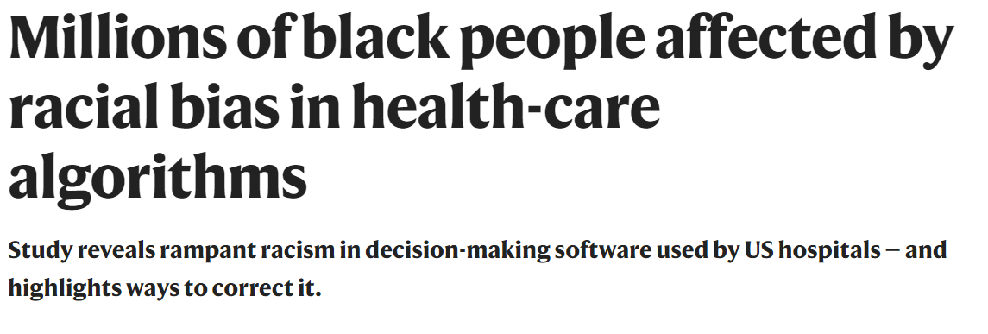
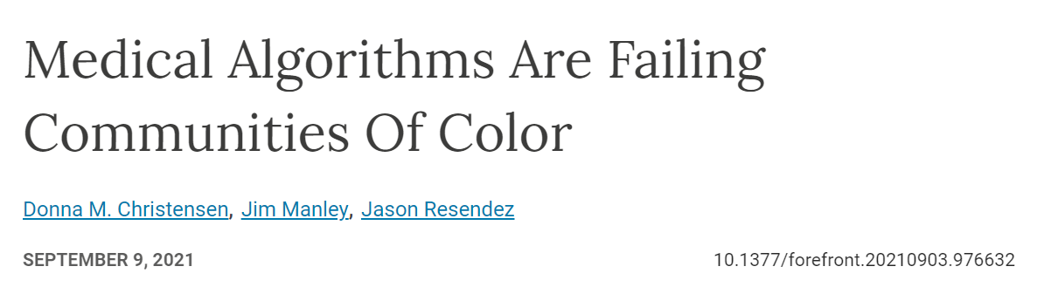
The hype of AI and racial bias

Slide 12
Racial Bias and AI
Health systems rely on commercial prediction algorithms to identify and help patients with complex health needs.
Science on 24 October, concluded that the algorithm was less likely to refer black people than white people who were equally sick to programmes that aim to improve care for patients with complex medical needs.
find that people who self-identified as black were generally assigned lower risk scores than equally sick white people. As a result, the black people were less likely to be referred to the programmes that provide more-personalized care.

Slide 13
Racial Bias and AI
researchers found that the algorithm assigned risk scores to patients on the basis of total health-care costs accrued in one year. They say that this assumption might have seemed reasonable because higher health-care costs are generally associated with greater health needs.
But a closer look at the data revealed that the average black person was also substantially sicker than the average white person, with a greater prevalence of conditions such as diabetes, anaemia, kidney failure and high blood pressure.
its results: black people had to be sicker than white people before being referred for additional help. Only 17.7% of patients that the algorithm assigned to receive extra care were black. The researchers calculate that the proportion would be 46.5% if the algorithm were unbiased.

Slide 14
Digital technology – visibility
Digital tech often framed as providing better visibility in terms of a health problem: granular data on new HIV infections; HIV treatment and HIV viral load suppression – viral load mapping and molecular HIV surveillance
Visibility and surveillance of health issues: used for early detection of outbreaks; surveillance of health trends and for modeling and forecasting diseases
Better data is often claimed to be able to solve global health issues: granular data as solution

Slide 15
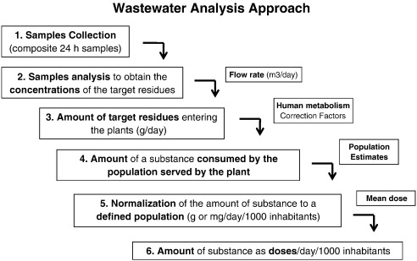
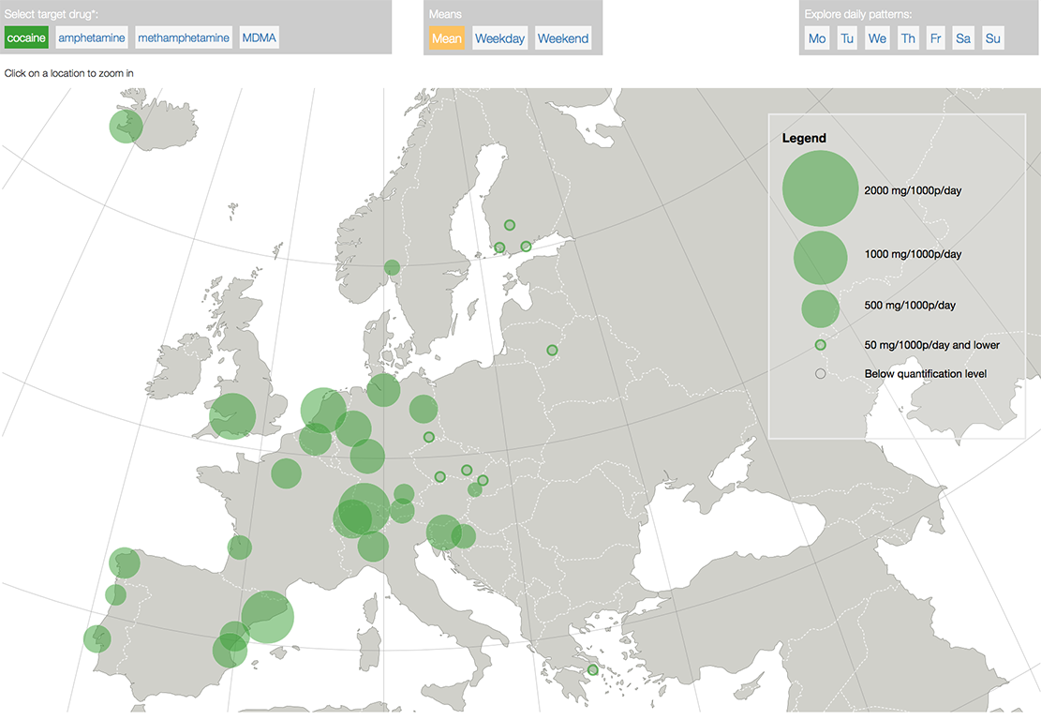
Case: Wastewater analysis of drug use

Slide 16
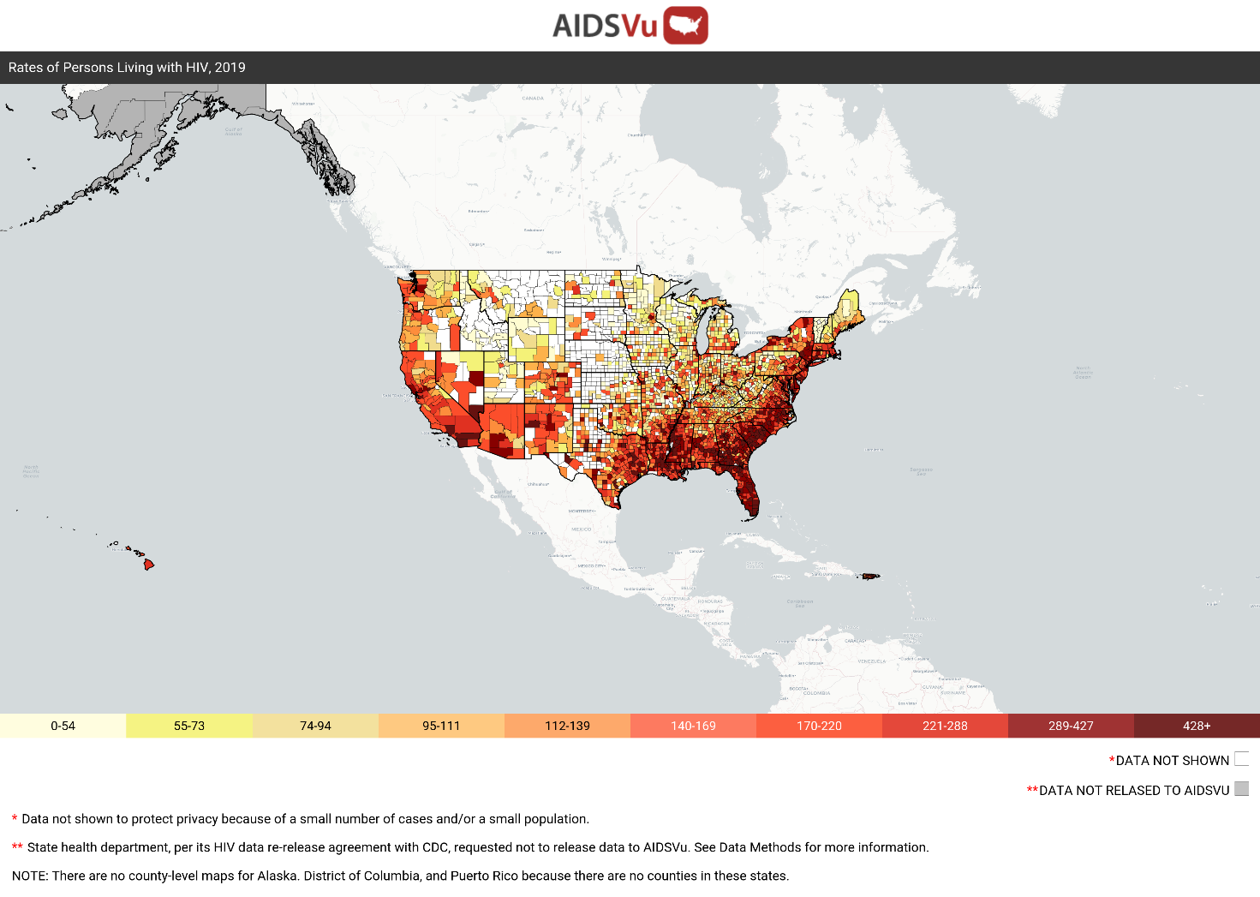
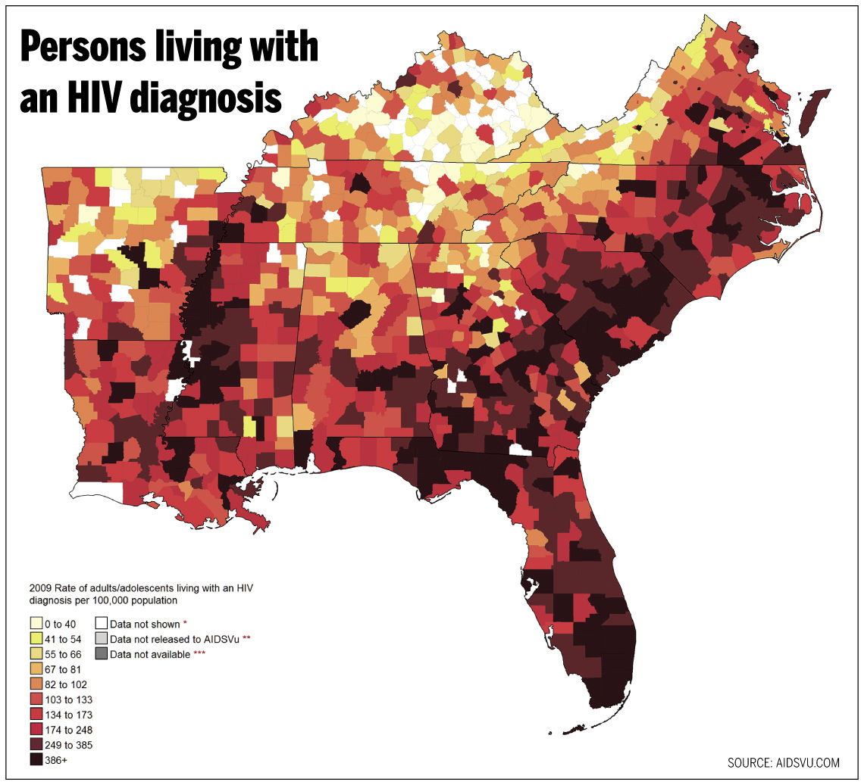
Viral load maps – example from AIDSVu

Slide 17
Molecular HIV Surveillance – case study of digital technology and visibility
What is the science & how does it work?
Takes place in care setting during routine resistance testing, currently in high-income countries
Genotyping = (1) the viral subtype, (2) the presence of drug resistant variations, and (3) phylogenetic analysis to examine how viral sequences are related
Done without patient consent
Phylogenetic analysis is used to identify “clusters”
Increasing calls for practice to aim to prove directionality

Slide 18
3 Examples: Where and how is it being deployed?
British Columbia, Canada
King County, Washington, USA
Los Angeles, USA
But also in certain research projects in South Africa and in Europe

Slide 19
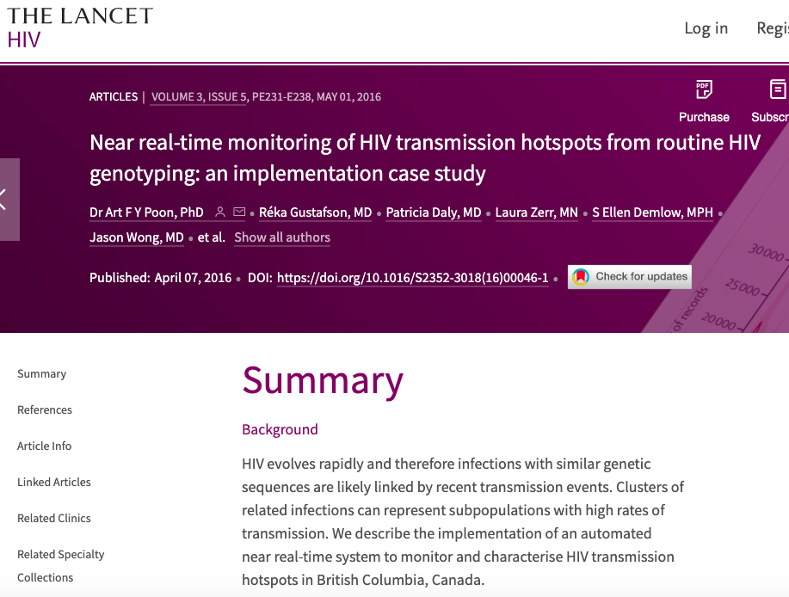

Slide 20
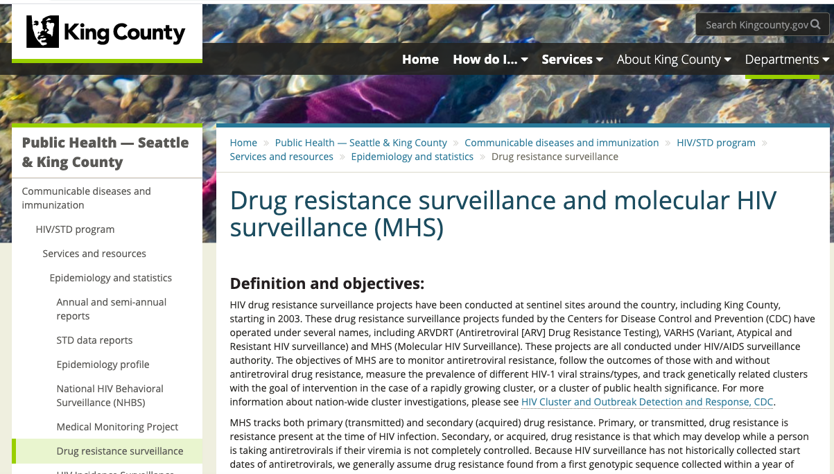

Slide 21
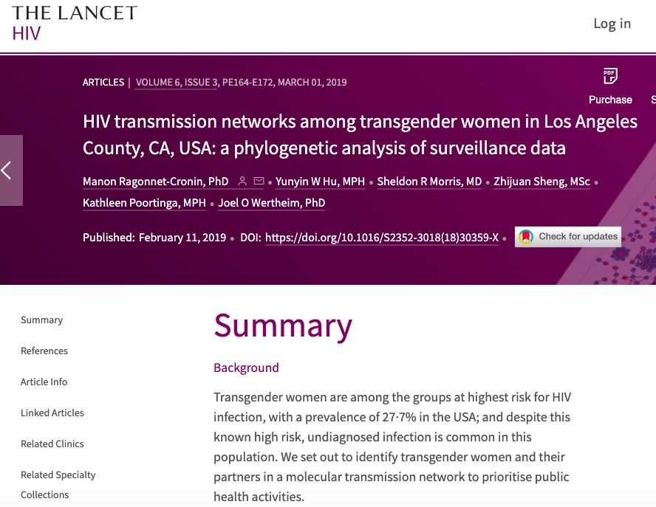

Slide 22
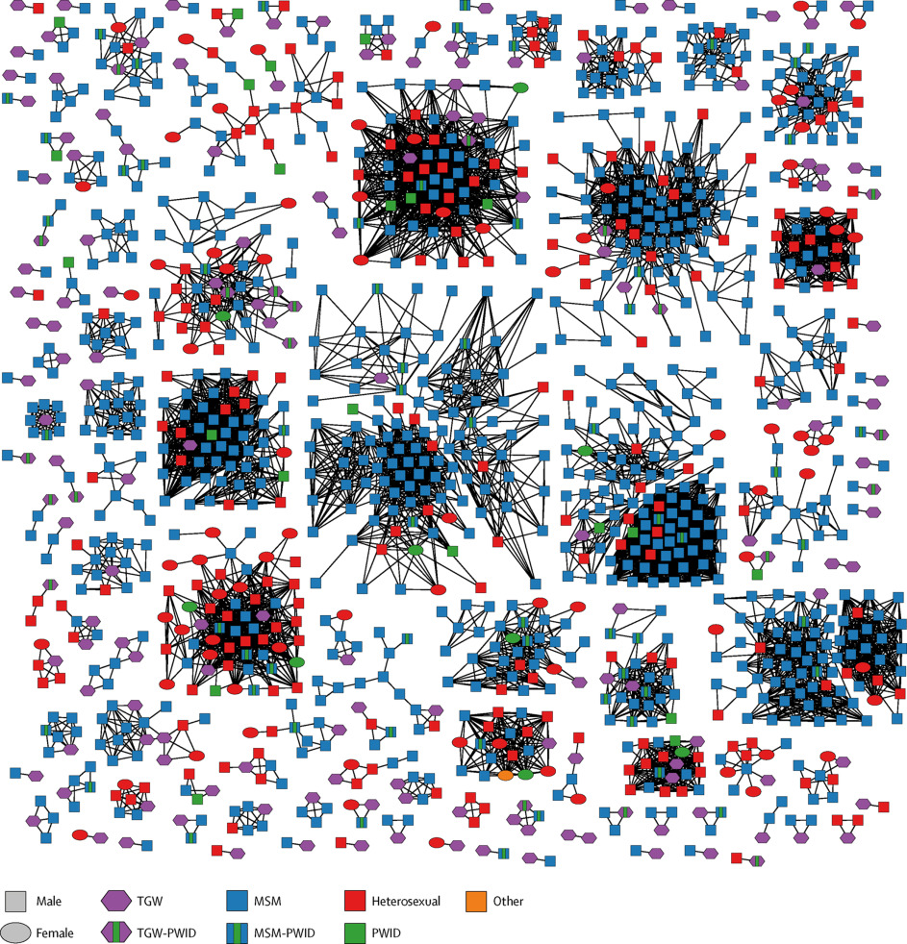

Slide 23
Directionality
Direction of transmission cannot be determined definitively from phylogenetics because there is always the possibility of an intermediary, unknown partner
It can be used to rule out someone if virus is not related in two people
In highly controlled settings directionality can and has been proved
There is a push by some to work to advance the science of directionality
Understanding of directionality science is limited

Slide 24
Push back from people living with HIV
1. Lack of informed consent from PLHIV;
2. Lack of consultation or meaningful engagement with PLHIV in development and implementation of MHS;
3. Wide variation in state-level data sharing environments and legal protections for MHS data;
4. Risk of potential data misuse in civil, immigration, and/or criminal proceedings;
5. Concerns about breaches of privacy and confidentiality; and
6. Lack of consistent standards for competency in the HIV disease investigation intervention workforce to attend to sensitivities around stigma, culture, and violence

Slide 25
‘Politics of the Uncounted’: Data (in)visibility
BUT data and the digitalization of global health data can also produce ‘data invisibility’
‘Politics of the uncounted’ – Sara ‘Meg’ Davis
Focuses on those who are NOT counted: counting is also a political act!
Those who gets counted counts – those who are not counted can be left behind and not show up in global health data

Slide 26
Visibility and vulnerability in data I
Key populations vulnerable to HIV (men who have sex with men, people who inject drugs, sex workers and transgender people) are often hidden due to stigma and criminalization
However, the absence of this data creates a paradox in which invisibility reinforces invisibility.
Key population size estimates are a central tool for planning and resourcing national and global HIV programming, but these become hard to obtain when key populations are hidden and political leaders deny their existence – for instance men who have sex with men and transgender populations are in many countries not counted or their populations estimates under-estimated in an effort to deny their excistence

Slide 27
Visibility and vulnerability in data II
Cases where sexworkers have been harassed and blackmailed by law enforcement due to data ‘visibility’ and privacy breaches
Same with men who have sex with men in Ghana
Some groups: visibility is a dual edged sword: they need health care but are vulnerable to privacy and criminalization issues

Slide 28
Notes from a multi-national participatory action research project
Vietnam, Ghana, Kenya, Colombia and Bangladesh
"how young adults, ages 18–30, experience the digital transformation in health, with a focus on sexual and reproductive health, HIV and COVID-19"
FGDs with 181 young adults across the three countries as well as interviewing 33 key informants across the three countries – these came from UNAIDS; WHO; national government agencies and private sector IT
Focusing on digital health technologies and focus on digital human rights as we called it

Slide 29
Main digital health technologies the young adults used: What do you think they used the most?
Google for information seeking – symptoms, etc.?
Apps for tracking health (menstruation, medication adherence, finding nearest SRHR clinic, etc.)?
Social media: Facebook groups; Whatsapp; Signal; Telegram?
Telemedicine and eHealth consultations?
COVID tracking apps?

Slide 30
What barriers do you think the young adults experienced as the most problematic?
Cost of data?
Access to own smartphone?
Services which were not experienced as relevant to them?
Discrimination through various digital platforms?

Slide 31
What do you think were their biggest fears and concerns with digital health technology?
Privacy?
Data protection?
Surveillance?
Quality and validity of the information online?
Lack of meaningful engagement from state and private companies?
Fear of rights infringements and human rights violations

