Slide 1
IN5230 - Mandatory Task 1

Slide 2

Simulation Tool
LTspice
  http://www.linear.com/designtools/softwareRegistration.jsp
  Download for either MAC or Windows.

Slide 3
Report
Submitting Individually
Complete schematics including forces and simulation mode as well as simulation results
White background on schematics and simulation results
Using legends
Avoiding yellow color on curves
Making a conclusion
  summary table
In English
PDF format
Attaching Schematics/symbols as LTspice format

Slide 4

Deadline for delivery
September 18th @ 08:00
Image is borrowed from Internet!

Slide 5
The exercise at a glance
Get familiar with the simulator
Frequency characteristics of some curves
Decoupling capacitors
Parasitic capacitive coupling
Artificial sources of transient analysis

Slide 6
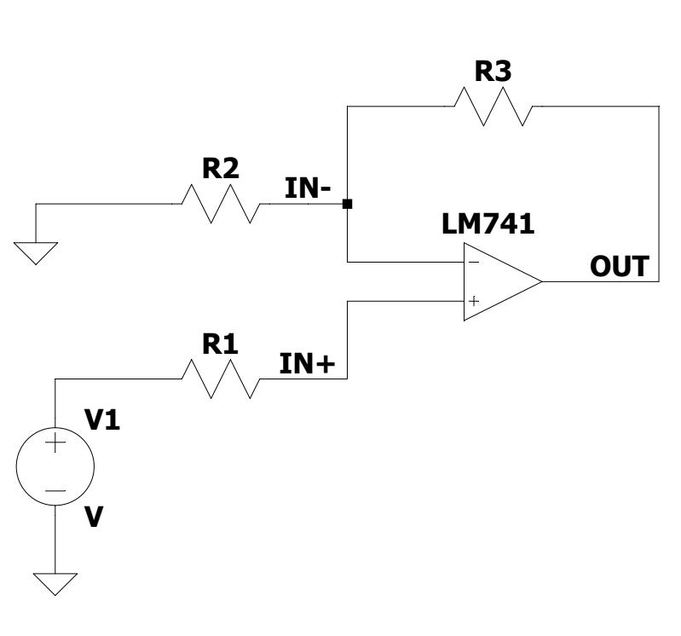
Task 1: Get familiar with the simulator
Op-amp LM741
  LTC\LTspiceIV\examples\Educational
a) Transient Analysis (.tran)
  Calculating the gain in theory
  Applying a DC offset for the negative input
and calculating the gain
  Finding DC offset interval where the output does not clip (.step)
b) AC Analysis (.ac)
  Finding DC gain and GBW
  Phase margin

Slide 7
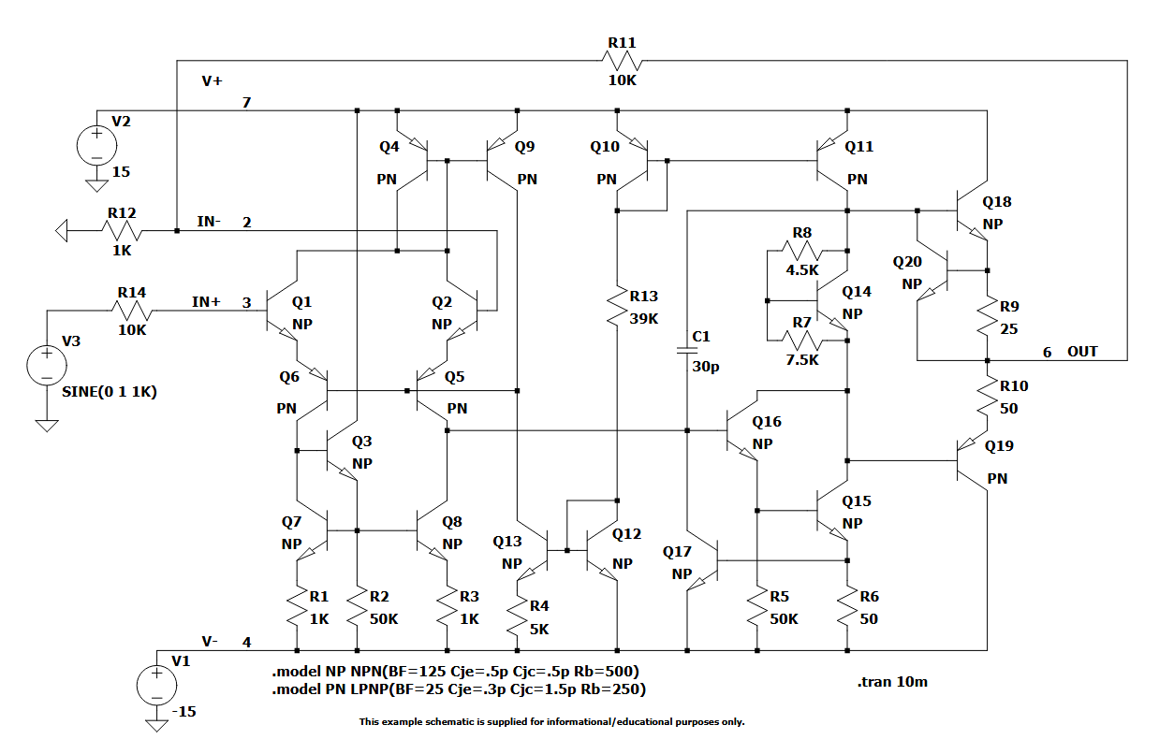
LM741
R11 = R3
R14 = R1
R12 = R2

Slide 8
Task 1: Get familiar with the simulator
c) Common mode DC offset
d) Effect of the load capacitor on the DC gain and GBW

Slide 9
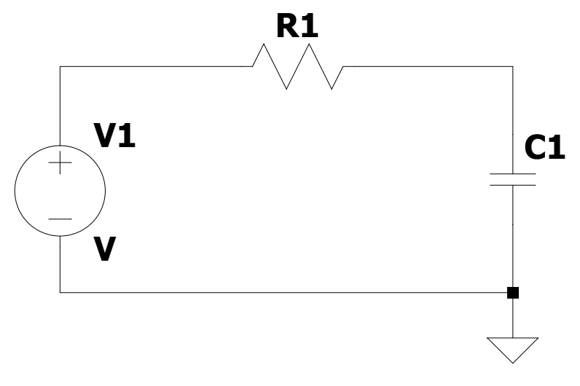
Task 2: Frequency characteristics of some curves
Define the R1 and C1 value to have a very high cut-off frequency
a) Effect of the time step in .tran simulation on the FFT values
b) FFT for different square pulse inputs with different rise time (freq. = 1KHz)
c) Redesign the filter so that the cut-off frequency is the 5 times over the fundamental frequency (1KHz), How is the FFT output?
A
B

Slide 10
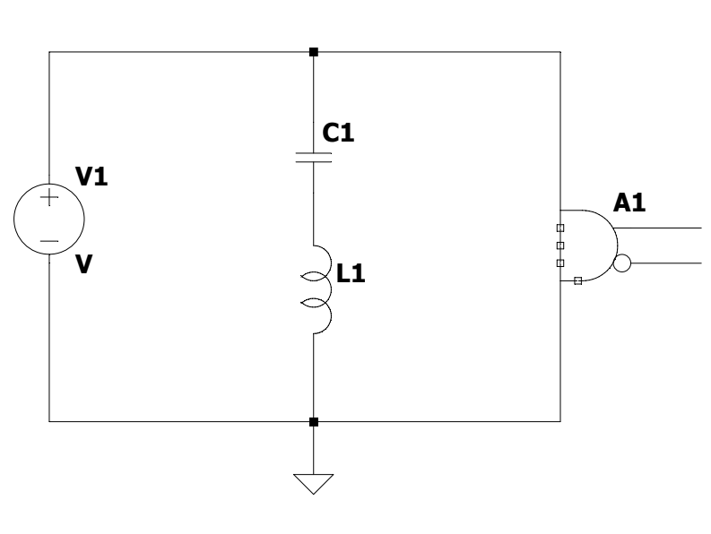
Task 3: Decoupling capacitors
Find the size and number of capacitors required to reduce the supply voltage noise to an acceptable level
Study the slide 48 to 57 of the first lecture
i

Slide 11
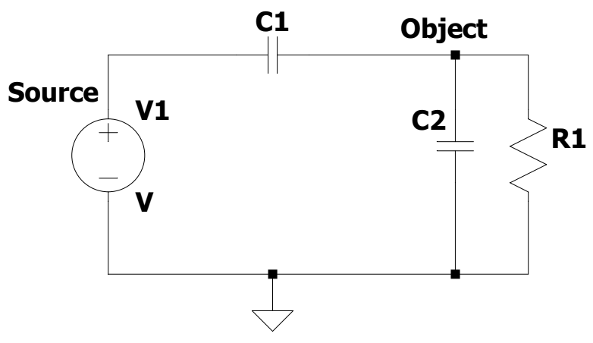
Imp.: Task 4 : Parasitic capacitive coupling
a) Coupling the signal from a noise source to an object due to the parasitic cap.
b) How does shielding reduce the coupling?
Source
Object
C1
{
Shield
Load
Notes:
Find the transfer function from source to object

Slide 12
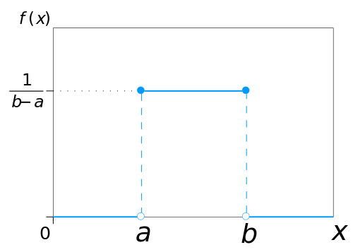
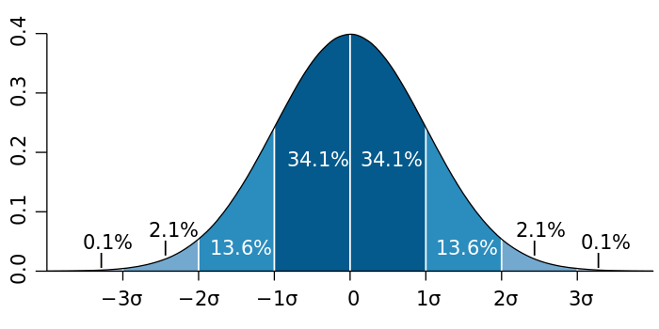
Task 5: Artificial sources of transient analysis
Generating different noise source “bv”:
  RAND, RANDOM: Uniform within [0, 1)
  WHITE: Semi gaussian distribution within (-0.5, 0.5)
  PWL signal
Uniform
Gaussian
*Datafile and example schematic are available on the web-site

Slide 13
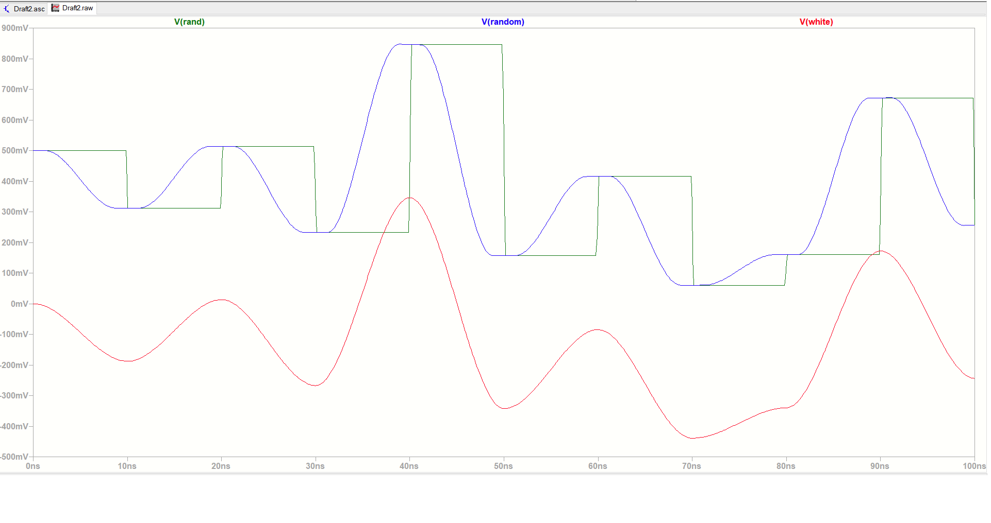
Random Noise Source

