Slide 1
IN5210
Seminar 6 – Autumn 2021
Digital Business Strategy and Digital Innovation

Slide 2
Presenting platform design

Slide 3
Key challenges with the platform design
Questions and discussion from the other groups:

Slide 4
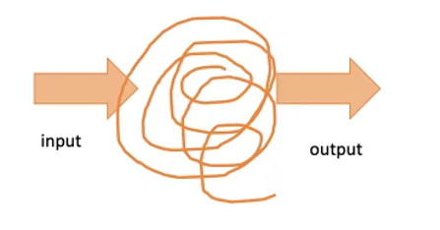
Key challenges with data use and AI
AI = Artificial Intelligence > what does it mean?
Accountability
Transparancy
Explainability
The black-box problem
Surveillance capitalism
Informate
From Miria Grisot's lecture

Slide 5
Good or bad? Right or Ethical?
Some questions from Baserville et al. (2020), combining different theorecal fields:
  Institutional logics shaped by the digital (f.ex. China's social point system):
    Appropriate / Not Appropriate?
    Acceptable / Not Acceptable?
Why do we need an increased focus on digital platforms and digital platform ecosystems (interconnection)?
Emergence of the digital world (f.ex. self-driving cars (data-driven), airplanes, the trolley problem):
  Improvement / Danger to human safety?
  Right / ethical?
  Value creation / efficiency?
Notes:
Accountability
Transparancy
Explainability

Slide 6

Years and Years- This is your fault

Slide 7
Group assignment: Challenges and opportunities
Presentation next week
Does the existence of the type of platforms you have exemplified pose any challenges?
  For the power relations between actors in the ecosystem?
  For the individual and/or industry?
  On society?
  Accountability
    Data, algorithms
Can theory help you see unintended consequences of the digitalization?
Might want to watch:
  The Age of Surveillance Capitalism – a live conversation with Shoshana Zuboff
  Netflix's series "Black Mirror"
Might want to read:
  Heat listed
5 – 7 minutes
Submit pdf by email
Notes:
Work platforms

