Slide 1
Institutional theory
- case
IN5210 Information systems
Johan Ivar Sæbø

Slide 2
Part 2
Example of (in-house) use of institutional theory in information systems research

Slide 3
Interplay of Institutional logics and implications for deinstitutionalization: Case study of HMIS implementation in Tajikistan
Health Information Systems Programme (HISP) at UiO (6th floor): have certain values, belief systems, something we take for granted, shaped by the institutions we are part of
Tajikistan Ministry of Health had different values and belief systems, concerning the same things!
How come? What were the implications?

Slide 4
What is HISP; short recap
Network of researchers, practictioners, developers, working on Health Information Systems
University of Oslo, colleagues across the world
Develops the open source DHIS2 platform, engaged in implementing it in many countries and for many organizations

Slide 5
What is DHIS2; short story
www.dhis2.org
Open source software/platform, primarly designed to support decisions in the health sector
Developed over two decades, it has become generic to cater the many different needs around the world

Slide 6
What do HISP try to do with DHIS2; short story
Help (primarily) Ministries of Health to better monitor, evaluate, and plan health interventions
In addition to DHIS2, we have certain ideas of how this should be done, and work with users to implement it in a way that we see as beneficial to
  Decentralized evidence-based decision-making
  Sustainability in terms of dealing with change and limited resources

Slide 7
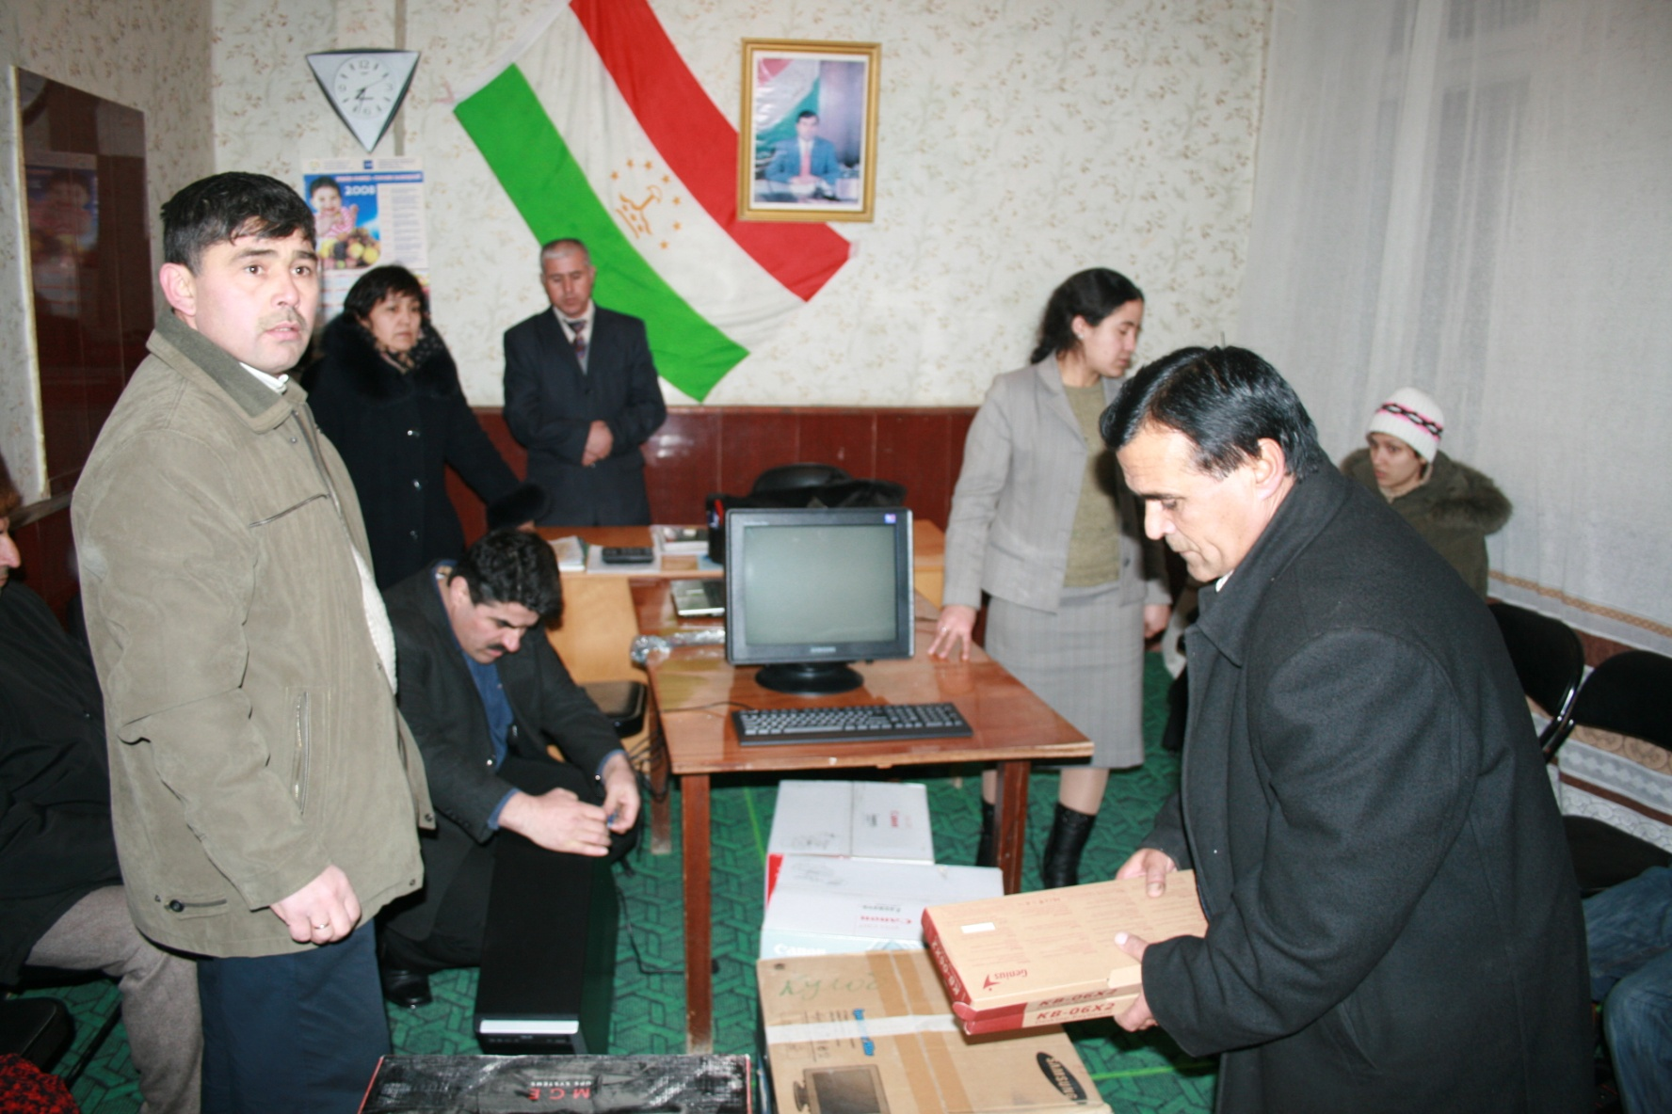
The Tajikistan story

Slide 8
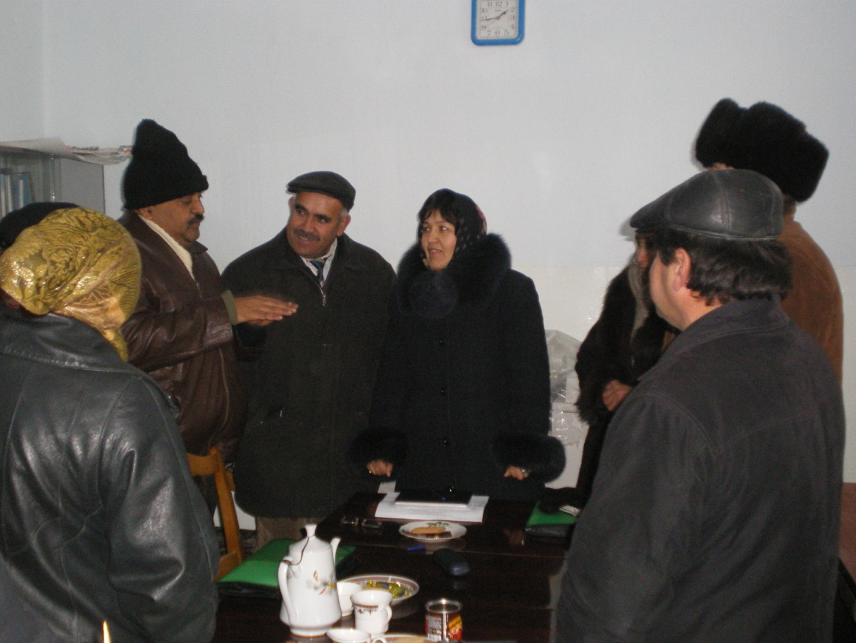
The project
HISP team from UiO responsible for a donor-led project to design, develop, and pilot a new HMIS, using DHIS2

Slide 9
Project a partial failure. Why?
What are the key institutions that challenge the introduction of ICT-based HMIS reforms in the context of a post-Soviet economy?
What theoretical concepts inspired by institutional theory could help us to understand deeply the nature of these challenges, and how these may be addressed?

Slide 10
Choose an institutional perspective
While institutions are the result of human activity, they are not necessarily the products of conscious design (DiMaggio and Powell)
Institutions are resistant to change and tend to be transmitted across generations (Scott)
Ceremonial role of ”ICT for development” (Noir and Walsham)
Institutional logics as ”the socially constructed, historical patterns of material practices, values, beliefs, and rules by which individuals produce and reproduce their material subsistence, organize time and space, and provide meaning to their social reality” (Thornton and Ocasio)
They work at different levels, and multiple logics may be simultaneously at play, contributing to institutional contradictions (Friedland and Alford)
Institutional entrepreneurs are agents of change (Thornton and Ocasio)
Three key factors contribute to deinstitutionalization: political, functional, and social (Oliver)

Slide 11
Existing logics at play
Two dominant logics had implications for what we tried to do:
  Central planning logic
  Logic of technology (paper-oriented)
These ”logics” are the products of our analysis, an example of IS researchers using institutional concepts perhaps with too shallow an understanding. But, they had analytic value for us.

Slide 12
Central planning (set of) logic(s)
A strong Soviet legacy: Central planning meant systems had been designed to feed the top level with data, who would scientifically examine it and make appropriate action
Curative rather than preventive approach to health. Preventive health need decision to be made closer to the problem, to stop them from emerging in the first place
Gigantomania: collecting data on all kinds of events and factors were seen as scientific rigour
However, while this may have made (more) sense in the Soviet era, the top level specialists were not there any longer, and the resources locally to collect this data was also not present. Data quality was poor.

Slide 13

Technology logic of paper
Soviet-style 5 year planning cycle.
Can not make changes between the 5 years
Also huge cost of making changes if everything is on paper
Double entry as data quality measure

Slide 14
Why was this bad? Conflicting logics
We came with different ideas, or institutional logics
Decentralized decision-making (as opposed to central planning)
HMIS is indicator and action-led (as opposed to gigantomania of data collection)
Computer systems should be employed to internalize routine aggregation, increase flexibility, and decrease response time to changes in epidemiological information needs

Slide 15
Two sets of conflicting logics
Statistics for central planning and control versus using information for decentralized action
Rigidity of paper-based reporting formats versus the flexibility of customizable electronic forms

Slide 16
Central planning vs. decentralized action
The Asian Development Bank gave us some legitimacy, but the ministry prevailed
We instead implemented their requirements in the hope of highlighting the shortcomings of such a solution
Led to development of new functionality in DHIS2, which made it easier to accommodate the requirements of Tajikistan
We believed this could make a stronger case for change in the future (which I think it did, eventually)

Slide 17
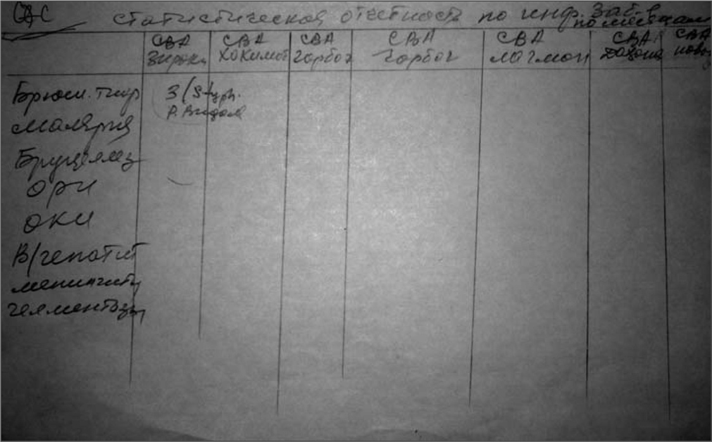
Rigidity of paper-based vs flexibility of electronic forms
Not able to utilize any of the flexibility in the technology. Forms, design, logic remained the same
However, we found at lower levels some alternative logics that were more in line with our thinking

Slide 18
Interplay of logics and implications for deinstitutionalization
A degree of social pressure had been placed on MoH to reform their HMIS through efforts of World Bank and ADB. However, the recommendations were not binding for the ministry, and we failed to create adequate momentum for change at the political level
The interplay of logics primarily occured on the functional domain. While we failed to create any change, we influenced the discourse and left a technology with flexibility for future change
There were some domestic seeds for change

Slide 19
Conclusions
The study attempted to use institutional theory, especially the concept of institutional logics, to analyse the failure of IS change
While maybe not completely faithful to the complexities of institutional theory, it was a useful exercise that shed light on the ”why” of this failure.
By using concepts from institutional theory, we came to better understand the dynamics of IS implementation

