Slide 1
Writing your own thesis proposal – part 2
Silvia Masiero
silvima@ifi.uio.no
IN4340 – Engaged Qualitative Research Methods
15.11.2023

Slide 2
Overview
Thesis structure: one way to build it
Analysing data in engaged research
Writing your proposal: tips and suggestions!

Slide 3
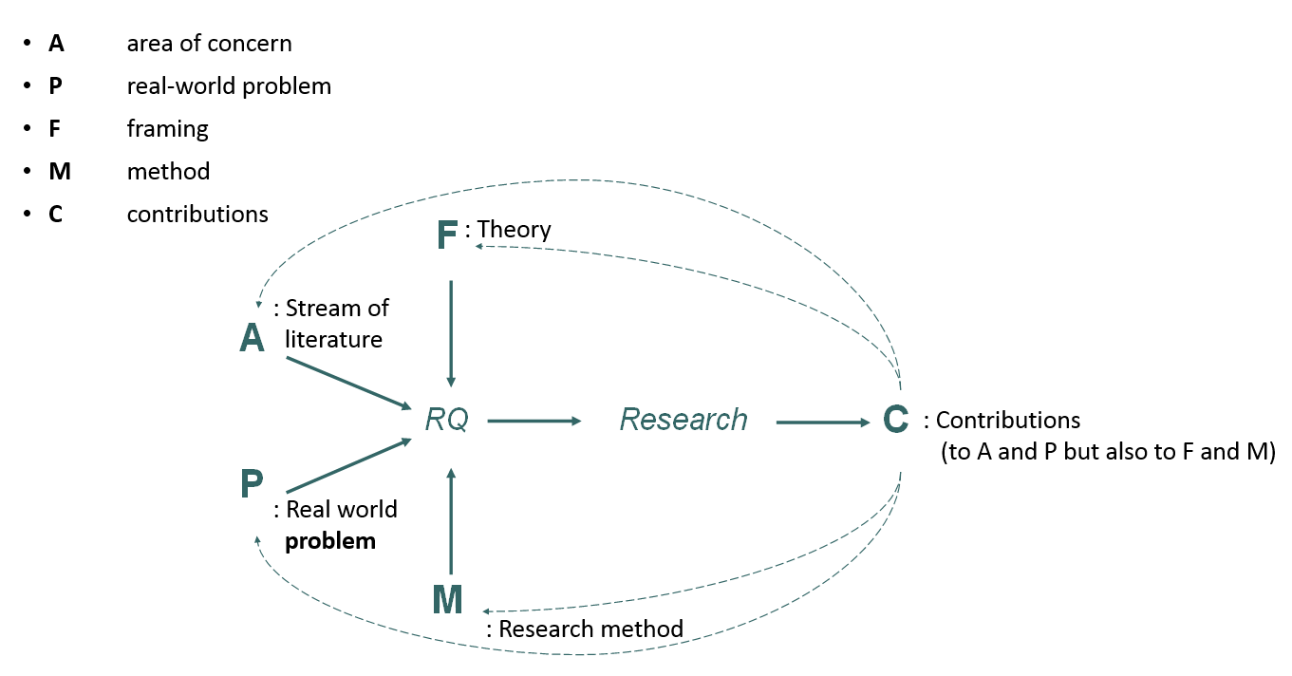
Research Design (Mathiassen, 2017)

Slide 4
From last week…

Slide 5
Thesis structure
1 Introduction
This is where the work is showcased. The introduction offers a synthesis of the thesis, why it is important, and the contribution.
2 Literature Review
This section shows “what has been written” on the topic. It identifies the literature you are contributing to, and the gap you are filling.
3 Theoretical Framework
This section contains the theoretical assumptions that frame your work. You use these assumptions to structure your research question and contribution.
4 Methodology
In this section you state how you answered the research question, i.e. the methodology. A methodology needs to be harmonised to the question asked, so to frame the response to it.

Slide 6
Thesis structure
5 Empirical Data
  Description – of the empirics you have studied, and its context
  Findings – the main results of your research, in response to the question
6 Discussion
In this section, you position the work within existing literature. Here you go back to section 2, the literature review, and state where your contribution is.
7 Conclusion
A brief summary of the work, and some pointers for further research.

Slide 7
Introduction
An introduction offers a synoptic perspective on the thesis. It identifies the core problem of the work, the literature to which it contributes, as well as its research questions, methodology, findings and contributions.
After having read the introduction, the reader should have a very firm sense of what you have researched, the essence and novelty of your findings, and the contribution you made to your literature of choice.
For this reason, a clear introduction is an essential ingredient for a solid thesis!

Slide 8
Literature Review
This section identifies the domain of literature that your thesis contributes to. Having reviewed the main debates on the topic, it leads to your research questions by illuminating one, or more, debates that still remain open.
The same research problem – e.g.: healthcare staff’ perception of a new app; challenges in the adoption of a new disease tracking protocol; use of health MIS in a developing country… - can be made to contribute to different literatures!
As you approach your review of the literature, you will need to identify the area of literature (Mathiassen’s A) you wish to contribute to.

Slide 9
Theoretical Framework
Theoretical perspective: the philosophical stance informing the methodology and providing context for the process and grounding its logic and criteria (Crotty, 1998)
In a MSc thesis, a theoretical framework provides an illuminating lens that supports you in structuring your research questions, devising a methodology to address them, and interpreting your results
In the case of grounded theory approaches, rather than a pre-fixed framework, the researcher discovers theory directly from the data.

Slide 10
Methodology
Methodology: the plan of action, process or design lying behind the choice and use of particular methods (Crotty, 1998)
A methodology section describes the route you have taken to answer your research question, and is harmonised with the epistemological assumptions made at the origin of the research.
Your methodology comprises of the set of methods that you will have used to collect the data and, in a second stage, to analyse them in response to the research question.

Slide 11
Empirical Data
A section normally divided in two parts: a descriptive one, making sense of the empirical domain of your research, and an analytical one, in which the question is answered.
Contextual richness is highly desirable: the reader wishes to learn about the context of your research, and how that has informed your findings!
In the analytical question, you will apply your theoretical framework to analyse the findings from your research. If using grounded theory, this is where your coding structure will be positioned.

Slide 12
Discussion
Arguably the most important part of the thesis!
In the discussion, your findings are placed within the literature which you have reviewed earlier in the thesis. As a result, the discussion is where your findings are made to contribute to your literature of choice.
The importance of the discussion stems from the fact that this is where your independent work, conducted across two years, is put in conversation with the existing literature.

Slide 13
Conclusion
Normally a short section, clear and concise
The conclusion restates the research problem that you faced, the methodology with which you faced it, and the contribution you have made through the original findings of your research.
It is also an opportunity to state pointers for further research, which your MSc research study has opened for the future.

Slide 14
Data analysis!
The data analysis section is a crucial one in your thesis. In this section, you will be answering your research question through the data you collected on the field, analysed through the theoretical framework you chose.
A first distinction is operated between deductive methods, where a framework is used to read and interpret your data, and inductive methods, where theory is generated directly from the data, in a grounded theory fashion.

Slide 15
Data analysis!
How to analyse data collected on the field?
Deductive methods: theory provides the framework for data analysis Examples: institutional theory (Gundersen et al., 2020) to identify institutions relevant to contact tracing in Norway; actor-network theory (Walsham & Sahay, 1999) to identify actor networks in the implementation of GIS in India
Inductive methods: theory is generated directly from the field data Examples: grounded theory (Urquhart, 2012) generated from the data collected on the field, using coding to arrive at theoretical categories.

Slide 16
Data analysis – 1: From Theory to Data
If you proceed deductively, you will apply an existing framework to the data you collected, using such a framework to develop a response to the research question you have originally asked.
An example (1): Institutional Theory (Masiero & Prakash, 2020)
RQ: how to make sense of the ongoing shift of Karnataka’s Public Distribution System (PDS) towards biometric technologies?
Having collected data from ration shops across the state, we used an institutional lens that entailed two processes:
Deinstitutionalisation of the existing subsidy-based welfare scheme;
Institutionalisation of a new system, biometrically enabled, based on cash transfers to recipients of the PDS.

Slide 17
Data analysis – 1: From Theory to Data
An example (2): Actor-Network Theory (ANT) (Walsham & Sahay, 1999)
Analysis of a major GIS initiative from an Indian government ministry
ANT: involves the phases of creation, maintenance and extension of a network, where actors are conceptualised as both human and non-human
RQ: how GIS technology became part of resource administration in the state, and how was its architecture maintained over time?
Analysis: distinguishes the phases of creation, maintenance and extension of the network, conceptualising the importance of human actors (GIS implementers, politicians, policymakers…) and non-human actors (computers, technologies, resources into place at the ministry)

Slide 18
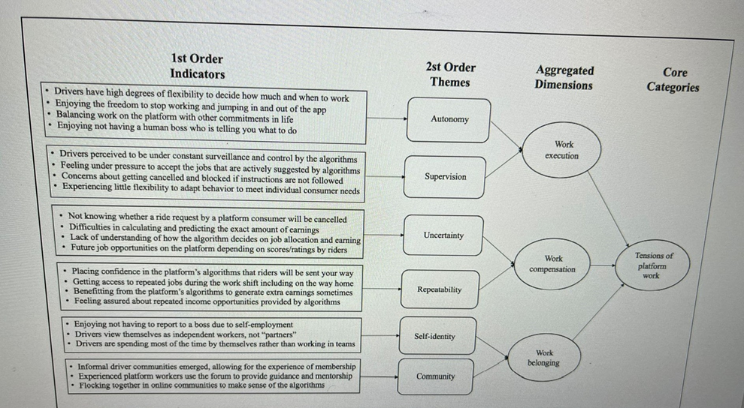
Data analysis – 2: From Data to Theory
Data structure: how Uber drivers respond to algorithmic control (Mohlmann et al., 2021)

Slide 19
Data analysis – 2: From Data to Theory
An example (3): Mohlmann et al. (2021)
RQ: how do Uber drivers respond to algorithmic surveillance?
Analysis: grounded theory methodology, generating theory directly from the data. This involves generating first-order codes, which group together data with similar characteristic (e.g. thematic), then organising them into theoretical categories.
In this case, Uber drivers are found to respond to surveillant work management adopting techniques of work execution, work compensation and work belonging, all of which emerge from data collected on the field.
Data collection is hence followed by the thematic organisation of data, from which the paper’s theoretical contribution is generated.

Slide 20
But remember…
Behind the codes… (Uber driver interviews, Mohlmann et al., 2021)
“She [the passenger] starts fighting with me: “why are you not dropping me first?” I said, “Miss, if you have a problem, just order UberX. It’s UberPOOL; it’s all about the Uber system, so I am just driving how they’re telling me to drive.”
“Now we are partners? You take 40% of the fare, we give our sweat, blood, and expenses, and you call us partners? What kinda partnership is that? You get to wear the pants while I do everything and I’m still stuck with the bills? Partnership? Partners? Employer? Master?”
“Use Uber, don’t get used by them! Don’t take the side of Uber. Uber is not a human who will understand your pain. Uber never listens to drivers or pax and never will in future!”

Slide 21
So…
A theoretical framework, or an inductive approach where theory is generated directly from the data, influence the construction of your research question, as well as the way you analyse data in response to it.
Remember: you may find that data do not fit the theoretical approach you had initially considered!
For this reason, it is common to iterate between data and theory, to find a theoretical approach that helps you make sense of the data collected.

Slide 22
Tips and strategies!

Slide 23
Tips and strategies!
There are many! But…
To start with the most important one: have a plan!
Plans will change over time, but a clear plan built in year one with your supervisor and team will give you a clear sense of the moves to take.
In the run-up to fieldwork: develop a good understanding of the literature on the topic, which is essential to make sure your contribution will be original, focused and in conversation with ongoing debates in research.
This is also the phase where you will likely initiate contact with your field organisation and people. Early contact is crucial for access maintenance, and for your time on the field to be as fruitful as ever.
Ask question, gather sources, maximise learning in this phase!

Slide 24
Tips and strategies!
When closer to writing up…
The mountain-of-data syndrome is likely. That is what happens when faced with a big mass of data just after fieldwork, and finding it difficult to organise them coherently.
This is where theory will help you! It will act as a guiding light to read your data in the light of your research question, and use them to answer it.
Give yourself time: developing an answer to a research question requires iteration between data and theory, and close engagement with the literature to which that answer belongs.
In this process, your group members if any – and your supervisor and peers – will be important “sparring partners” to confront yourself with.

Slide 25
But first of all…
…enjoy your research!

Slide 26
Thank you!
silvima@ifi.uio.no

Slide 27
Readings
Core Reading
Mathiassen, L. (2017). Designing engaged scholarship: From real-world problems to research publications. Engaged Management Review, 1(1), 2.
Supplementary Reading
Van de Ven, A. H. (2007). Engaged scholarship: A guide for organizational and social research. London: Oxford University Press.

