Slide 1
Moore’s Law
Used to be known as: «CPU speeds double every 2 years»

Slide 2
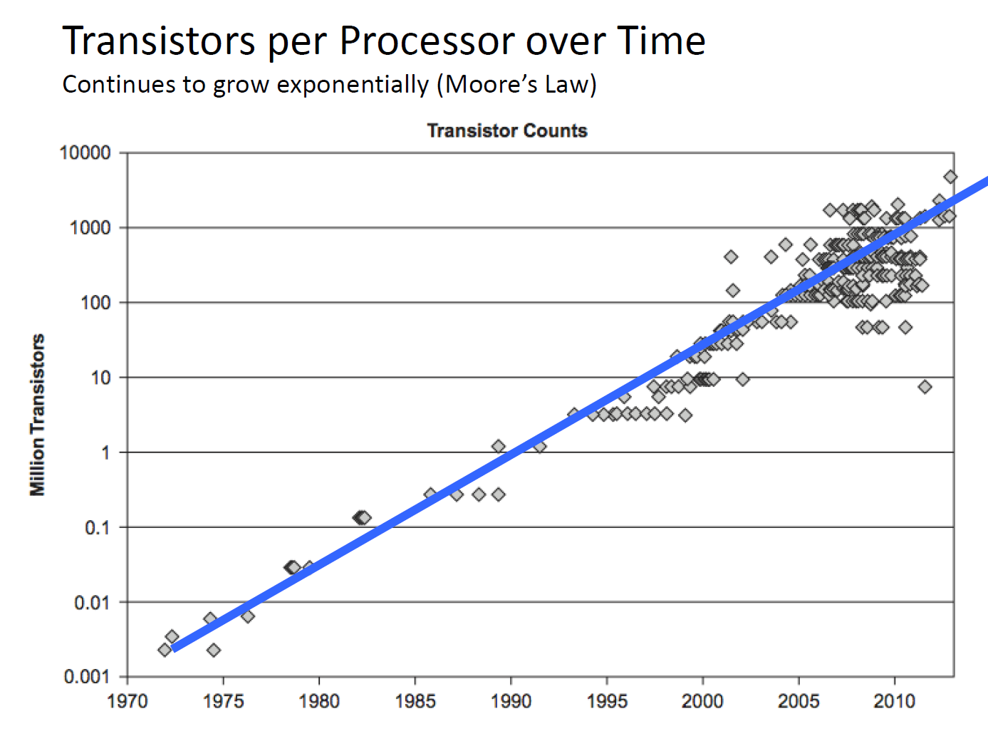

Slide 3
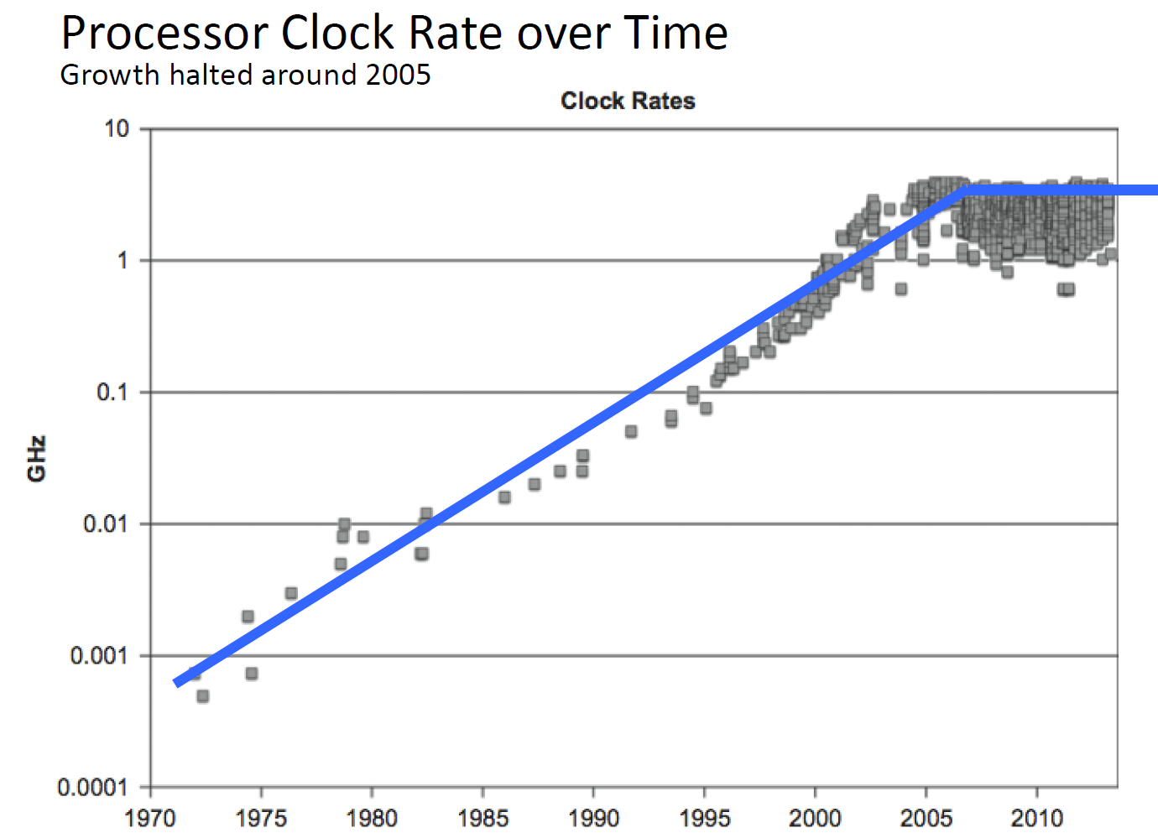

Slide 4
Original Moore’s Law
Transistors per square cm doubles every year
1965 Article: Every year
1975 Article: Every two years

Slide 5
Speed of light
What is the speed of light?
Close to 300,000 km/s
Exact value: 299 792 458 m/s BY DEFINITION

Slide 6
End lecture L3v22

