Slide 1
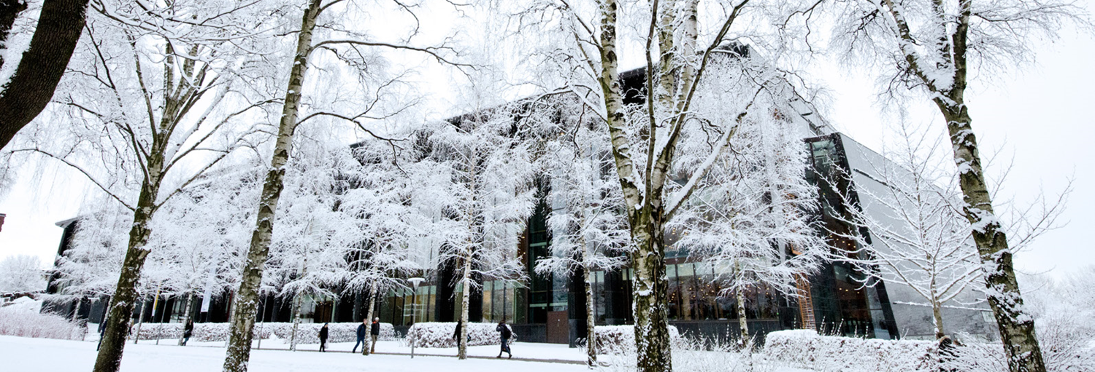
ISS Styremøte
13. desember 2022

Slide 2
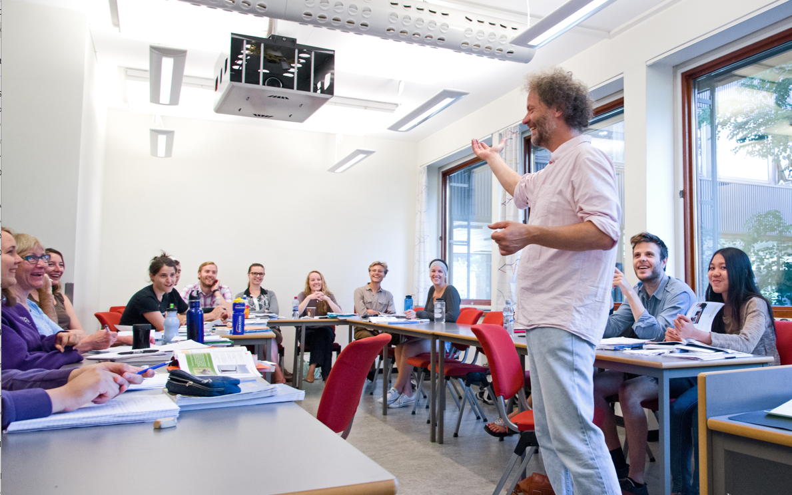
Sak 17/22 Evaluering av NORIR periode september til november 2022.
31 % av studentene svarte på evalueringen.
Totalt antall studenter: 85
Antall svar: 27

Slide 3
Please elaborate why the course met your expectations.
The professor was excellent, especially good in phonetics and pronunciation. That was exactly my biggest lack in Norwegian.
The teacher was professional
Good balance of different activity types (speaking, reading, grammar, interesting facts about language in the historical and cultural context). Not very intensive, yet provides opportunity to grasp essential language features and practice speaking in casual situations.
It gave me much useful knowledge about Norwegian.
Practice speaking in a relaxed setting was key for my further development, and what I had hoped to get out of the course.
The course provided knowledge about the Norwegian language use in everyday life for beginners.

Slide 4
Please elaborate why the course failed to meet your expectations
I wish class contents were structured in a more organized and coherent way
I had hoped for a higher difficulty. As it focuses on the basics of the language the topics could have gone further. Moreover I would have expected more exercises or referrals for self-study.
I thought it would have more usefull information, that would actually help us survive in the first days in Oslo. Not all information was useful, some was revealed only on the last day. But in general I enjoyd the course and it helped me.

Slide 5
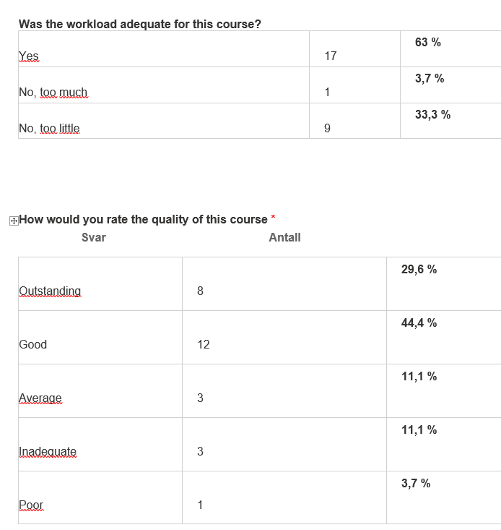

Slide 6
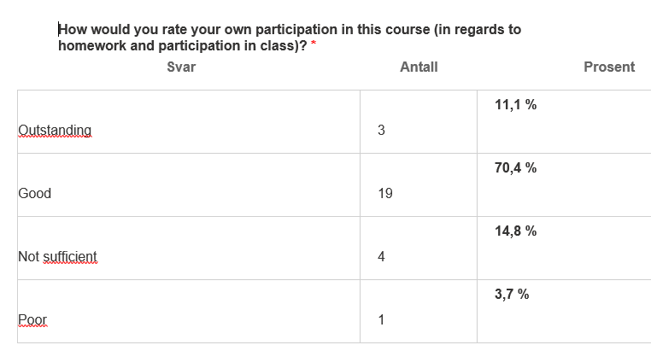

Slide 7
Any other comments?
I was really happy with the content of the course. And as I hoped, the course was perfectly appropriate for international researchers as me who can not afford taking the NORA course because of its intensity. I was great to have classes with much less pressure than it would be in NORA, as I found more confident into trying to speak in Norwegian. Repetitions were great to learn and remember previous lessons, but I would have liked to advance faster with a bit less repetitions.
I love the classes. The teacher is fantastic.
I really appreciate the opportunity to take the course. Some work and travel obligations interfered with my ability to attend every session, but I still found it valuable.

Slide 8
Forslag til vedtak:
Styret tar informasjonen til orientering om det pågående budsjettarbeid for 2023 samt langtidsprognosen.
Begge deler ventes å ferdigstilles 15.12.22. Målsetning om at endelig vedtak vil bli elektronisk styrebehandlet så snart som mulig.

Slide 9
C. Orienteringssaker
  Muntlig orientering om avtalen med Rønningen folkehøgskole
  Muntlig orientering om organisasjonsarbeid i enheten
  ISS stipendfond, Unifors regnskap over fondet for 2021 (vedlegg 5A og 5B)

Slide 10
FORSLAG: ISS STYREMØTER 2023
Mars 16.03.23 kl 14.00.- 15.30
Juni 13.06 kl 14.00 – 15.30
Oktober 03.10 kl 14.00 – 15.30
Desember 14.12 kl 14.00 – 15.30

